Slide 1
Enrollment & Marketing Strategic Plan Working Group
October 21, 2015

Slide 2
Strategic Planning Presentation
Brand Identity
Brand Messaging
Target Audiences
Public Relations
Marketing Channels
Internal Communications
Resources & Structure
Recommendations

Slide 3
University Branding
The Arkansas Tech Brand
What it was
What it is
What it will become

Slide 4
University Branding
The Arkansas Tech Brand
Brand research
Prospective students
Parents
Alumni
Brand strength & attributes for Tech and competitors
2002, 2006, 2009, 2013

Slide 5
University Branding
The Arkansas Tech Brand
What it was 1998-2001
No consistent identity
No strategic direction
No brand standards
No consistent external communication of the brand

Slide 6
University Branding
The Arkansas Tech Brand
What it was in 2002
Values students as individuals
Good value
Limited academic programs
Limited extra-curricula activities
Not known for strong academic focus
Brand is significantly improved with contact

Slide 7
University Branding
The Arkansas Tech Brand
What it was in 2006
Values students as individuals
Good value
Accredited engineering program (parents)
Strong academic focus (students)
Limited extra-curricula activities
The UCA marketing blitz effect

Slide 8
University Branding
The Arkansas Tech Brand
What it was in 2009
Higher unaided awareness
Values students as individuals
Good value
Improved quality
Producing quality graduates (parents)
Preparing students for the workforce
Experiencing significant growth

Slide 9
University Branding
The Arkansas Tech Brand
What it is: (2013 research)
New research methodology
Regional results
River Valley
Fort Smith
NWA
Central Arkansas

Slide 10
University Branding
The Arkansas Tech Brand
What it is
Significant regional differences
Very strong brand in River Valley & Fort Smith
Much work to do in NWA & Central

Slide 11
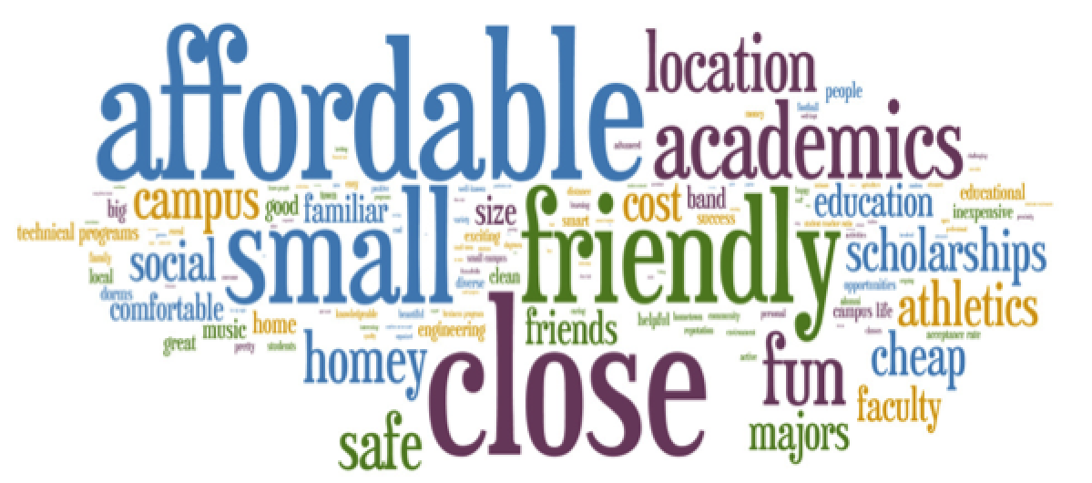
University Branding
The Arkansas Tech Brand
What it is: Students (Positive)

Slide 12
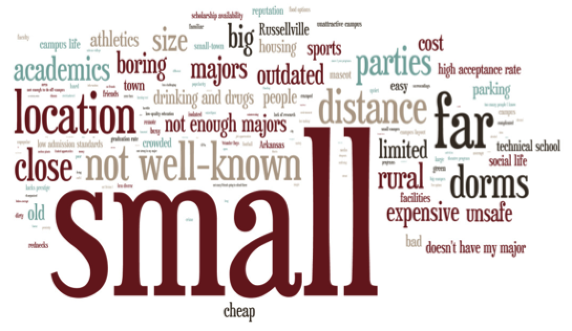
University Branding
The Arkansas Tech Brand
What it is: Students (Negative)

Slide 13
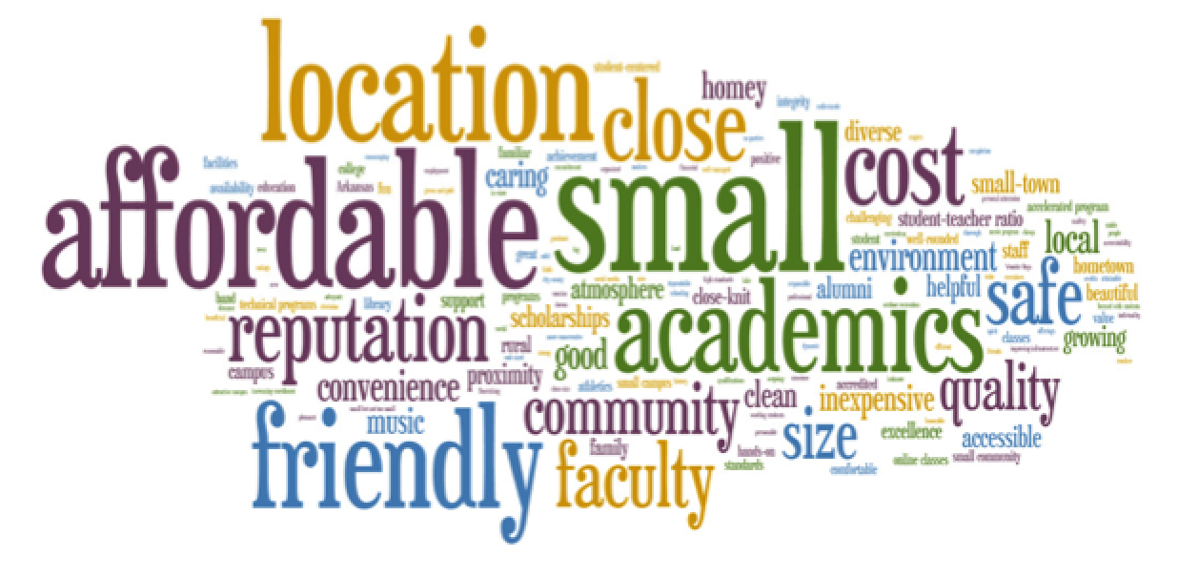
University Branding
The Arkansas Tech Brand
What it is: Parents (Positive)

Slide 14
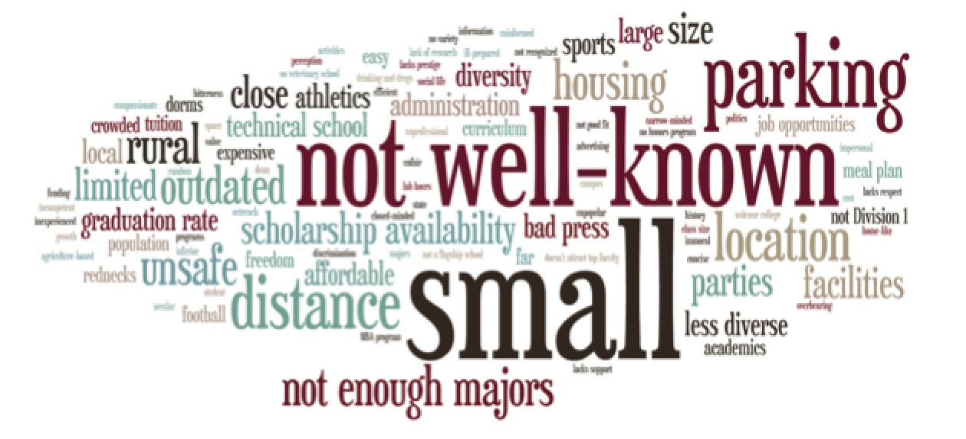
University Branding
The Arkansas Tech Brand
What it is: Parents (Negative)

Slide 15
University Branding
The Arkansas Tech Brand
Updated research in first half of 2016
Hoping for improvements in NWA & Central
Tracking against 2013 study

Slide 16
University Branding
The Arkansas Tech Brand
What will the Tech brand be in 2020?
Third largest university in Arkansas
Quality education
Quality graduates
Vibrant university campus
School of choice

Slide 17
University Branding
Brand Messaging
What are the messages about Arkansas Tech that we communicate with prospective students and their influencers?

Slide 18
University Branding
2001-2004
Growth in facilities
Growth in academic programs
Bigger than you think
Better than you think

Slide 19
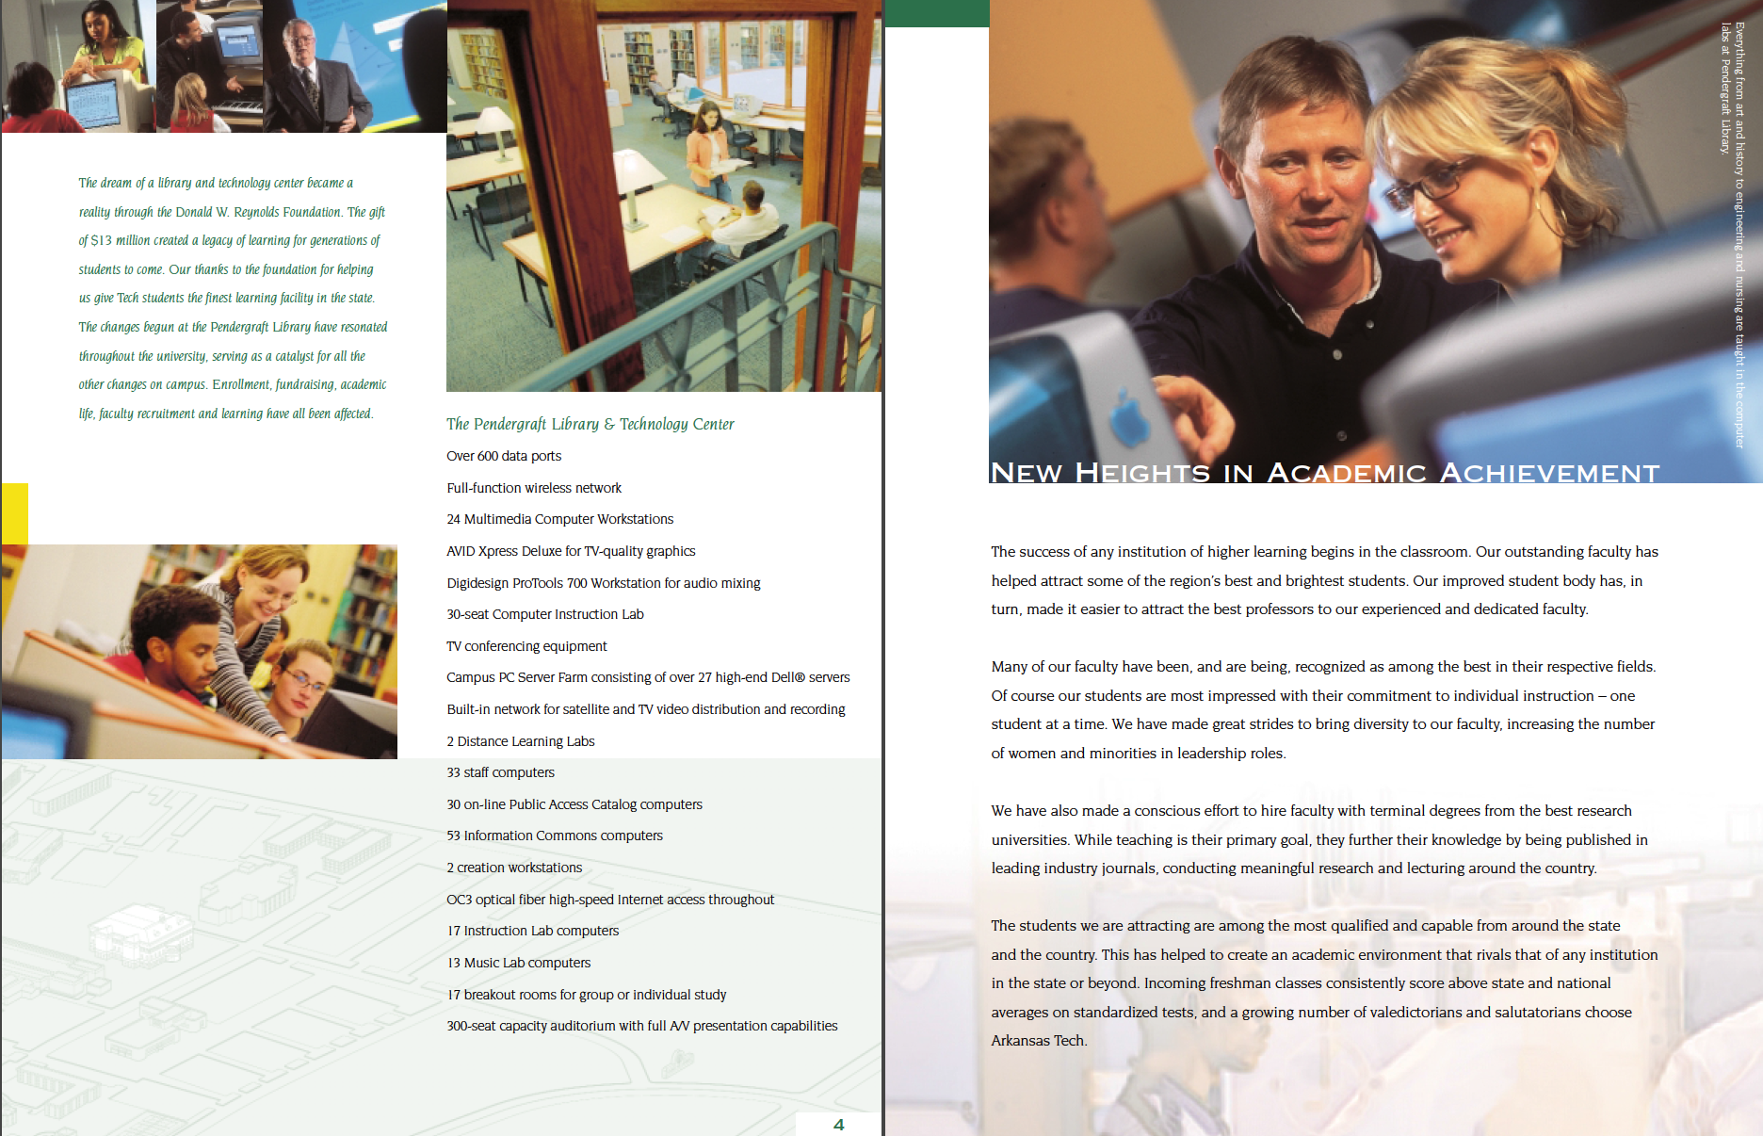
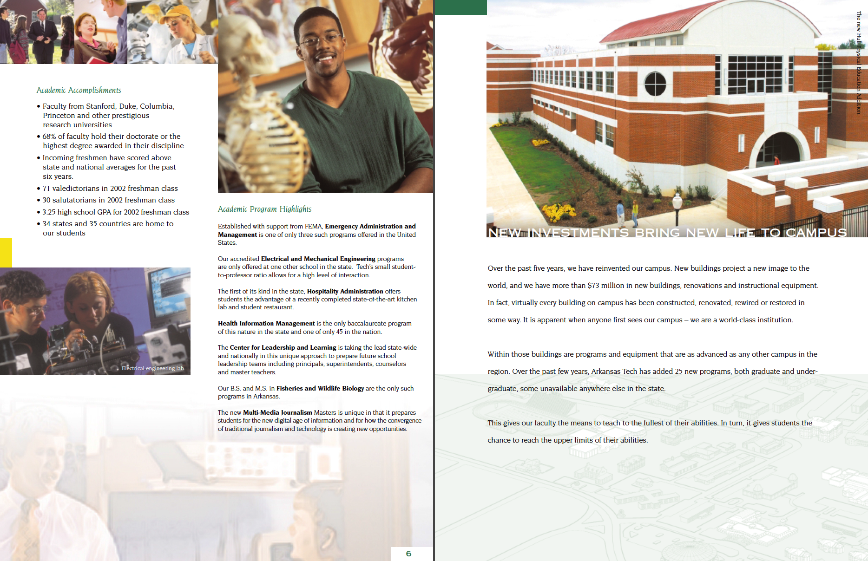
University Branding
Newspaper Insert
Qty: 175,000

Slide 20
University Branding
Academic Brochures

Slide 21
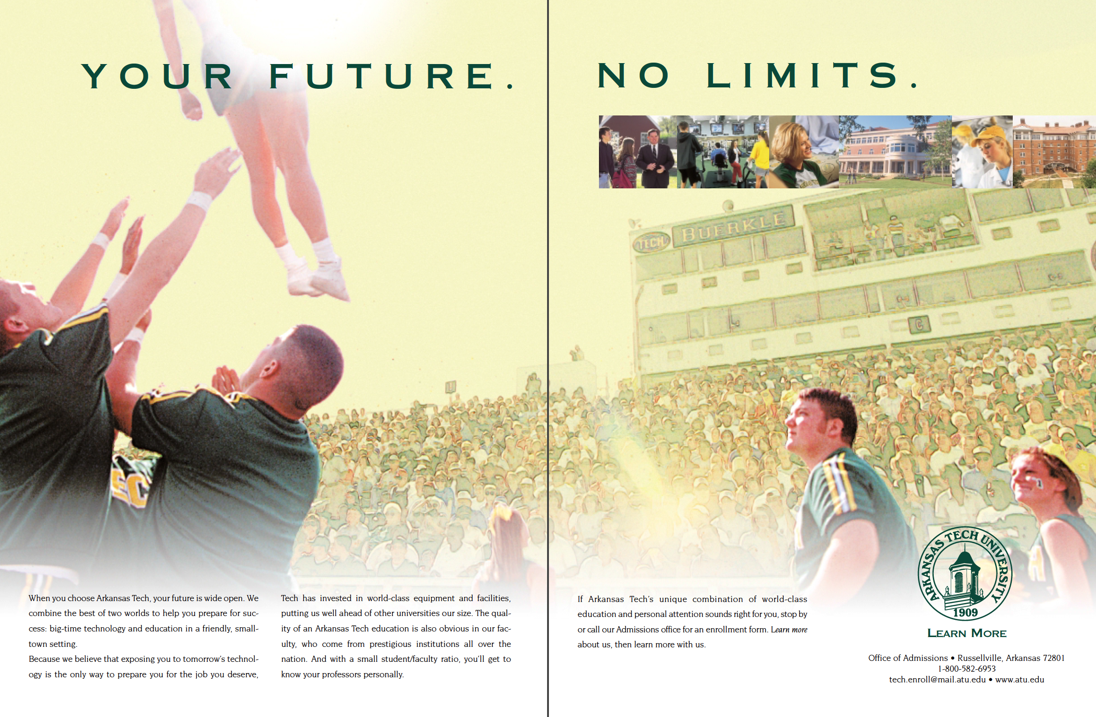
University Branding
Print Ads

Slide 22
University Branding
Website

Slide 23
University Branding
2005-2010
Academic quality
Student stories
“Why I chose Tech”
“I Met Myself”

Slide 24
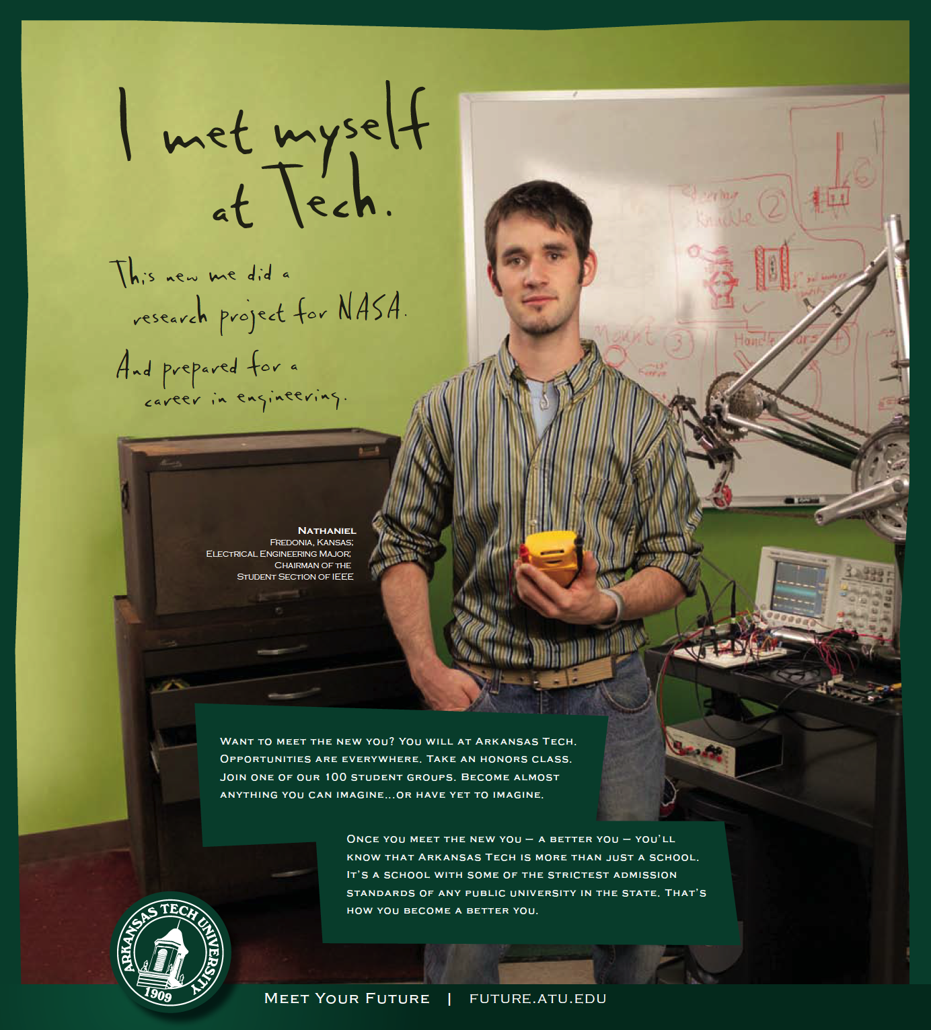
University Branding
Print Ads

Slide 25
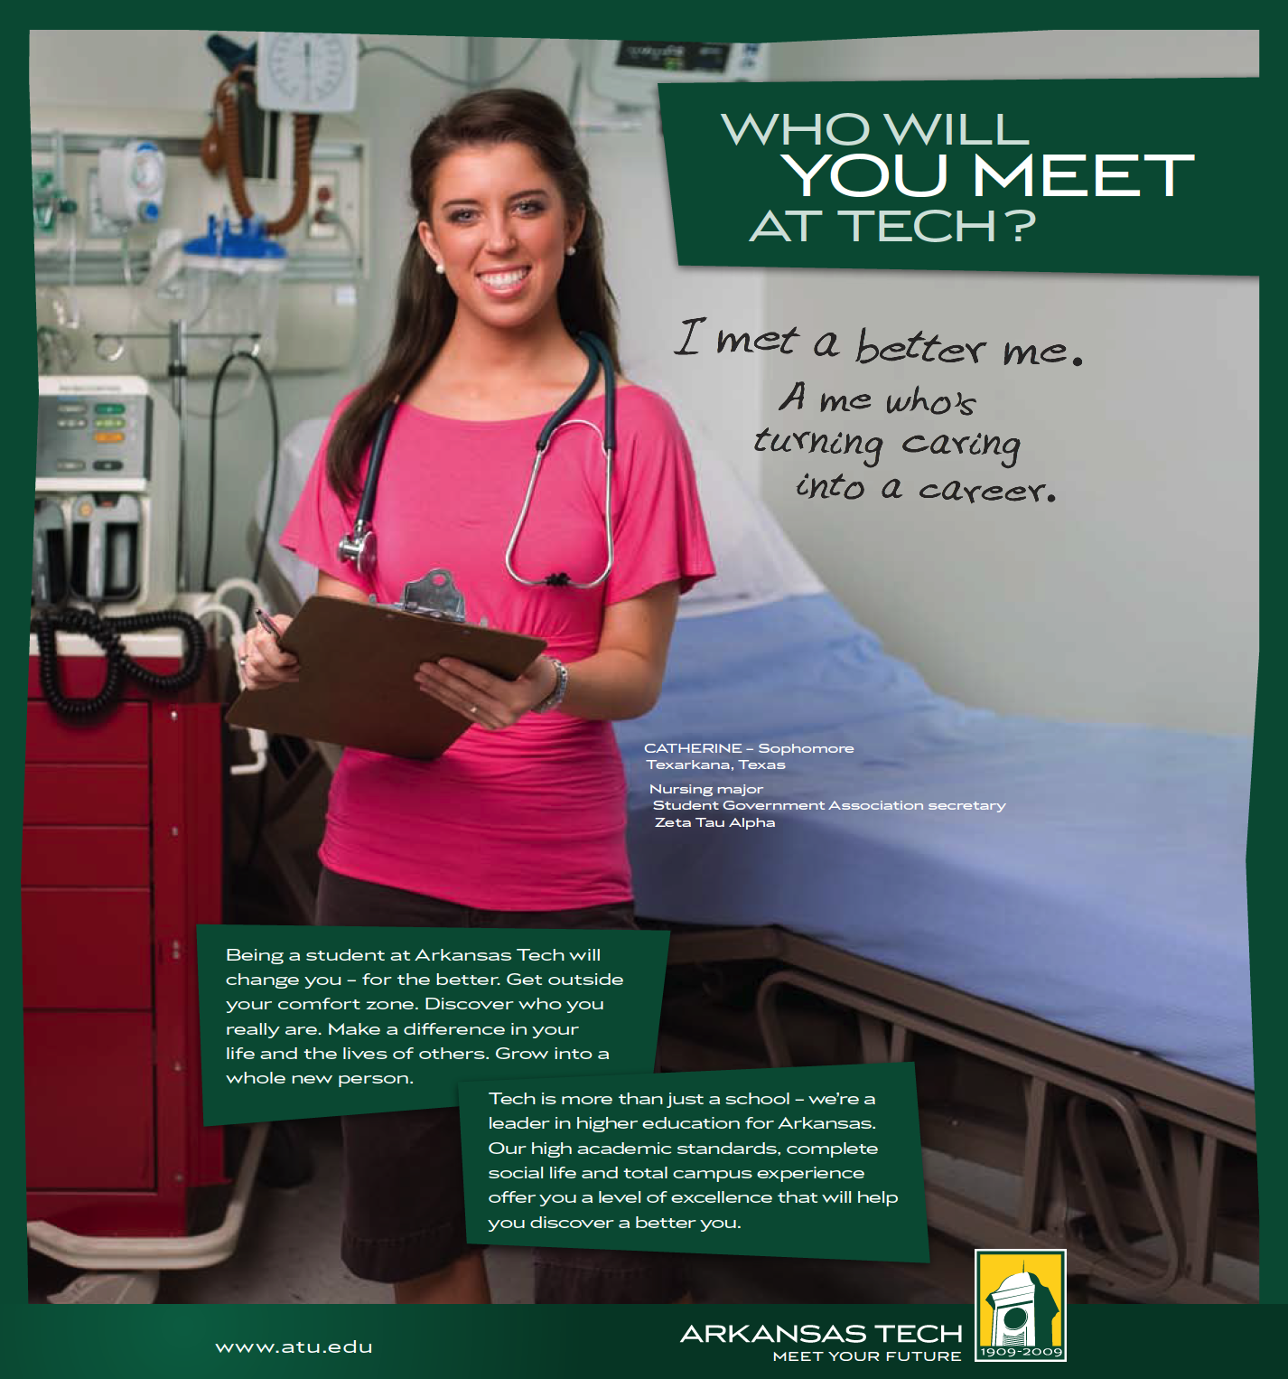
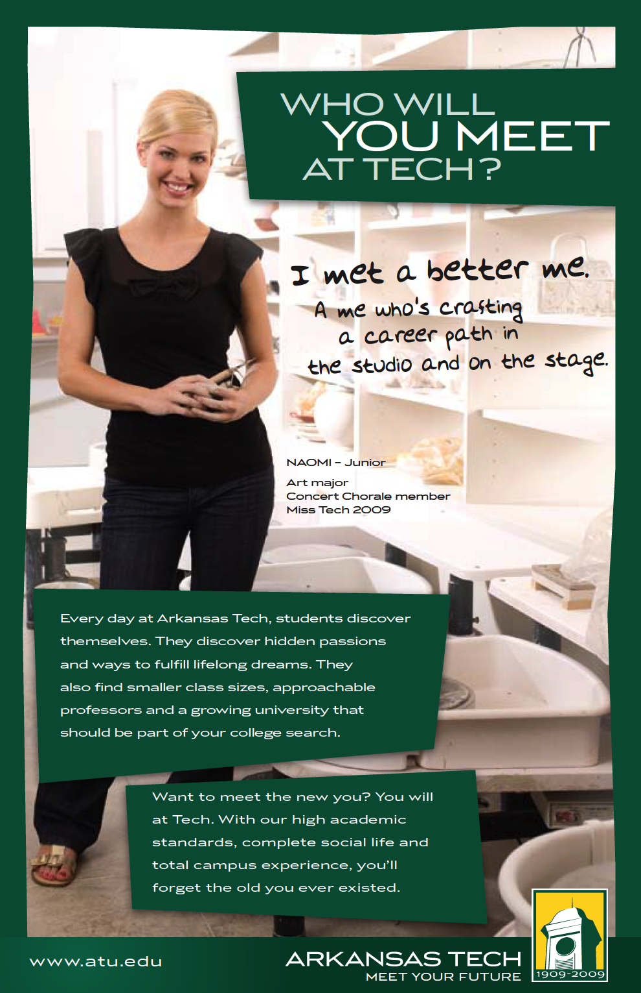
University Branding
Print Ads

Slide 26
University Branding
Outdoor

Slide 27
University Branding
2011-2013
Accelerated Degree Program
Peer-to-Peer
“Choose Tech”

Slide 28
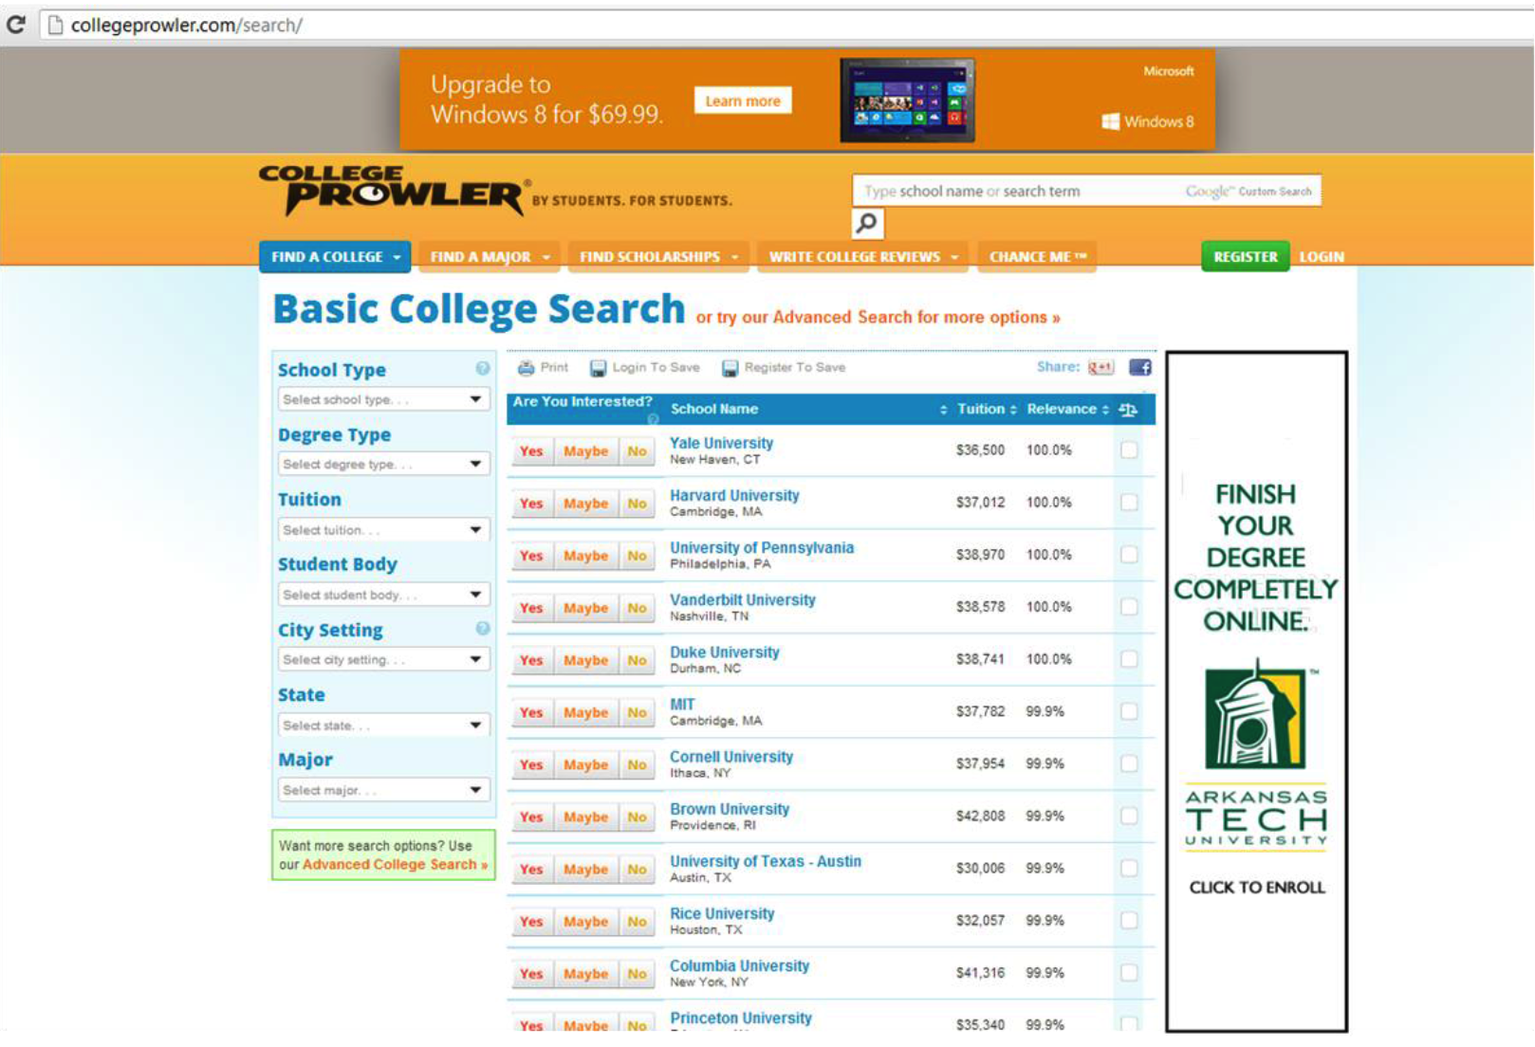
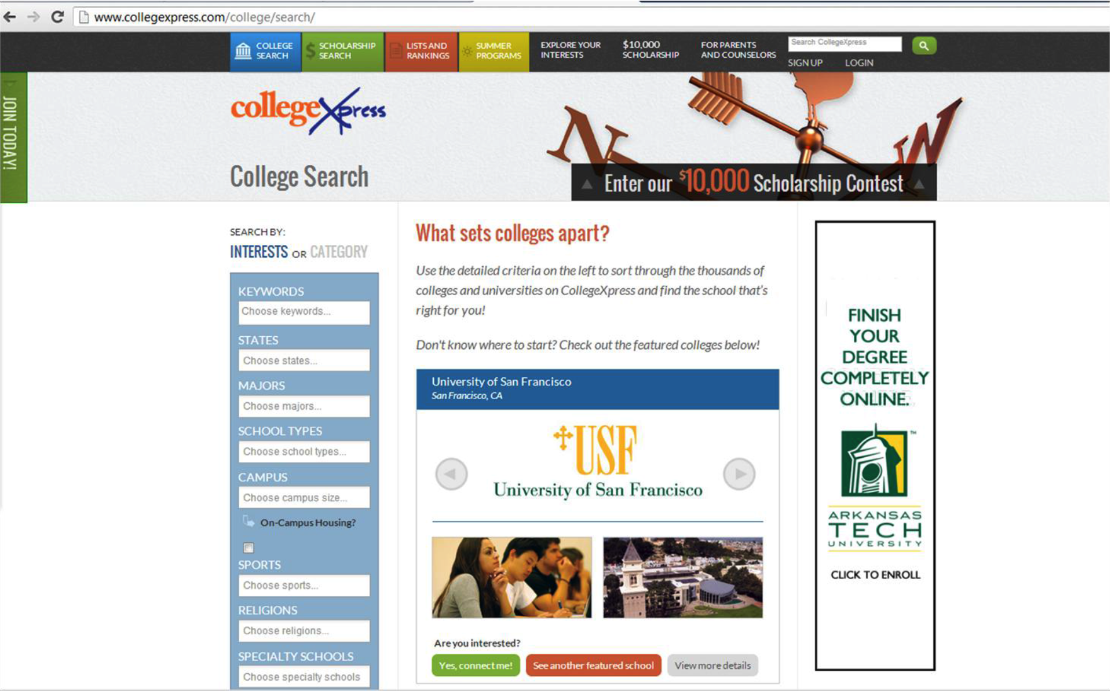
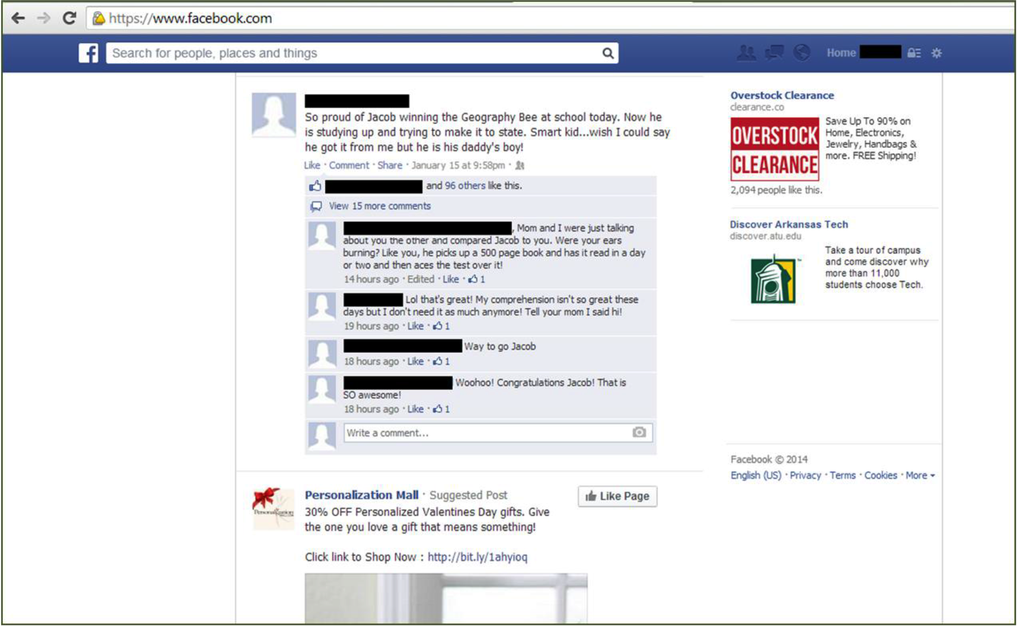
University Branding
Online/Facebook

Slide 29
University Branding
Microsite

Slide 30
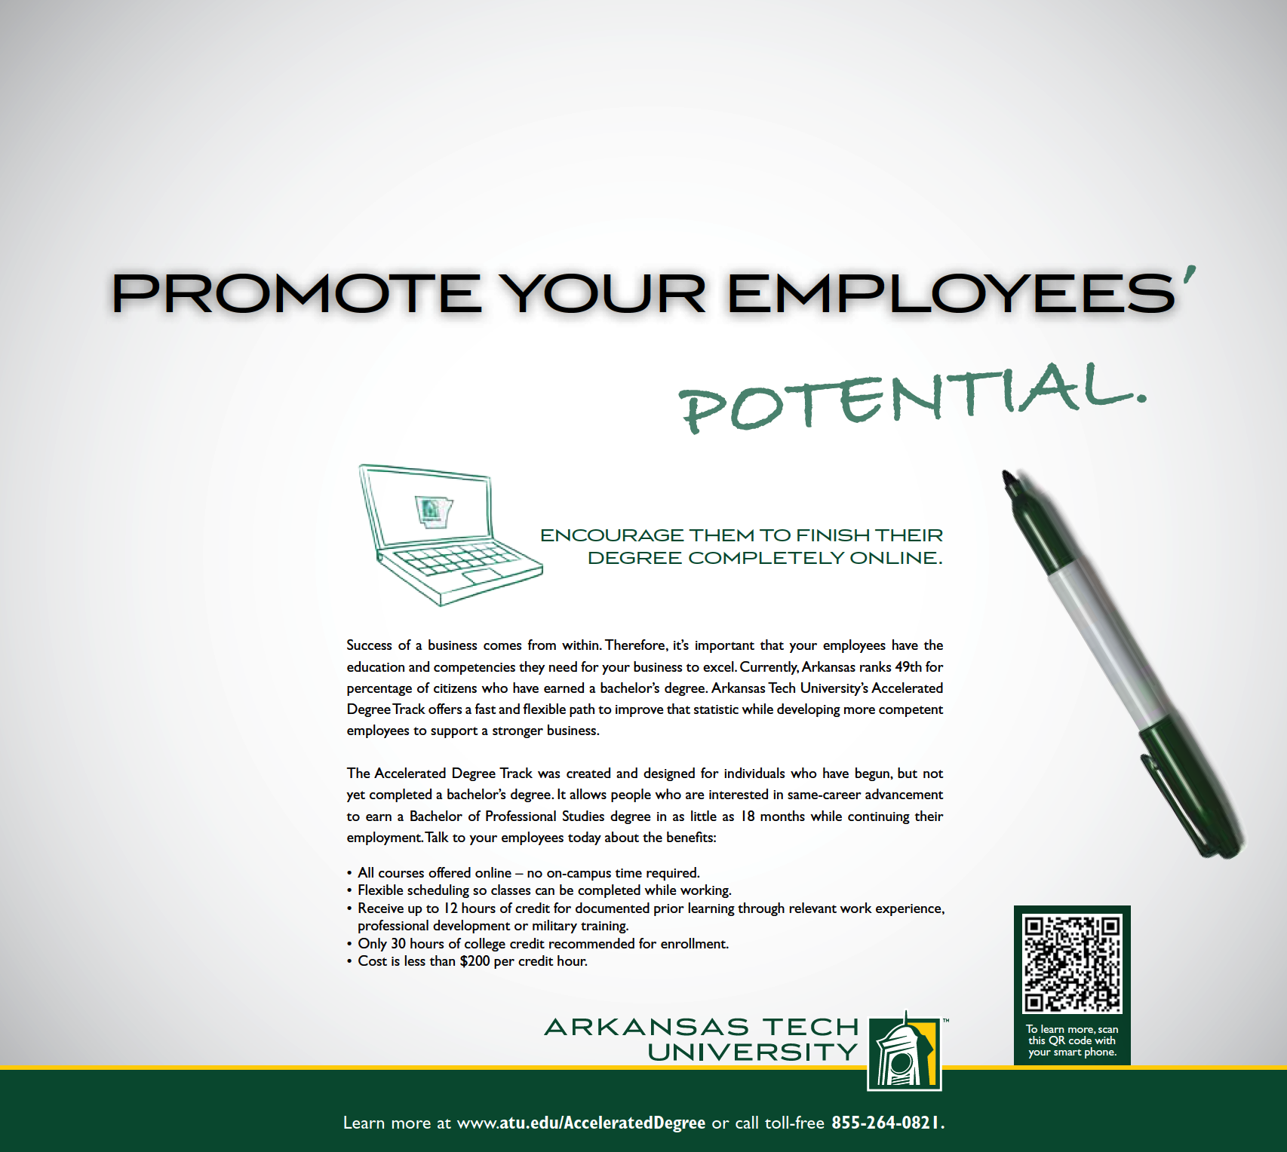
University Branding
Print

Slide 31
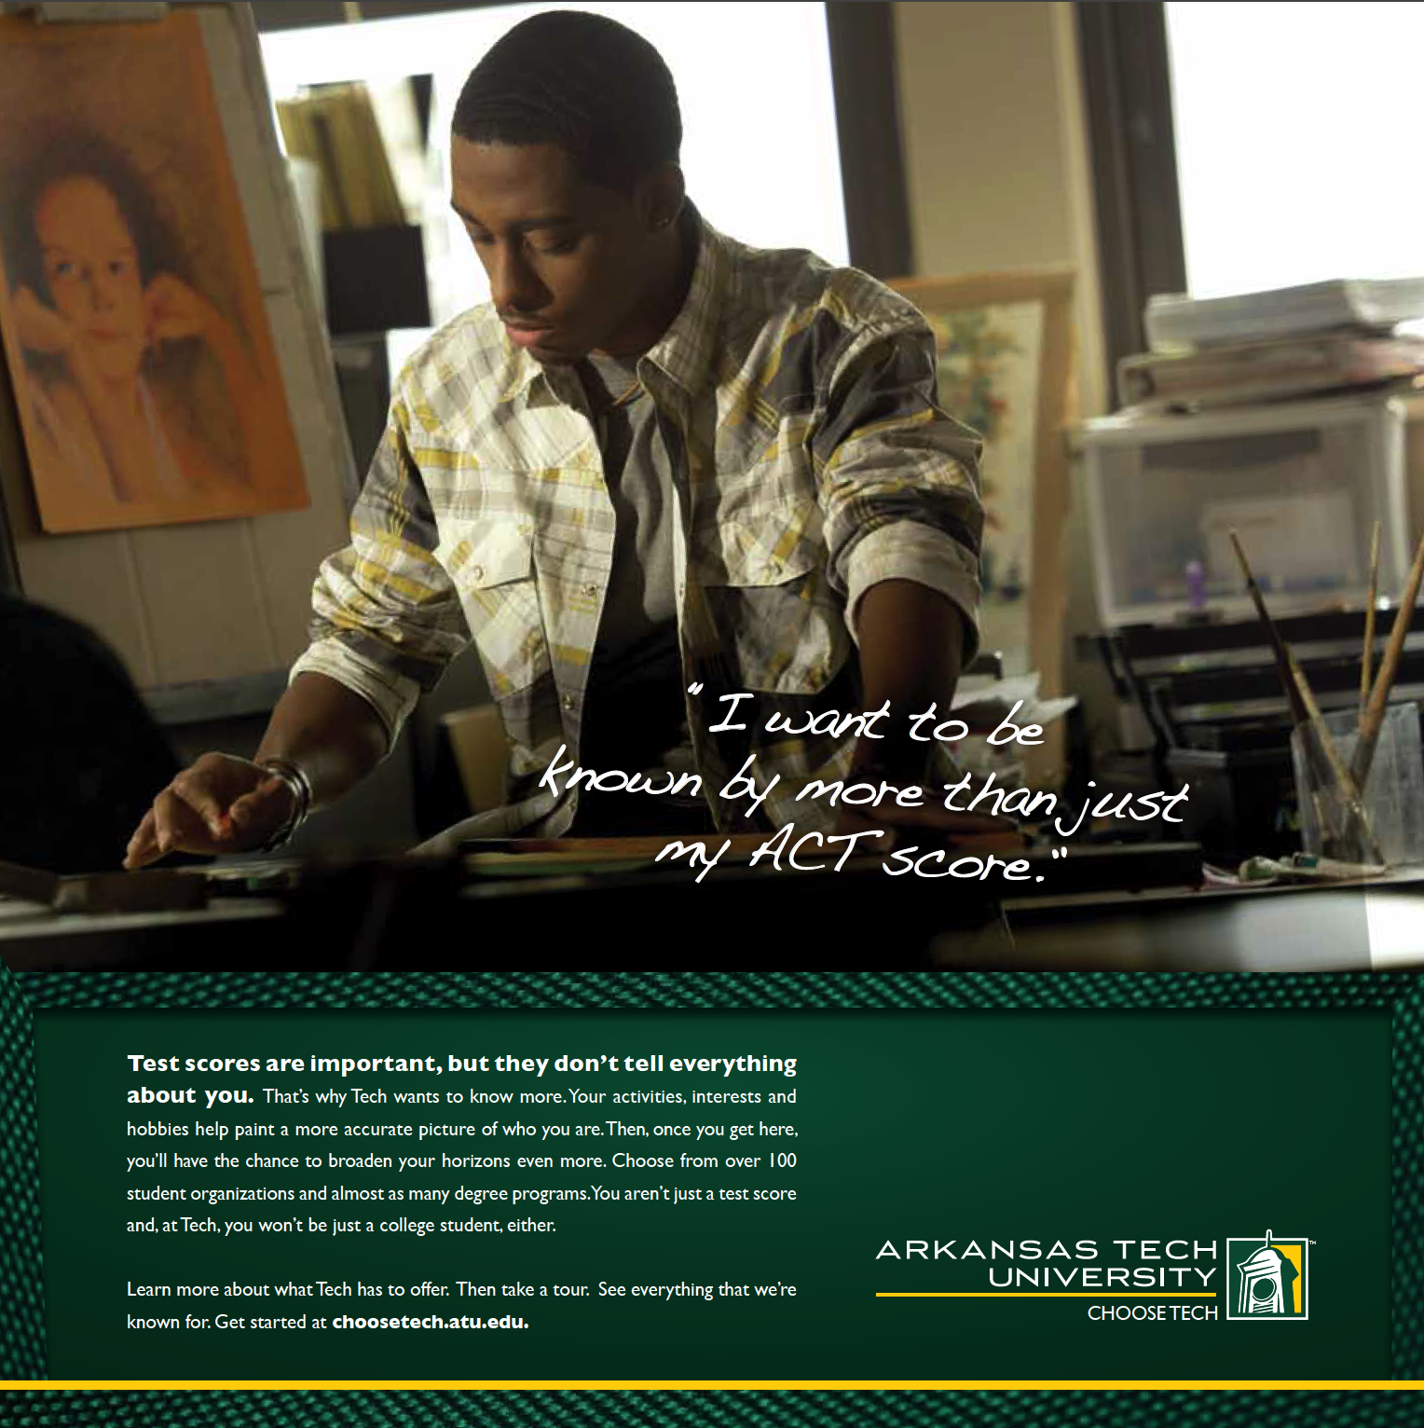
University Branding
Print

Slide 32
University Branding
2013-2015
Discover What You Don’t Know About Tech
Real Students
Growth/Size
Graduation Rates
Value
Diversity
Campus Life

Slide 33
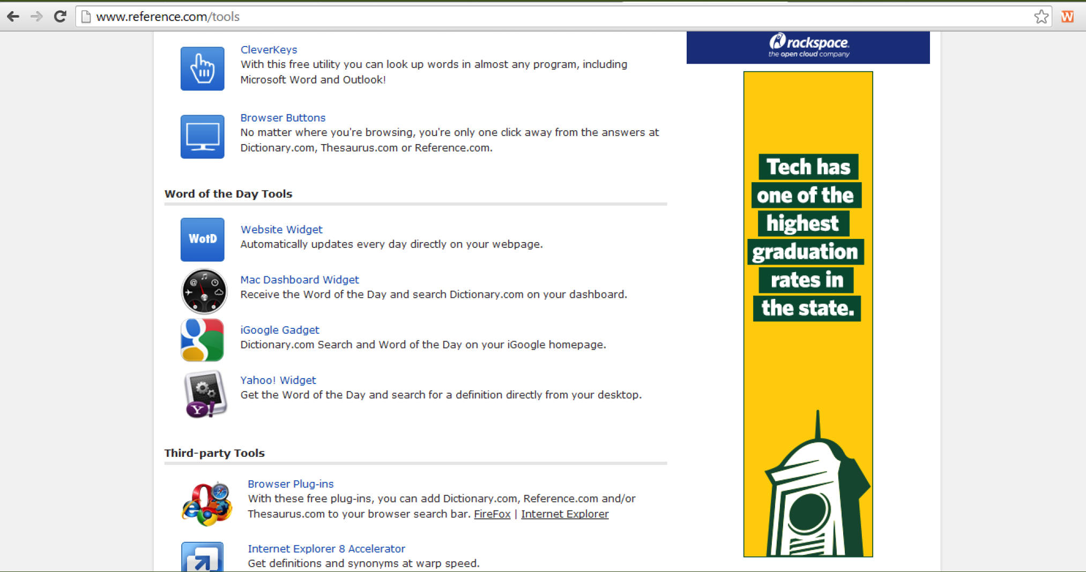
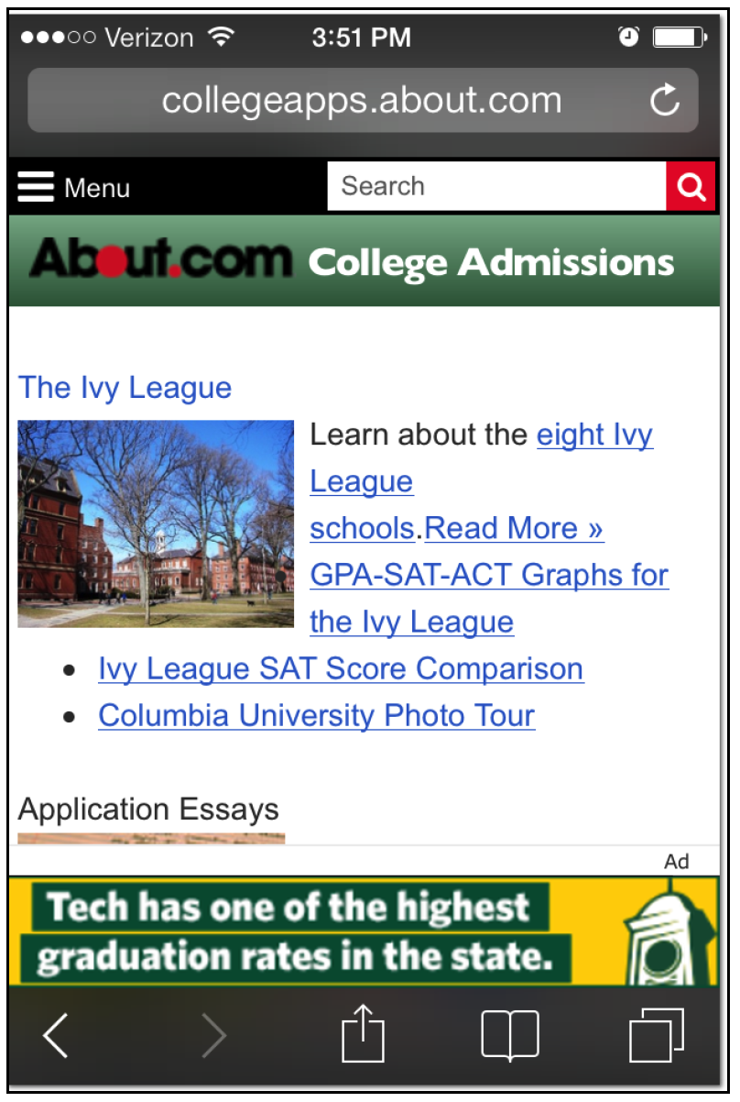
University Branding
Online/Mobile

Slide 34
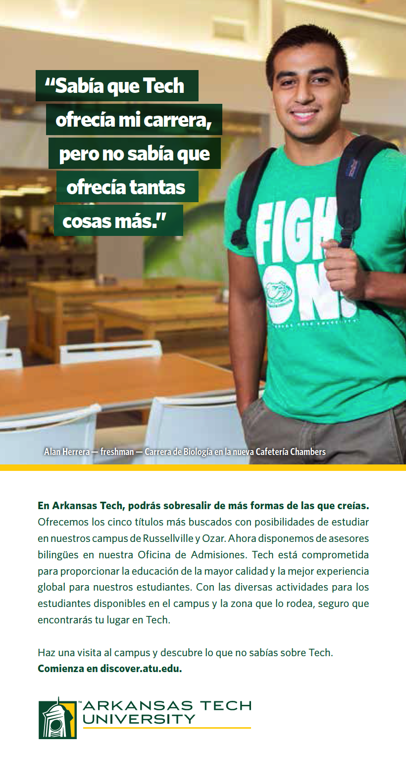
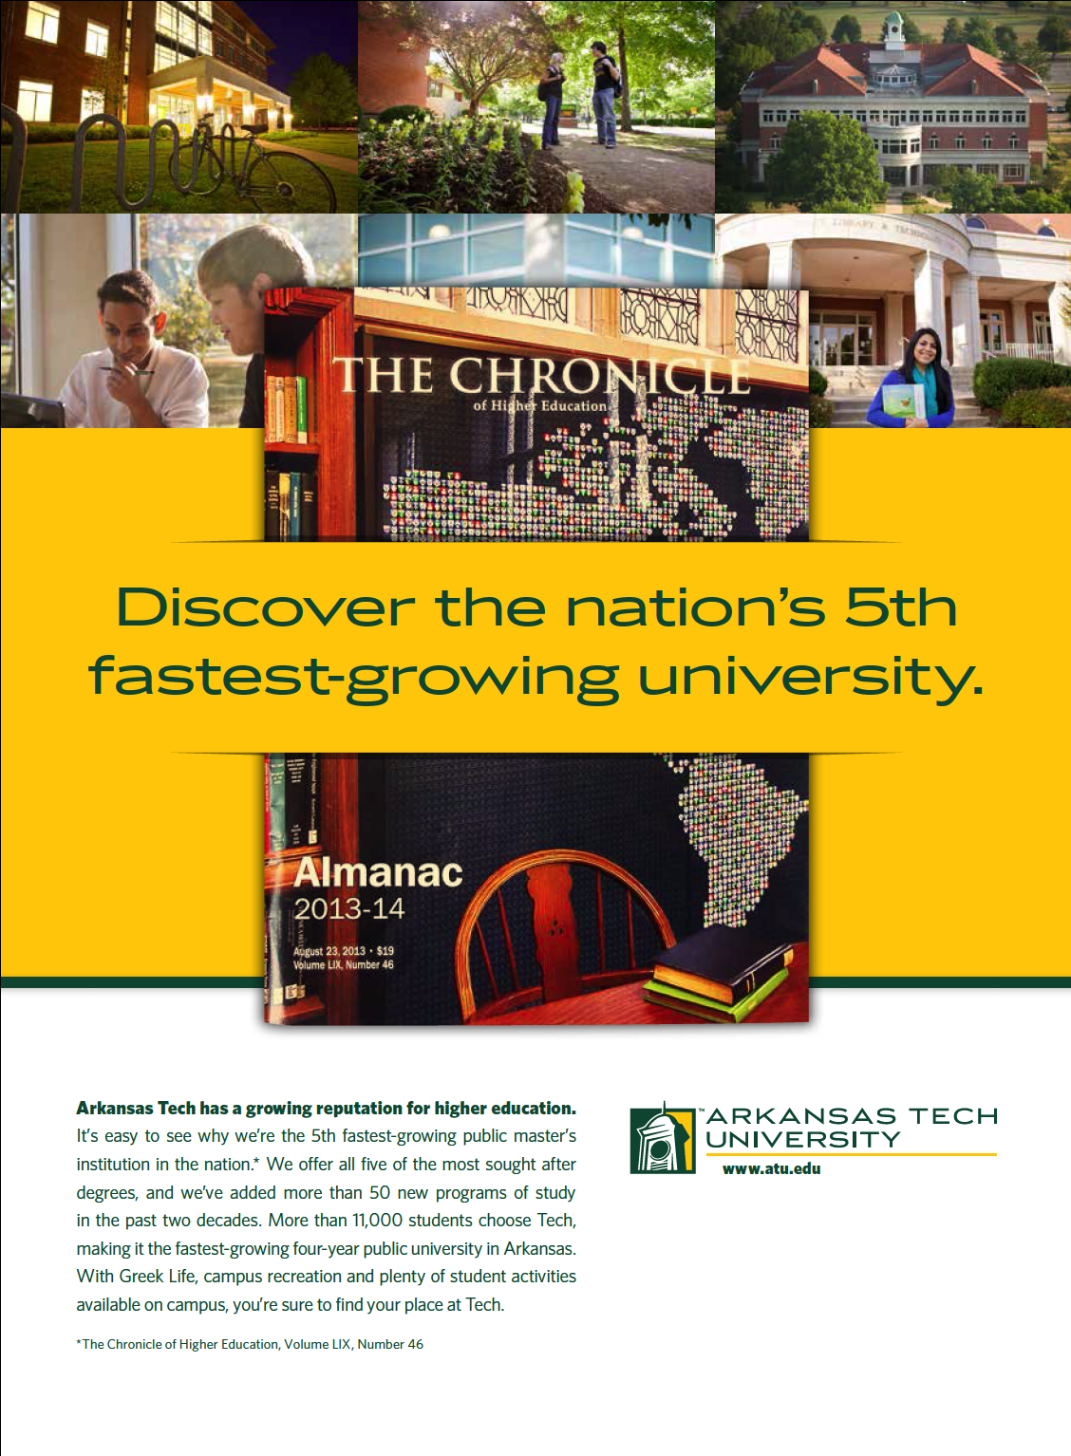
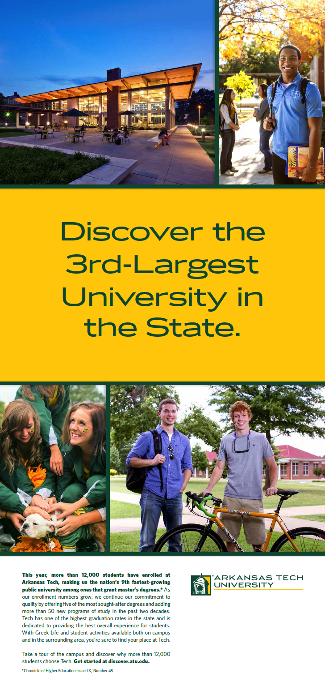
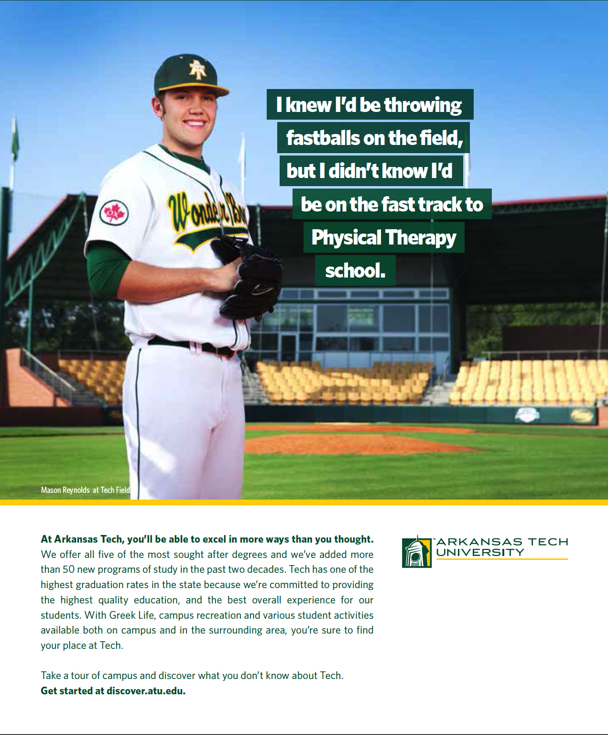
University Branding
Print

Slide 35
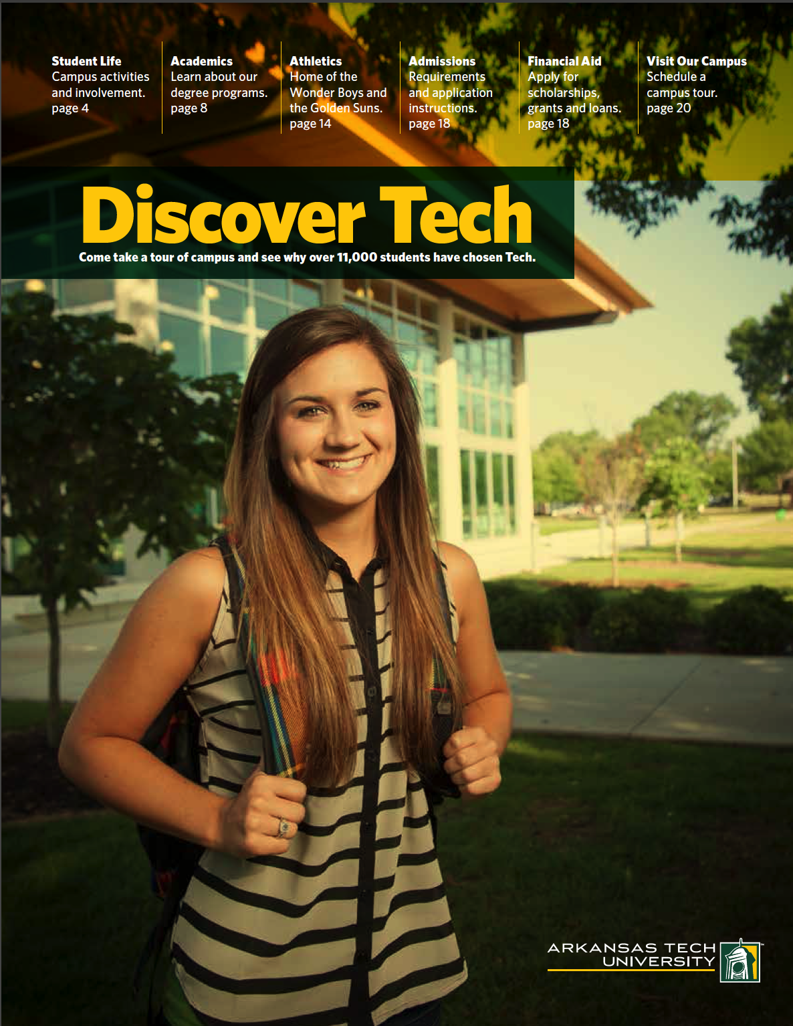
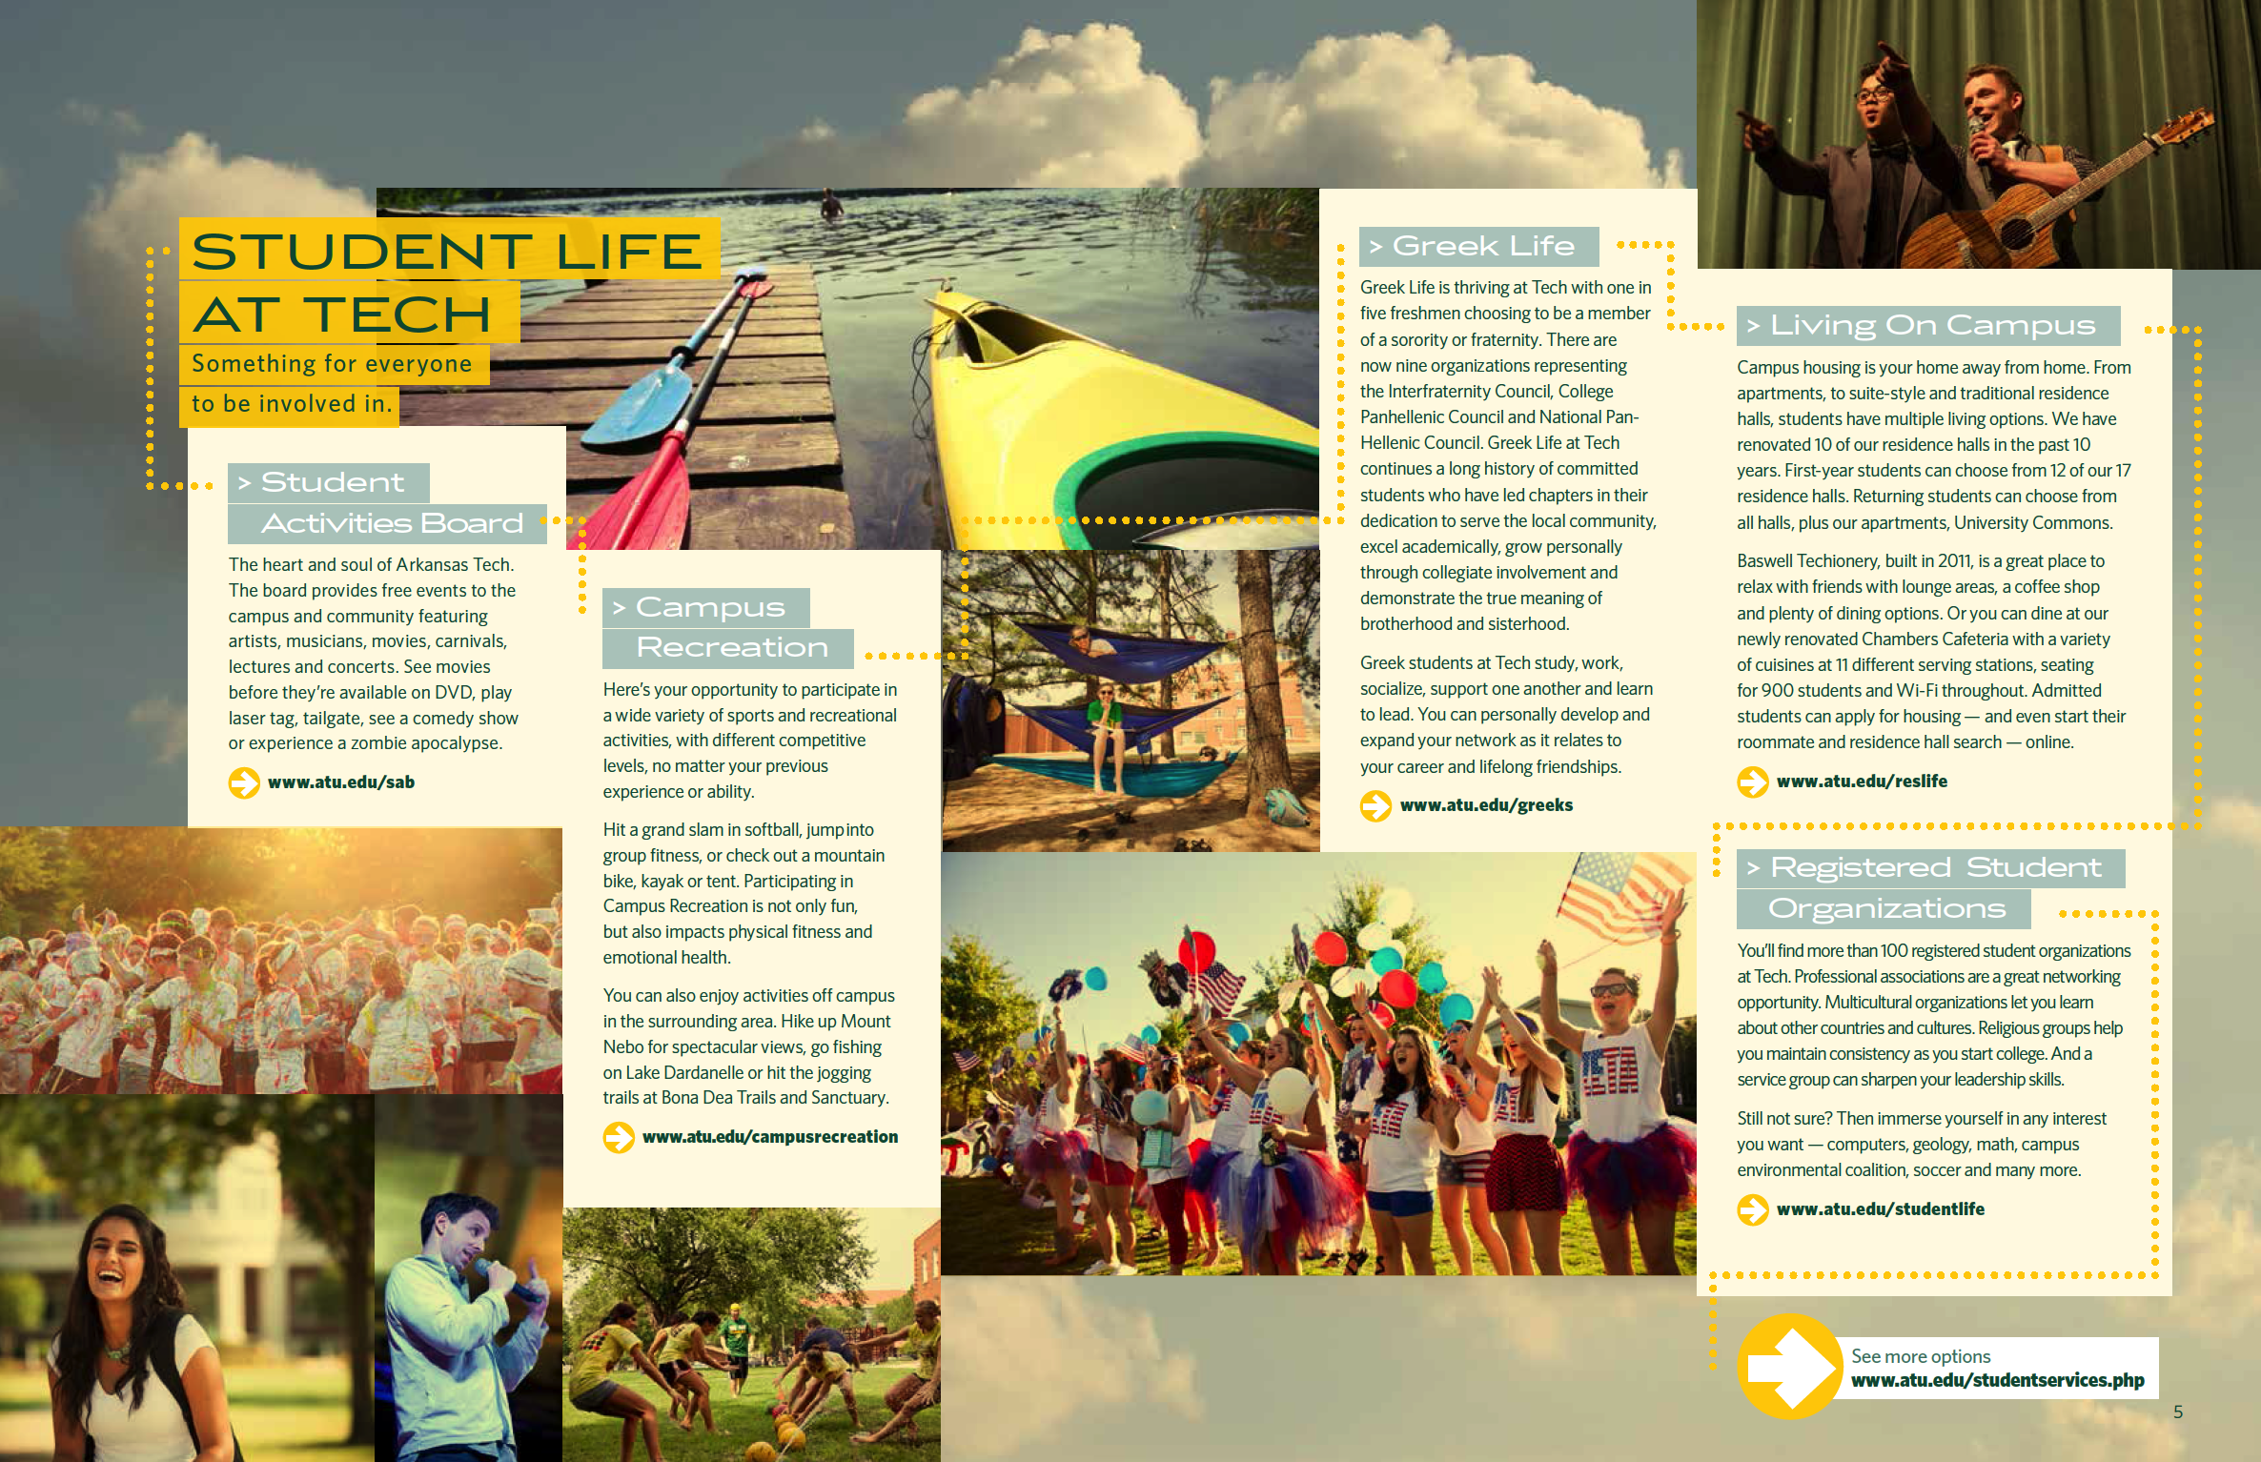
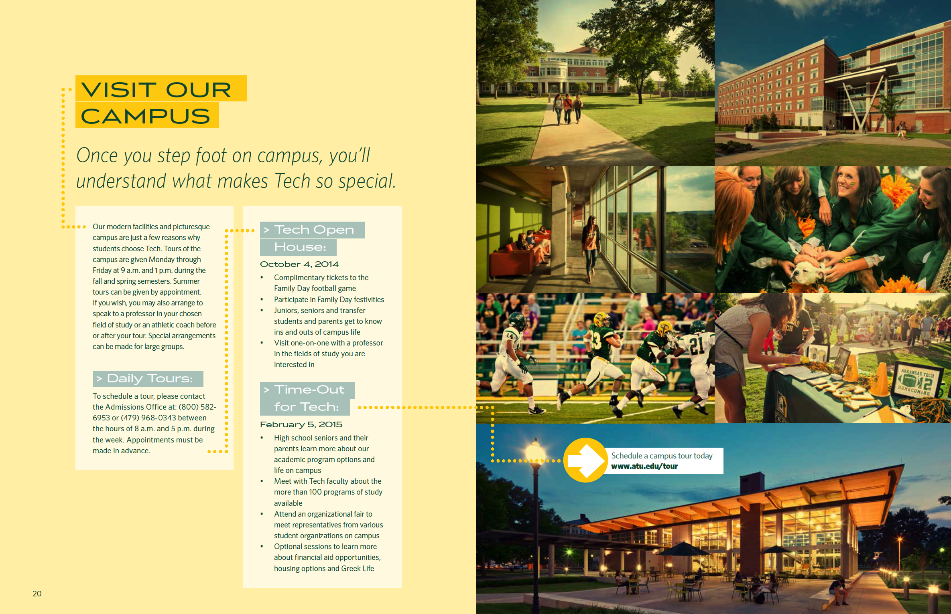
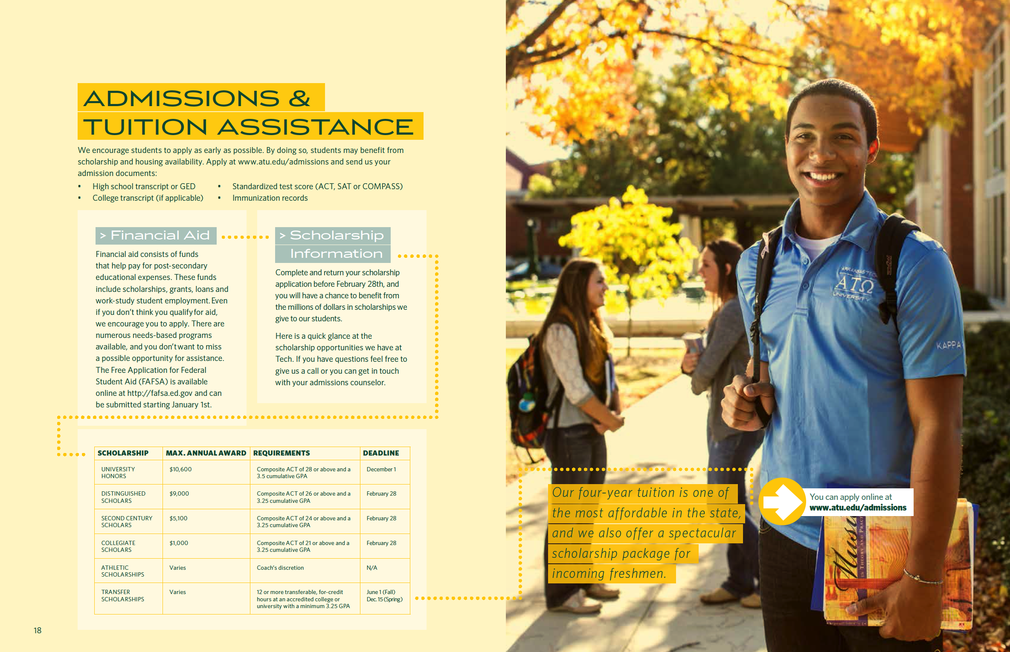
University Branding
Viewbook

Slide 36
University Branding
Target Audiences
Traditional prospective students/influencers
River Valley
Fort Smith
Central Arkansas
Northwest Arkansas
Non-traditional students/employers
Alumni
Government and other funding influencers
Campus community

Slide 37
University Branding
Public Relations
Media Relations
Regular dissemination of news releases, photographs and video content to newspapers, radio stations, news websites, news services and television stations around state and region; respond to their inquiries
arkansastechnews.com
Largely internal communication channel for dissemination of news, photos and video content of interest to the campus community and beyond
Social Media
Maintain, utilize and monitor university accounts on Facebook, Twitter, Instagram, Flickr, YouTube and emerging platforms to connect with a variety of audiences
Tech Action Magazine
Articles, photographs, design and editing handled by University Relations

Slide 38
University Branding
Marketing Channels
Cable & Network TV
Online & mobile video
Cinema video
Digital radio (Pandora, Spotify)
Outdoor boards
College-bound print publications
Online networks – geographic, demographic & behavioral targeting
Mobile devices – geographic, demographic & behavioral targeting
Newspapers
Collateral/sales support materials

Slide 39
University Branding
Internal Communications
Graphic Design Services
Flyers, brochures, publications, T-shirts, advertisements, signs, etc.
atu.edu
Responsible for look and feel of website; assist departmental web managers in developing and placing compelling content
OneTech
Posting of announcements on behalf of campus entities
Licensing Services
Ensures consistent use of Arkansas Tech logos

Slide 40
University Branding
Structure and Resources
Current Staff
Susie Nicholson, VP for Student Services and University Relations
Sam Strasner, Director of University Relations
Carrie Phillips, Director of New Media
Mike Stoker, Director of Web Strategies and Operations
Felisha Weaver, Director of Publications and Creative Services
Liz Chrisman, Director of Photography Services
Liz Underwood, Coordinator of Creative Services
Ryan Taylor, Coordinator of Information Services
Brandi Collins, Licensing Coordinator
Sells Agency
Aids in large-scale marketing efforts and strategic communications
Budget
Have built budget over time to reach traditional-age prospective undergraduate students (television, web, limited printed pieces)
Additional resources required for increased demand for printed pieces, need for increased marketing for online programs and graduate programs and any other additional marketing needs that arise

Slide 41
Enrollment & Marketing Strategic Plan Working Group
October 21, 2015

