Slide 1

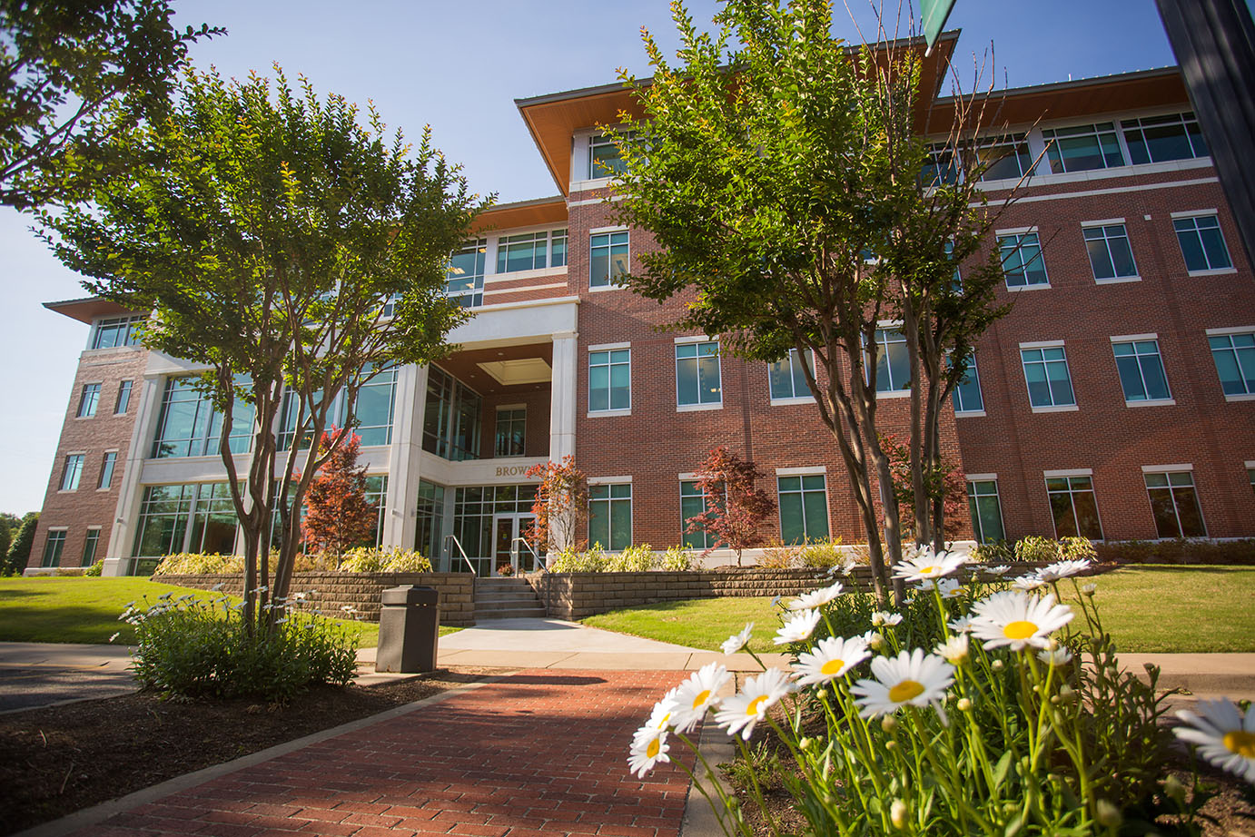
Arkansas Tech University
OFFICE OF THE REGISTRAR
How To Register for Courses
Visit Our Website
https://www.atu.edu/registrar/index.php

Slide 2
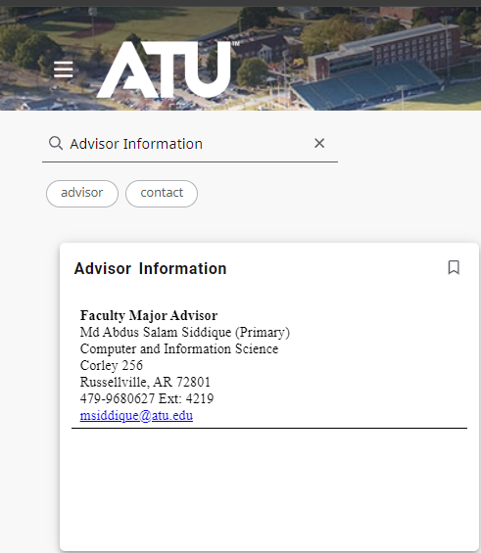
Find your advisor
To find your advisor, access your OneTech portal. Click the icon, located in the top left, then click Discover and search for Advisor Information.
Under the card, you will find your advisor’s name, department, location, and email.

Slide 3
Advising
Freshman & Sophomores
0-60 earned credit hours
Juniors & Seniors
60+ earned credit hours
The Sturgis Academic Advising Center functions under the guidance of a team of professional advisors located in Rothwell Hall, Suite 107.
For incoming freshmen who have declared a major, the AAC will assign you a dedicated professional advisor to provide personalized guidance.
Around the 60-credit hour mark, the AAC will assist you in transitioning to a faculty advisor within your specific academic department.
To schedule an appointment ahead of your registration date, please contact the AAC at (479) 964-0843.
Your assigned advisor is a faculty member within the department corresponding to your major. To locate your advisor, navigate to your Advisor Information tab in OneTech.
For information regarding early advising policies, reach out to your department. When ready to schedule an advising appointment, visit with your advisor in person or contact them via email.

Slide 4
Early Registration
Early Registration is for currently enrolled students.
Current students will enroll based on the number of earned credit hours (hours earned before the current semester).
  Students can check their earned hours on their Academic Transcript, accessible through the Registration Resources dropdown on their Onetech Portal.
Registration dates and information are available on the registrar's website.
  https://www.atu.edu/registrar/registrationinfo.php

Slide 5
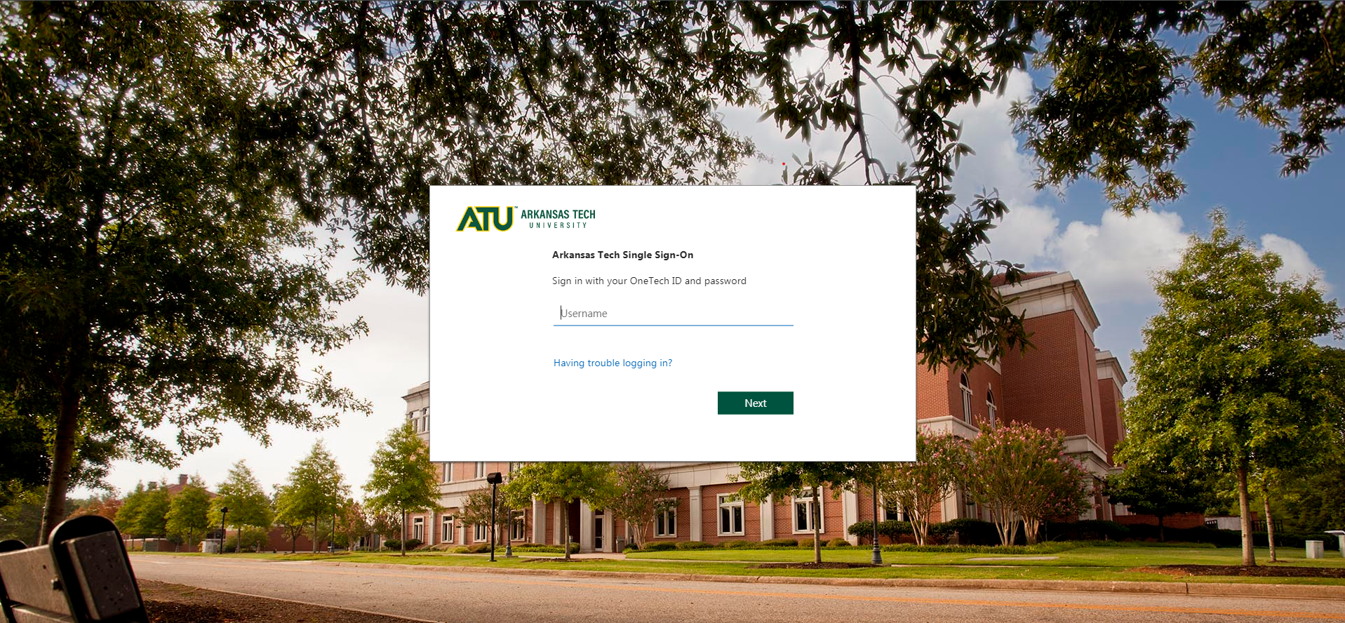
How to Register Online
Sign in to your OneTech: http://www.onetech.atu.edu/

Slide 6
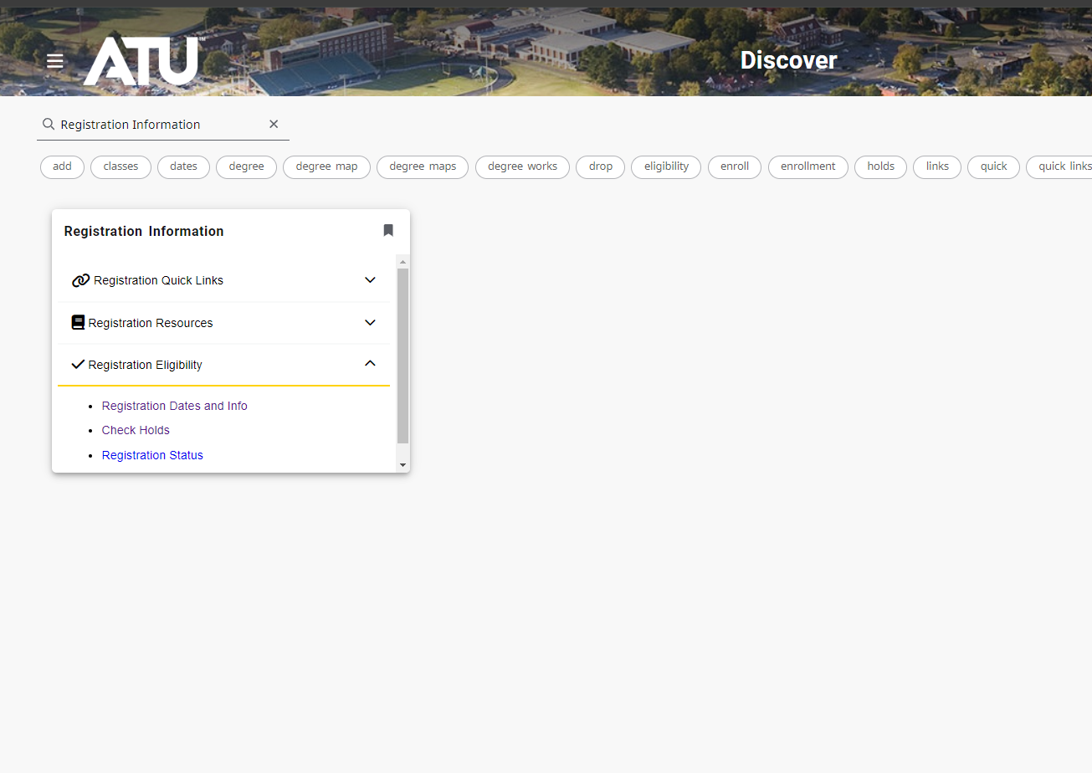
How to Register Online
Step 1: Prior to your approved registration date, log in to your OneTech and locate the Registration Information tab. Then, under the Registration drop-down, click Check Holds.
Here, you can check for holds and the processes affected. Please note that some holds are sensitive and may not display on this page.
*Common holds preventing registration include:
Student Accounts
Residence Life
Missing Admissions Documents
Graduation Checkout

Slide 7
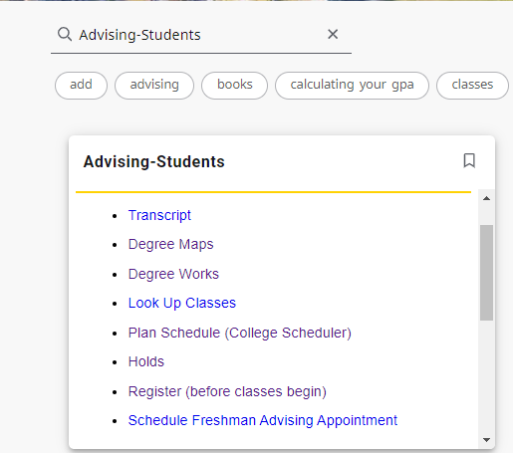
How to Register Online
Step 2: On your approved registration date, log in to your OneTech, navigate to the Advising-Students tab, and then Register (before classes begin).
Follow the on-screen instructions to select the term you wish to register for and to enter your Student Registration Code (SRC) given to you by your academic advisor.
You can get your Student Registration Code (SRC) from your academic advisor or from your primary major department.

Slide 8
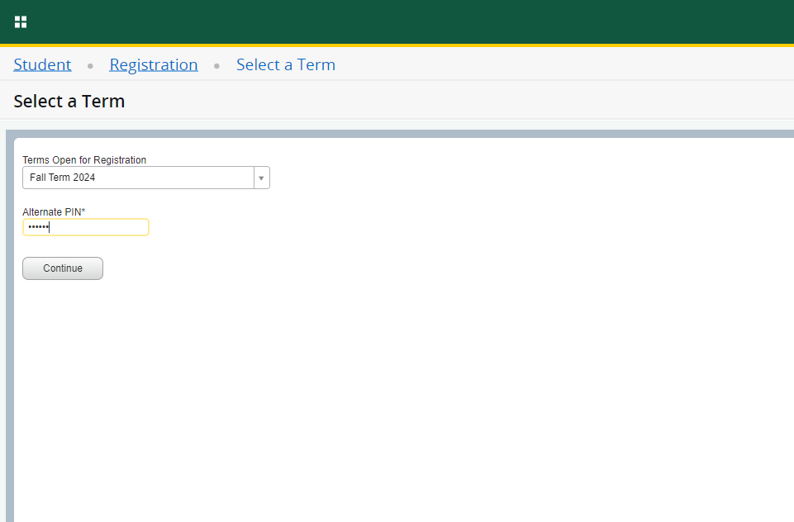
How to Register Online
Step 3: Follow the on-screen steps carefully, choose the term you want, and type in your Student Registration Code (SRC) given by your advisor.
No student will have access to register for classes without their SRC.
Select the term for which you wish to register and enter your Student Registration Code (SRC), then click Continue.

Slide 9
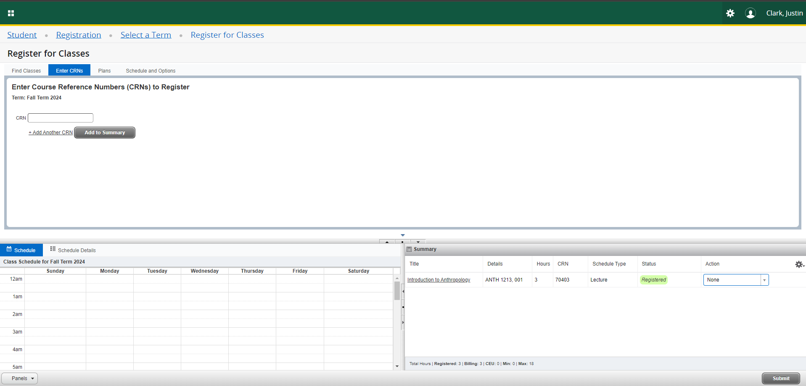
How to Register Online
Step 4: Once your SRC is submitted, you will be prompted to enter the course information to class you wish to enroll. Enter the Course Reference Numbers (CRN) for the course(s) you have selected into the provided boxes.
  If you have not already looked up the CRN’s, click on find classes tab to select classes and search for the course information. After you have selected the course in which you want to enroll, click the box beside the section you have chosen and then click Add.
Enter the Course Reference Number (CRN) for the courses you have selected into the provide box.
You can find classes by selecting this tab, if you do not have your CRNs.
Classes that have been added to your schedule summary will appear here
When you have added all the courses you wish to register for, click submit

Slide 10
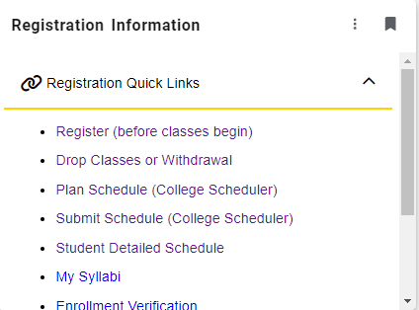
How to Register Online
Step 5: Your registration should now be complete. To view or print your schedule, click Student Detail Schedule in the Registration Quick Links section and select the corresponding term .
  If you are registering for more than one semester (summer and fall), return to your Registration Quick Links section and repeat Steps 2-5.

Slide 11
Registered! Now what?
Check the class schedule; it is the student's responsibility to verify the registration has been completed accurately, so it is recommended that students print a copy of their class schedule for their records. Students may view their schedule by selecting Student Detailed Schedule, which is listed under Registration. Refer to Building Abbreviations for helpful information and a link to the campus map.
Pay charges and/or confirm financial settlement according to Fee Payment Policy. Visit the websites for Student Accounts and Financial Aid for more information.
Students must attend the course before its unique attendance date. There are no exceptions. Attendance is measured as: physical attendance, submission of an assignment, OR completion of Blackboard Attendance Accounting module.
All students operating a vehicle on campus must purchase a Hang Tag. For information on Hang Tags and parking areas visit Public Safety's website. Official enrollment is contingent upon eligibility to enroll for future terms.
Verify addresses and phones numbers are correct by selecting Update Addresses and Phones on the home tab under personal information.

Slide 12

Questions? Contact Us
The Office of the Registrar
Brown Hall , Suite 307
Monday – Friday, 8 a.m. – 5 p.m.
(479) 968-0272
Visit Our Website
https://www.atu.edu/registrar/

