Slide 1
Procurement Card
Policies and Guidelines
Arkansas Tech University

Slide 2
Introduction
State of Arkansas/Arkansas Tech University
Program helps manage lower-dollar supply purchases
Used by full-time employees
Liability at department level
Personal purchases are strictly forbidden and may result in disciplinary action

Slide 3

What is a procurement card?
Visa credit card issued by U.S. Bank
The PCard is to be used only for official business purchases for Arkansas Tech University
Issued only in an individual cardholders name

Slide 4
Who may carry a Pcard?
Full-time employee of Arkansas Tech University
  Employees with budgets funded by grants or any other special funding must receive approval for a PCard from the Budget department and for each purchase made on the card.
Only used by the cardholder
  No other office worker may use your card
  Your name-Your signature
  Cards may not be transferred between individuals

Slide 5
Pcard Transaction
Cardholder enters a business or goes online and makes a purchase
Merchant submits the transaction to Visa who submits it to U.S. Bank
U.S. Bank bills ATU on the 15th of each month for all charges made by our PCard users
Tech reconciles receipts from the PCard transaction log
Tech makes a single payment to U.S. Bank for all charges for all departments. Individual vendors are not set up in Banner for each purchase.
Accounting department debits/credits each appropriate departmental budget
Departments are responsible for assuring that credit card charges are accurate on their budget

Slide 6

Making a Purchase
Purchasing in person
Phone orders
Internet orders
Making sure that the company is legitimate
Procurement cards may not be used at the
Campus Bookstore or at Chartwells Catering
services.

Slide 7

Allowable Charges
Included, but not limited to
  Books
  General office supplies
  Educational supplies
  Lab supplies
  Postage
  UPS, FedEx

Slide 8

Non-Allowable Charges
Alcoholic beverages of any kind
Cash advances
Printing-Excluding Copies
Food, meals, kitchen items, space heaters
Gifts, greeting cards, gift-certificates, flowers
Travel expenses of any kind

Slide 9
Non-Allowable Charges
Any items listed on mandatory agency or state contracts
Any purchase involving a trade-in
Any other purchase not permitted under Tech policy and or/procedures
Any item that is to be inventoried
Questionable items are dealt with on a case-by-case basis

Slide 10
Cardholder liaison
Optional step for the cardholder
May be assigned by department
Responsible for obtaining the statement
Prepare the PCard log
Maintaining records with applicable back-up documentation

Slide 11
Cardholder responsibilities
Do’s
  Ensure Pcard is used for Tech business only
  Hold card in secure location
  Adhere to purchase limits of card and purchasing rules and regulations
  Obtain all receipts
  Submit PCard log monthly to Purchasing Department
  Retain copies of PCard log and documentation for two years
  Attempt to resolve disputes with vendors

Slide 12
Cardholder responsibilities
DO’s
  Ensure credit is received for returned items
  Immediately notify VISA of a lost or stolen card-24 hours a day
  Notify Purchasing during business hours
  Return the PCard to Purchasing upon leaving employment at Tech
    upon the request of the Department head or Purchasing Department
  Contact the Purchasing department if transferring departments

Slide 13
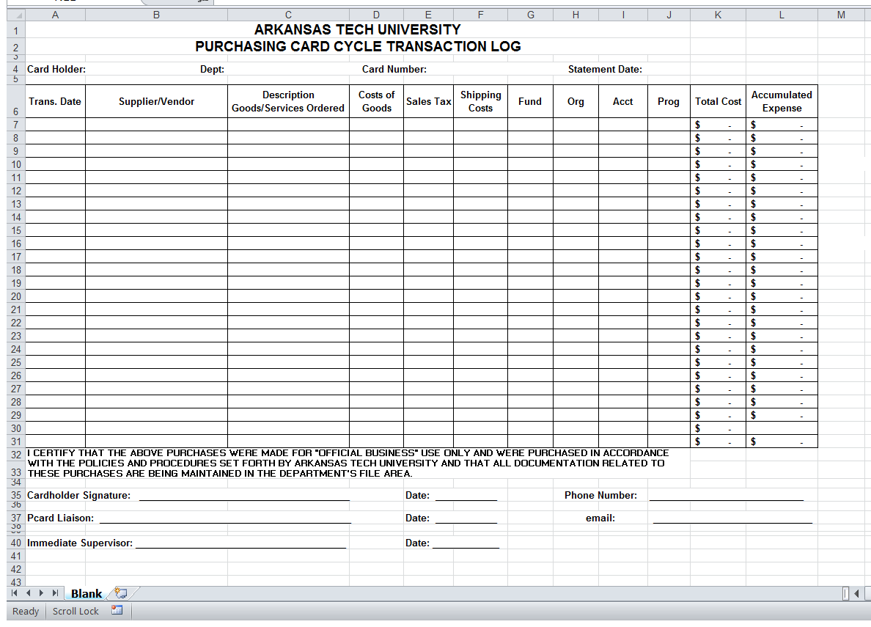
Pcard Log

Slide 14
Cardholder Responsibilities
Don’ts
Allow anyone else to use your card
Accept cash in lieu of a credit
Ultimate responsibility for use/misuse of charges rest with the cardholder

Slide 15

Purchasing Department Responsibilities
Maintaining University’s procurement card program
ATU’s contact with US Bank
Training cardholders
Audit monthly PCard logs for accuracy

Slide 16
Cardholder Termination
Reasons for Termination
  Move to a new job and the PCard is not required
  Terminates ATU employment
  Card is used for personal or unauthorized purposes
  Card is used to purchase alcoholic beverages, or any substance that violates policy, law or regulation pertaining to ATU
  Cardholder splits a purchase to circumvent the limitations of AR Procurement Law
  Cardholder fails to provide liaison with required receipts
    Failure to provide a receipt will result in employee reimbursing the University
  Cardholder fails to provide information about any specific purchase
  Cardholder does not adhere to all the Pcard policies and guidelines

Slide 17
Documentation of Expenditures
Who, What, When, and How Much?
Must include
    Vendor Name
    Date of Purchase
    Description and quantity of each item
    Per item cost
    Total cost of the transaction
    If not included on receipt, handwrite details of purchase

Slide 18
Sources of Documentation
Valid source of documentation
  Original receipt from the merchant-emailed receipts are acceptable
  Order form for books, subscriptions, or similar items
  Invoice showing credit card payment
  Packing slip form delivery annotated by the cardholder as ordered by , received by, paid by and signature of Cardholder
  Complete Lost/Unobtainable Procurement Card Receipt Form located at atu.edu/purchasing

Slide 19
Refunds and Promotional Items
Refunds
  Deposited back into the appropriate account
  Documentation of the refund is required with the PCard log
Promotional Items
  Two types of promotional items
    First-received as a result of PCard transaction, become the property of ATU
    Second-Items purchased to promote the University
      Require approval of the Controller’s office prior to purchase and copy of approval must be included in PCard log

Slide 20
Card Declined/Disputes and Billing Errors
Card Declined
  Contact the Purchasing Department for assistance
  Merchant Category Code Blocking
Unresolved Disputes and Billing Errors
  Cardholder responsible for contacting vendor to resolve disputed charges
  If unsuccessful, contact Purchasing Department for assistance

Slide 21
Reconciliation and allocation of billing
Funds are not encumbered at the time of purchase
Cardholders responsibility to make sure that there are sufficient funds to cover charges at the time of reconciliation
ATU is not a tax exempt agency
  You may see a separate line item on your budget for taxes paid on transactions

Slide 22
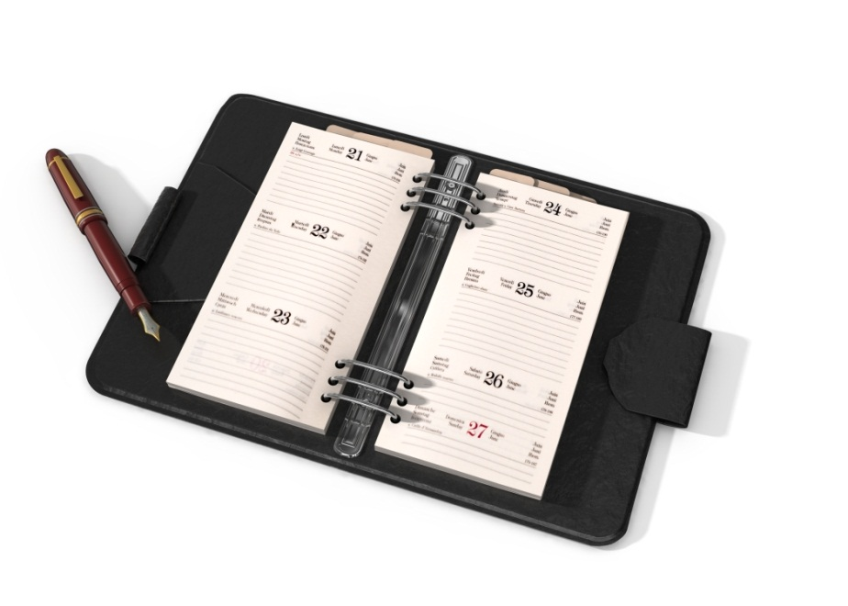
End of Fiscal Year Procedure
Goods and services expended in the year they are received
Watch your email and OneTech for announcements on PCard cut-off date for current year

Slide 23
Manual and Forms
Procurement Manual and Forms located at atu.edu/purchasing
Contact Purchasing at 479-968-0269 or purchasing@atu.edu

