Slide 1
ATU Procurement Training for Faculty and Staff
Business Services
Procurement Services
purchasing@atu.edu
479-964-0589 ext. 3554

Slide 2
Today’s Topics
Ethics-What is expected of me as a state employee?
Procurement Processes-How are things purchased and paid for at ATU?
Basic Procurement Guidelines-What are the rules and how do we follow them?
Contract Review Process-The vendor sent me this contract, now what?
Online Resources for Faculty and Staff-Where can I go to find direction and answers to my questions?
Procurement Requisition Entry-I know what I need to buy, how do I get the ball rolling?
Take Away

Slide 3
Ethics
ATU is an institution of the State of Arkansas.
As public employees our employment is a public trust and must be executed in such a manner to foster public confidence.
Any attempt to realize personal gain through public employment by conduct inconsistent with the proper discharge of the employee’s duties is a breach of public trust. –Ark. Code Ann. §19-11-704(a)
Personal gain include financial gains by any member of an employee’s family.
Splitting purchases to circumvent the bidding process is a violation of Arkansas Law. 19-11-702. “Any employee who knowingly violates any of the provisions shall be guilty of a felony and upon conviction shall be fined in any sum not to exceed ten thousand dollars ($10,000) or shall be imprisoned not less than one (1) nor more than five (5) years, or shall be punished by both.”
If you aren’t comfortable with it being in the headlines, don’t do it!

Slide 4
Procurement Cycle
Department realizes a need.
Research is done to determine how to meet the need. Procurement is a great source of information. Please reach out to us!
Department enters a requisition to reserve funds for purchase. Requisition travels through electronic approval process and lands in Procurement for processing. Pcard may also be used
Procurement assist in making sure that the good or service is procured within State of Arkansas and ATU guidelines. This may include issuing an Invitation for Bid or Request for Proposal.
If any software is purchased, fill out the OIS Software Application for review first.
If any contract or agreement is required for purchase, fill out the cover sheet and submit to Legal Counsel.
Procurement converts requisition to a purchase order and submits to vendor. Requestor receives a departmental copy of the PO in email inbox.
Good is received or service is performed.
Department signs departmental purchase order and forwards to Accounts Payable
Accounts Payable issues payment to the vendor.
Don’t commit to buying anything unless you have a PO or P-card in hand.
Don’t sign any agreements or contracts.
This is for your protection!

Slide 5
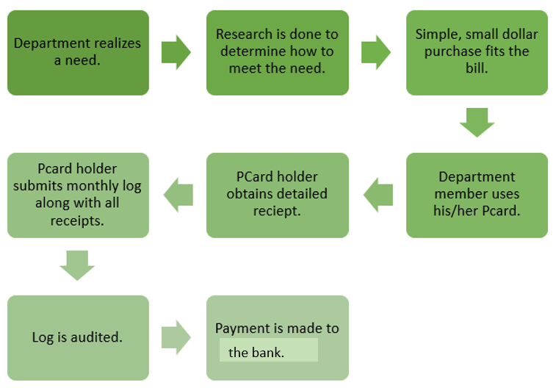
Procurement Process-PCard
Pcard Tips
Cardholders can check available balance and see transactions at BOA global connect.
Remember, no requisition means no encumbrance against your budget as you use your card.
Stay up to date with Pcard procedures. See the Newsletter and OneTech!

Slide 6
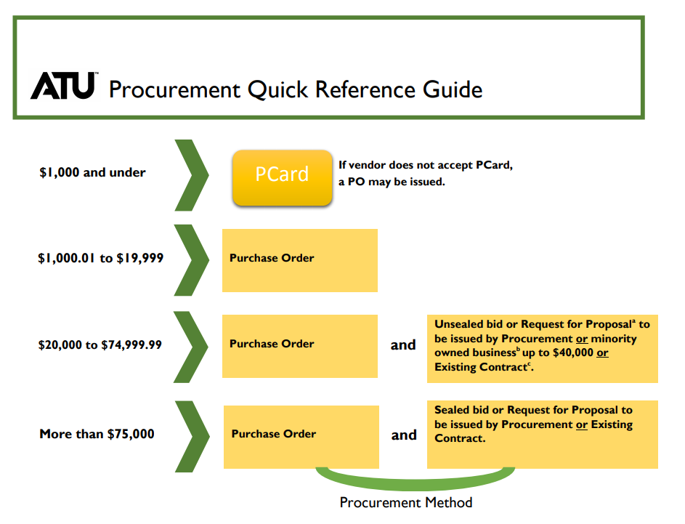
Procurement Guidelines

Slide 7
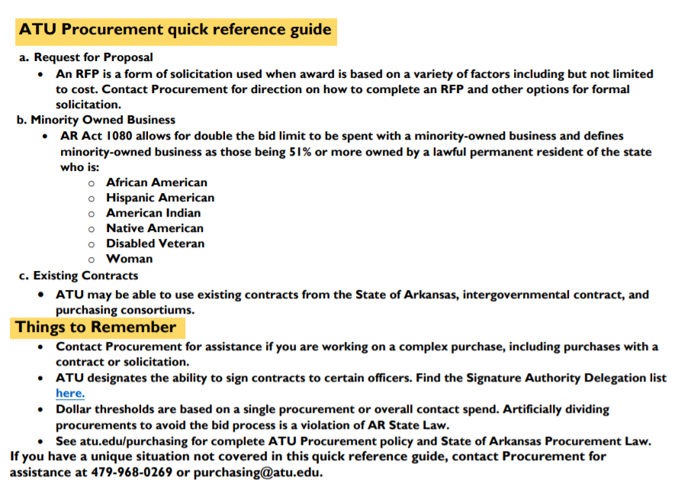
Procurement Guidelines

Slide 8
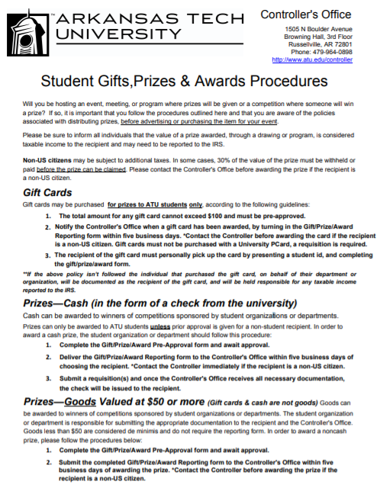
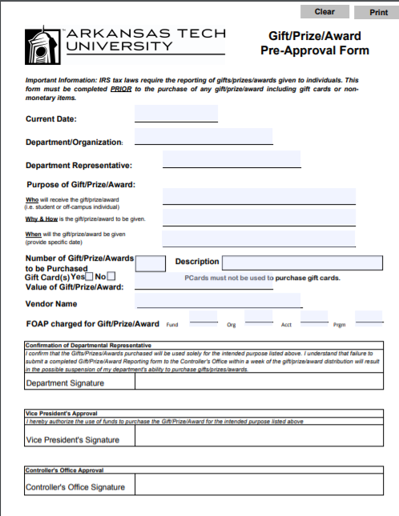
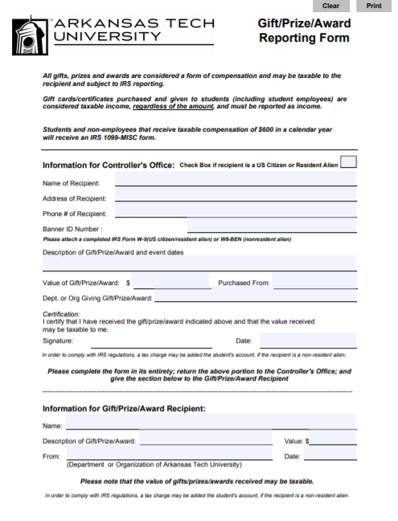
Required Prize/Gift Form
Completed and approved form must place prior to any giveaway being advertised or purchased.
Available at atu.edu/controller
Select Menu/Forms/Student Gift Prize Award Form

Slide 9
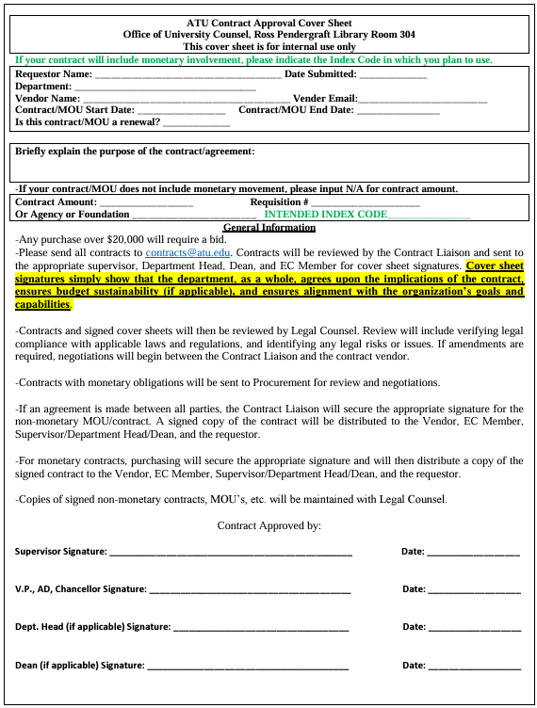
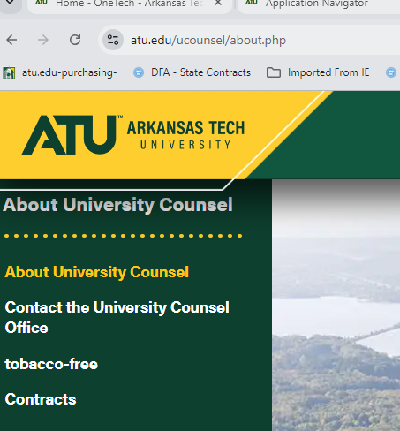
Contract Review Submission
Every agreement that is presented must be evaluated prior to PO being issued. Enter “Contract to Follow” on requisition. Be cautious. Some documents may seem common place, but if it requires a signature it must be evaluated.

Slide 10
Requisition Entry Application Navigator
Verify budget availability before beginning requisition entry
Application Navigator form FGIBAVL
Enter a commodity description line for each item purchased-avoid entering purchases as one lot.
Commodity codes are never used on procurement requisition-only travel requisitions
Always enter the index code in the accounting section of the requisition entry form. The index code is a shortcut to the Fund, Organization, and Program for each budget, also known as the FOAP.
Select the appropriate Account code for the item or service to be purchased from the account code listing available at atu.edu/purchasing.

Slide 11
Online Resources
Business Services maintains two websites for our campus community and vendors.
Travel Services-www.atu/edu/travel
Procurement Services-www.atu.edu/purchasing
Both contain links to training materials as well as pages dedicated to specific topics.
Since we are focusing on Procurement for this training, let’s look at the site.

Slide 12
Take Away
Contact Procurement in the beginning of the process.
You must have a PO or Pcard in hand prior to a purchase.
ATU operates under AR procurement law, let us help you navigate these requirements.
Don’t sign a contract or agreement, but submit for review and signature.
Secure an approved Gift/Prize Award Form prior to advertising and purchasing items.
Check out the website for updated information and resources.
Enter information clearly and concisely on requisitions.
Reach out with any questions or concerns.
Don’t commit to buying anything unless you have a PO or Pcard with adequate limits in hand.
Don’t sign any agreements or contracts.
These rules are for your protection!

Slide 13
Questions or Comments
Reach out to us at
purchasing@atu.edu or 479-968-0269

