Slide 1
The NIH Peer Review Process
NIH Regional Seminars 2017
Sally A. Amero, Ph.D. Weijia Ni, Ph.D., Chief
NIH Review Policy Officer Risk, Prevention and Health Behavior IRG
Extramural Research Integrity Liaison Officer Center for Scientific Review
Office of Extramural Research National Institutes of Health
National Institutes of Health

Slide 2

NIH Peer Review
Cornerstone of NIH extramural research
Standard of excellence worldwide
Two-stage review process
Receipt and Referral
Initial Peer Review
National Advisory Council
Review
Submit your
application
Funding
decision
2

Slide 3
When to submit?
Program specific dates
  Program types
    PUI – only eligible for certain program types
      Research – R15-AREA
      Research Education/Capacity Building – R25
      Research Training – T34, etc.
      Career Awards – K series ???????
‘Standard’ due dates
  https://grants.nih.gov/grants/how-to-apply-application-guide/due-dates-and-submission-policies/due-dates.htm
  START THE PROCESS and SUBMIT EARLY!!!!
  * Hilliard

Slide 4
What to Submit?
eRA Commons registration
Must electronically submit via SPUI
  Original, non-duplicate proposal
  Proposal ‘kicked back’ if errors
Program Announcement as a guide
  Read carefully!
  https://grants.nih.gov/grants/guide/pa-files/PA-18-504.html
  Forms – PHS 398 vs SF-424
  * Hilliard

Slide 5
Division of Receipt and Referral (DRR)
Key decisions
  Policy compliance (format, timeliness, etc.)
  Assignment to Institute(s) for funding consideration
  Assignment to study section for initial peer review
Managed by Referral Officers
Funding Institute(s)
Scientific Review Group
Initial Review Groups (CSR or ICs)
Scientific Focus & Mission Relevance
Program Officials (POs)
Scientific Review Officers (SROs)
DRR
Council
IC
Director
Application

Slide 6
National Institutes of Health
Office of the Director
National Institute
on Aging
National Institute
on Alcohol Abuse
and Alcoholism
National Institute
of Allergy and
Infectious Diseases
National Institute
of Arthritis and
Musculoskeletal
and Skin Diseases
National Cancer
Institute
Eunice Kennedy
Shriver National Institute
of Child Health and
Human Development
National Institute on
Deafness and Other
Communication
Disorders
National Institute
of Dental and
Craniofacial
Research
National Institute
of Diabetes and
Digestive and
Kidney Diseases
National Institute
on Drug Abuse
National Institute
of Environmental
Health Sciences
National Eye
Institute
National Institute
of General
Medical Sciences
National Heart,
Lung, and Blood
Institute
National Human
Genome Research
Institute
National Institute
of Mental Health
National Institute
of Neurological
Disorders and
Stroke
National Institute
of Nursing Research
National Institute of
Biomedical Imaging
and Bioengineering
National Center
for Complementary
and Alternative
Medicine
John E. Fogarty
International
Center
National Center
for Research
Resources
National Library
of Medicine
National Institute on
Minority Health and
Health Disparities
Clinical Center
Center for
Information
Technology
Center for
Scientific Review

Slide 7

Submitting a Cover Letter
The cover letter conveys important information:
Application title
FOA # and title
Any special situations (such as a late application)
Statement if proposed studies will generate large-scale genomic data

Slide 8
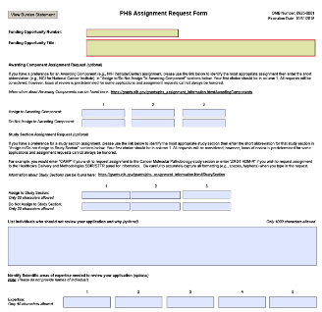
PHS Assignment Request Form
The PHS Assignment Request form conveys:
Awarding component assignment requests
Study section assignment requests
List of individuals who should not review your application and why
Expertise
Optional form in all NIH application form packages.

Slide 9

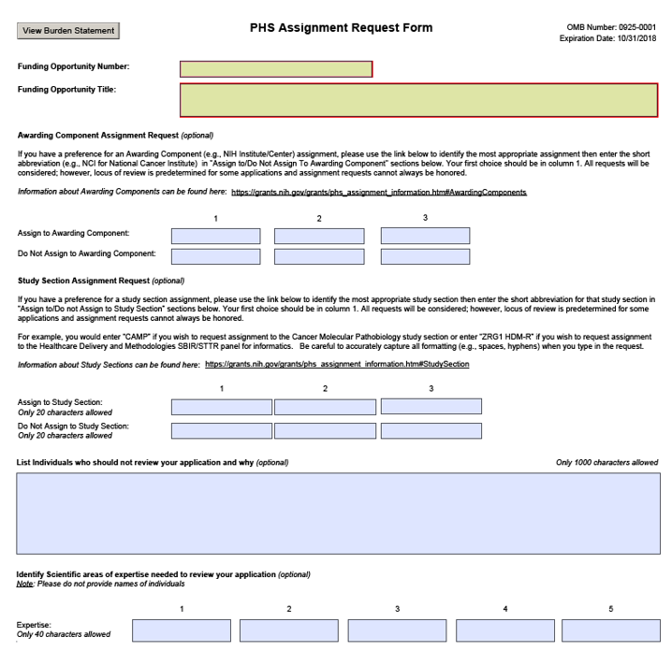
New PHS Assignment Request form

Slide 10
Requesting a Study Section
IC or CSR review is stated in the Funding Opportunity Announcement (FOA).
Information about study sections:
  Center for Scientific Review study sections: http://public.csr.nih.gov/StudySections/Pages/default.aspx
  Rosters are available on NIH websites https://public.era.nih.gov/pubroster/
  http://www.csr.nih.gov/Committees/rosterindex.asp
  eRA Like (A Thesaurus-based Search Tool)
    http://era.nih.gov/services_for_applicants/like_this/likethis.cfm
Not all study section/IC requests can be honored.

Slide 11
Level 1: Initial Peer Review
Key decisions
  Scientific and technical merit of the work proposed
  Overall impact
  Appropriate justification for human subjects, inclusion, and vertebrate animals
Managed by Scientific Review Officers (SROs)
Funding Institute(s)
Scientific Review Group
Initial Review Groups (CSR or ICs)
Scientific Focus & Mission Relevance
Program Officials (POs)
Scientific Review Officers (SROs)
DRR
Council
IC
Director
Application

Slide 12

Maintaining Integrity in Peer Review
  All materials, discussions, and documents are confidential – deleted or destroyed after review.
  All questions must be referred to the SRO.
  Reviewers: Do not contact applicants directly!
  Applicants: Do not contact reviewers directly!
Research Misconduct
    Fabrication, falsification, or plagiarism.
    Reviewers: Report allegations directly
    to the SRO in confidence.

Slide 13
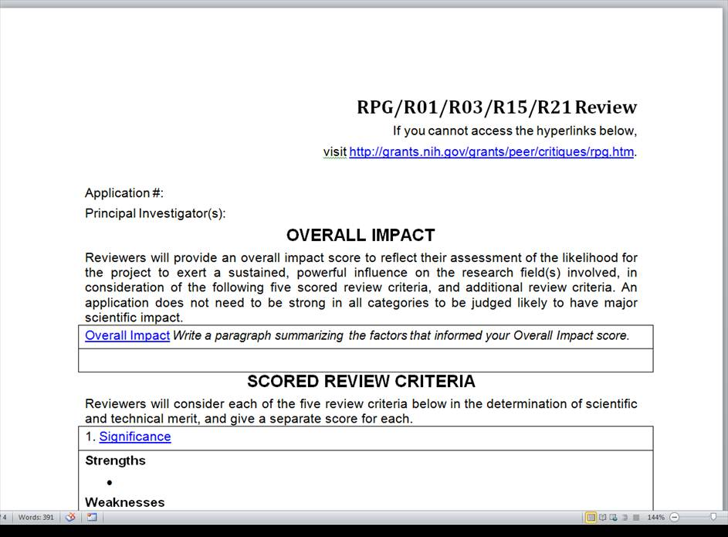
Written Critiques
Links to
definitions
of review
criteria

Slide 14
Types of Review Criteria
Category* | Criteria (Research) | Criterion Scores? | Affect Overall Impact Score?
Scored Review Criteria | Significance Investigators Innovation Approach Environment | Yes | Yes
Additional Review Criteria | Human Subjects** Vertebrate Animals** Inclusion** Biohazards | No | Yes
Additional Review Considerations | Foreign Institutions Select Agents Resource Sharing Authentication of Key Resources | No | No
*Found in every Funding Opportunity Announcement
** If Unacceptable, award cannot be issued until resolved

Slide 15
NIH Scoring System
Reviewers give numerical scores
  1 (exceptional) to 9 (poor)
  Used for criterion scores and final impact score
Impact | Score | Descriptor
High Impact | 1 | Exceptional
 | 2 | Outstanding
 | 3 | Excellent
Moderate Impact | 4 | Very Good
 | 5 | Good
 | 6 | Satisfactory
Low Impact | 7 | Fair
 | 8 | Marginal
 | 9 | Poor

Slide 16
At the Review Meeting
    Any member in conflict with an application leaves the room
    Reviewer 1 introduces the application and presents critique, including all score-able issues (core criteria, human subjects and animal protection, etc.). Reviewers 2 and 3 highlight additional issues and areas that significantly impact scores
    All members join the discussion; Summary by Chair
    Assigned reviewers provide final scores, setting range
    All members provide final scores privately. If voting out of range, rationales are given
    Non-score-able issues discussed: budget, data sharing plan, foreign applications, etc.

Slide 17
Final Impact Scores
Entire panel of eligible members votes
    Eligible means no COI, no abstention
    Not just assigned reviewers
Voted by private ballot at the meeting
Calculated by averaging all reviewers’ scores and multiplying by 10
Range from 10 through 90
Percentiled for some mechanisms
10 – Highest Impact
90 – Lowest Impact

Slide 18
After the Review
eRA Commons (https://public.uat.era.nih.gov/commons)
    Final Impact Score within 3 days
    Summary statement available within 4 – 8 weeks to:
      Funding Institute Program Officer
      PD/PI
      Other NIH Officials
      Advisory Council members

Slide 19
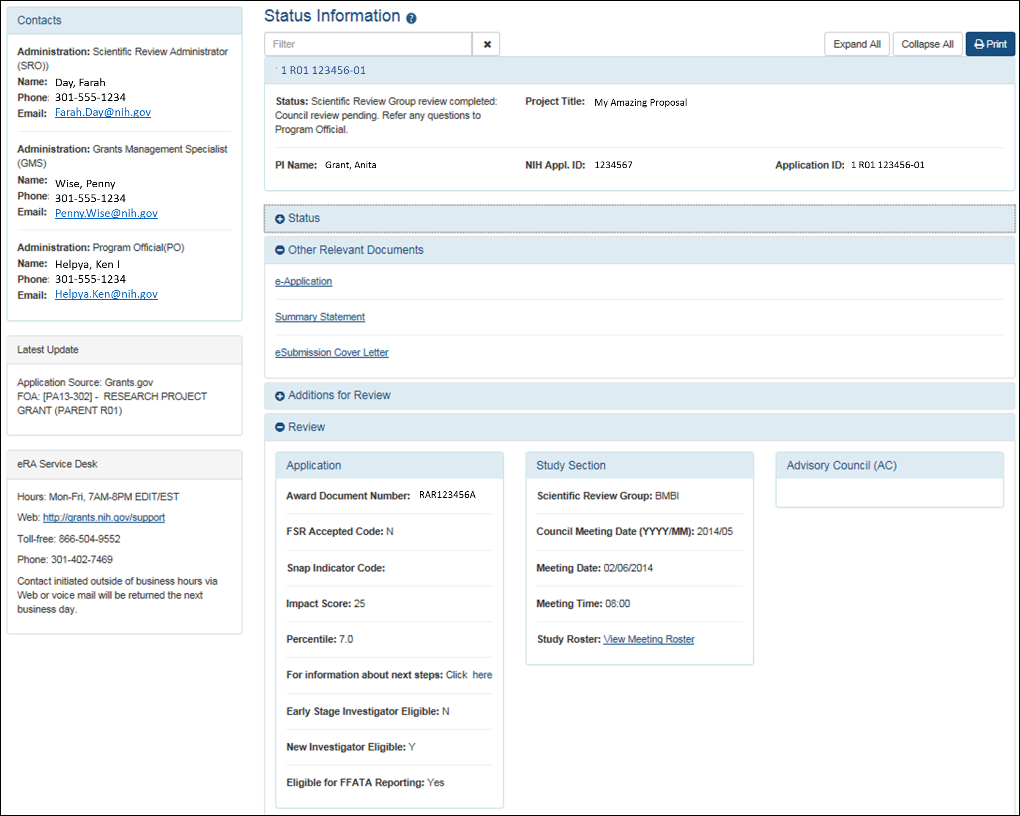
Check Application Status in the eRA Commons

Slide 20
Summary Statement
First page
  NIH Program Official (upper left corner)
  Final Impact Score or other designation
  Percentile (if applicable)
  Codes (human subjects, vertebrate animals, inclusion)
    44 = bar to funding
    35 = default for training grant applications
    30 = involves human subjects or vertebrate animals but the SRG had no concerns
    10 = no human subjects or vertebrate animals
  Budget request
A favorable score does not guarantee funding!

Slide 21
Level 2 of NIH Peer Review: Councils
Key Decisions:
    Funding recommendations
    Program priority
Funding Institute(s)
Scientific Review Group
Initial Review Groups (CSR or ICs)
Scientific Focus & Mission Relevance
Program Officials (POs)
Scientific Review Officers (SROs)
DRR
Council
IC
Director
Application

Slide 22

Funding Decisions: IC Director
The IC Director makes the final funding decisions
Based on:
    Mission of the NIH Institute or Center
    Program priorities, Congressional mandates
    Outcome (score/percentile) of initial peer review
    Additional outside expertise, if needed
    Recommendation of IC Program Staff
    Recommendation of the IC Advisory Council
    Available Funds

Slide 23
Additional Information
Office of Extramural Research Peer Review Process
http://grants.nih.gov/grants/peer_review_process.htm
Peer Review Policies & Practices
http://grants.nih.gov/grants/peer/peer.htm
Center for Scientific Review
http://public.csr.nih.gov/Pages/default.aspx
NIH Guide to Grants and Contracts
http://grants.nih.gov/grants/guide/index.html

