Slide 1
National Endowment for the Humanities
American History
World History
Political Science
Philosophy
Ethics
History of Art
History of Music
Classical Studies
Religious Studies
Theology
English Literature
American Literature
Languages
Linguistics
World Literature
History of Science
History of Mathematics
Archaeology
Overview and Tips

Slide 2
Funding divisions
Education
Summer Seminars and Institutes Humanities Connections
Research
Fellowships and Summer Stipends Collaborative Research Public Scholar
Public Programs
Documentary Films Radio Programs Museum Exhibitions
Preservation and Access
Sustaining Cultural Heritage Preservation Assistance
Digital Humanities
Digital Humanities Advancement Institutes
Challenge Grants
*NEW – Infrastructure and capacity-building grants
State Humanities Councils Check out https://arkansashumanitiescouncil.org

Slide 3
Facts and figures
2018 budget of $152,848,000
Awards around 900 grants per year, ranging from $1,000 to $750,000 each
Success rate varies from 6% - 40%; average across programs is about 16%
Evaluates around 5,700 applications across 40 grant programs annually

Slide 4
www.neh.gov

Slide 5
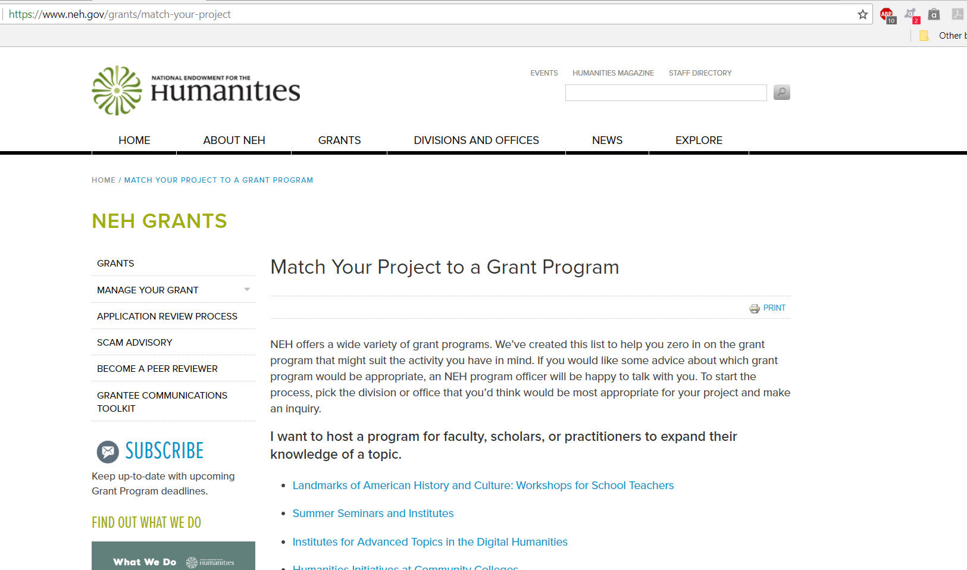
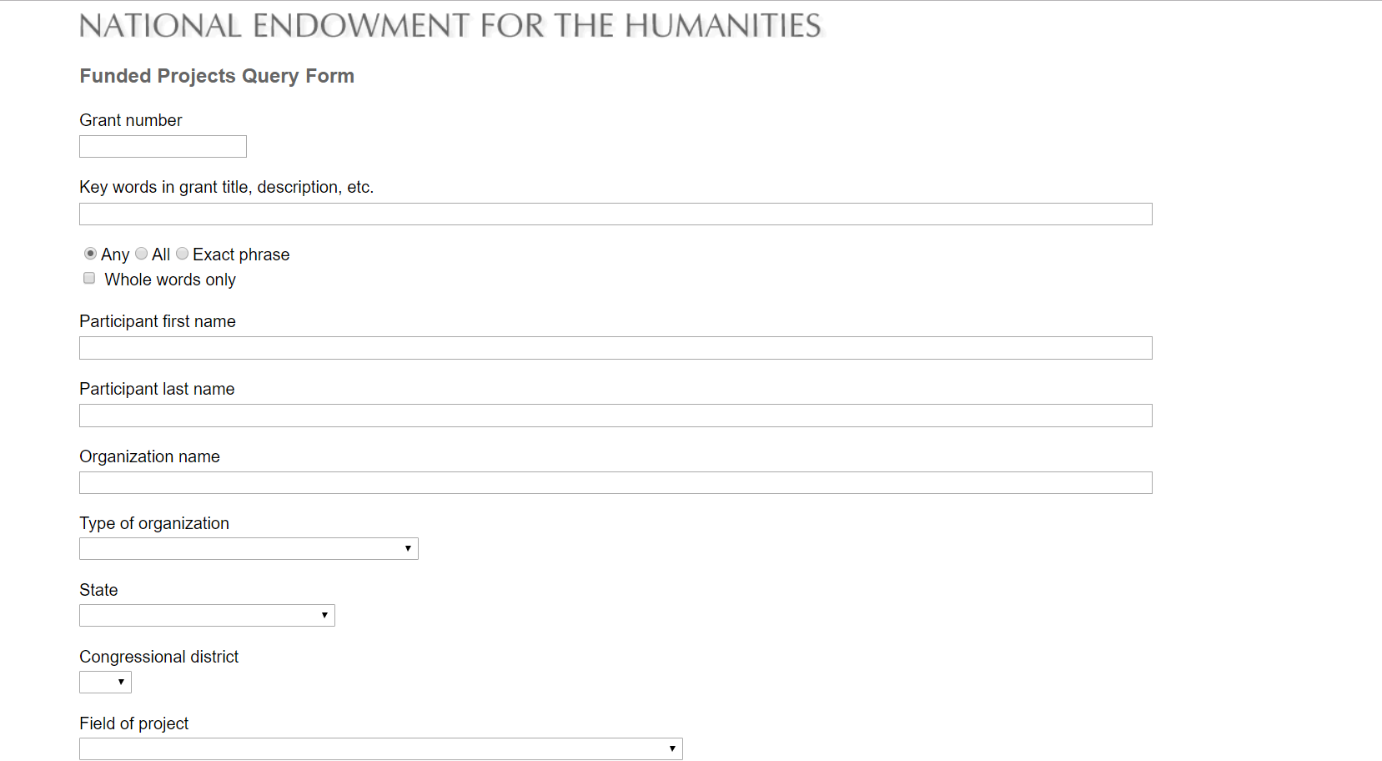
www.neh.gov

Slide 6
www.neh.gov

Slide 7
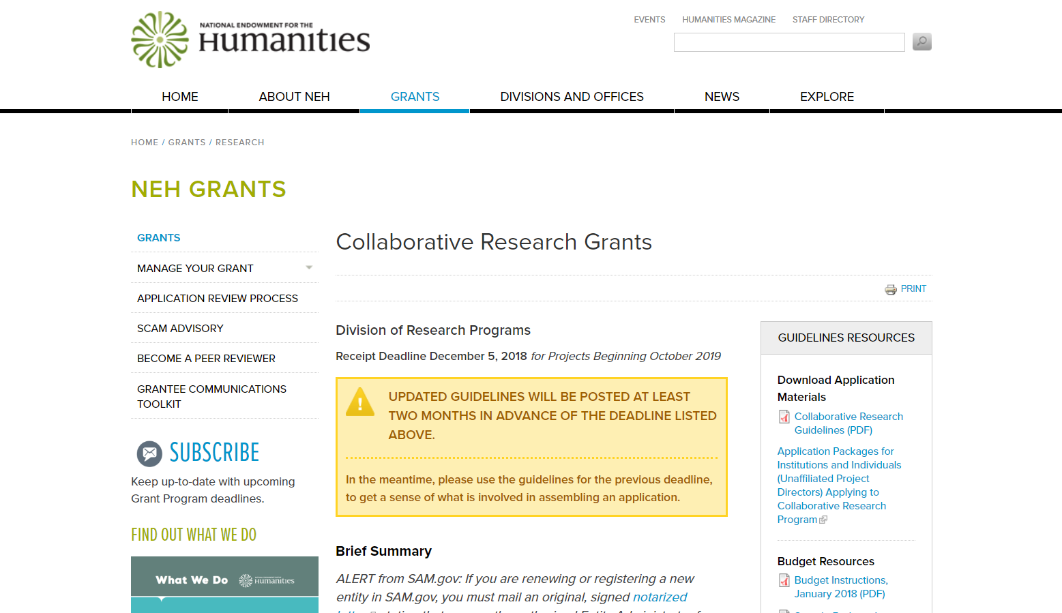

Slide 9
Proposal evaluation*
Intellectual quality
Significant humanities topic and texts
Clear and persuasive rationale
Quality of project design
Potential for significant results
*See specific program announcements for other evaluation criteria.

Slide 10
Tips for success
Read program guidelines carefully
Check out recent awards and sample narratives
Consult with program officers early
Submit a draft proposal
Ask questions regarding feedback
Write for an intelligent, but non-specialist audience
Explain project significance and benefits clearly and persuasively
Include a detailed work plan/schedule of activities
Have a tangible and sustainable dissemination plan
Avoid political advocacy
Proofread
Submit early

Slide 11
Review process
Peer review panels
NEH staff recommendations
National Council on the Humanities recommendations
NEH chairperson makes final decisions

Slide 12
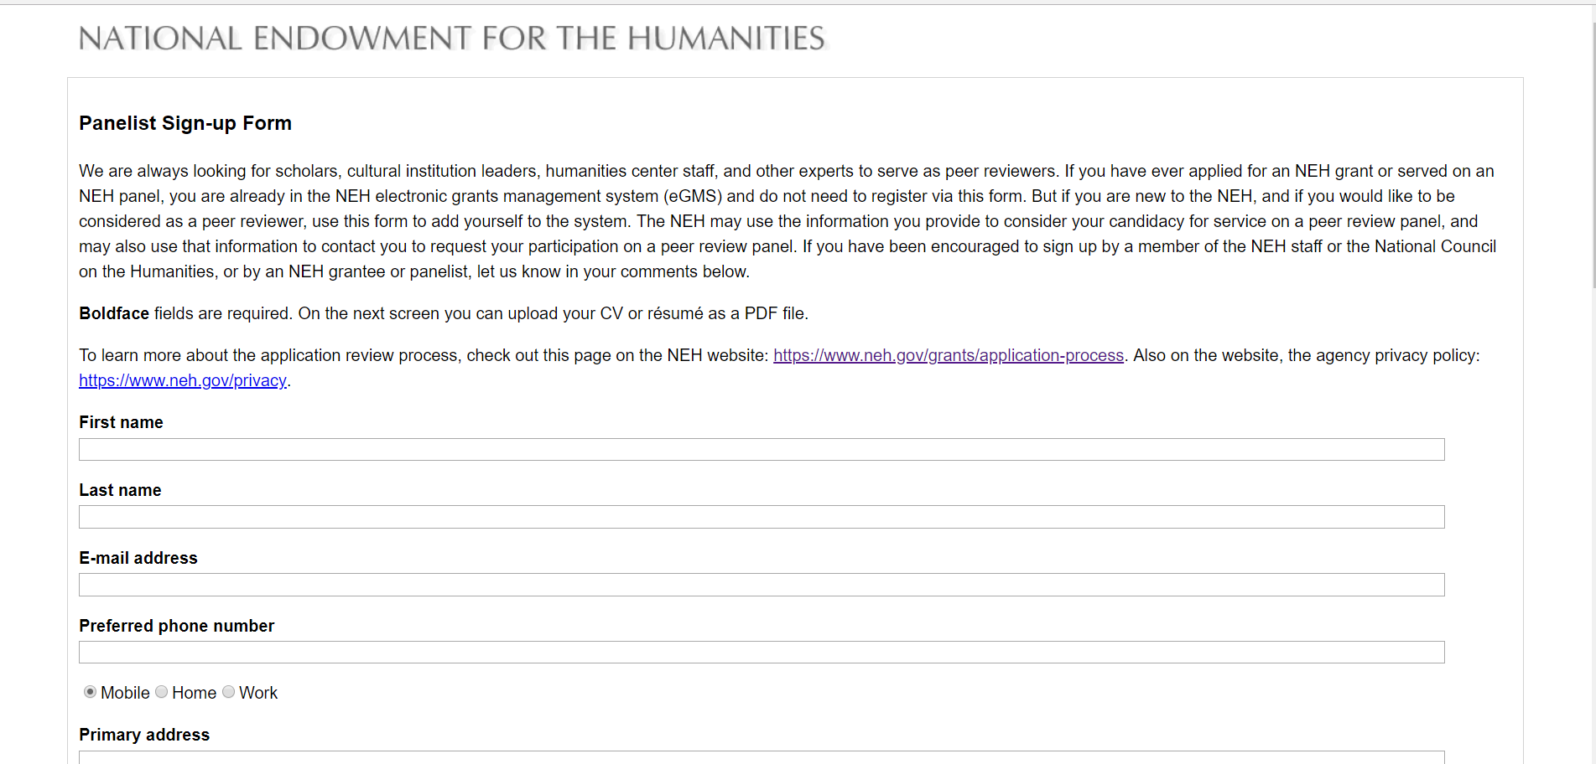
Become a reviewer!
Visit https://www.neh.gov/grants/application-process and click on “panelist sign-up form”

