Slide 1
Arkansas Tech University Institutional Review Board
Dr. Jeff Aulgur, Chair
jaulgur@atu.edu
Office: 968-0318
IRB Institutional Point of Contact:
Mrs. Tiffany Henry, Grant Coordinator
Office of Sponsored Programs and University Initiatives (OSPUI)
Administration 207
880-4327
thenry1@atu.edu

Slide 2
Presentation Agenda
IRB 1001: The Basics
Levels of IRB Review
IRB Decisions
The Process of Consent
Open Discussion

Slide 3
IRB 1001: The Basics Human Participant Review
All research projects conducted by faculty, staff and students associated with Arkansas Tech University that deal with clinical investigation and/or human participants shall be assessed by the Institutional Review Board (IRB) for risks and benefits of research participation.

Slide 4
IRB 1001:The Basics Committee Membership
Membership on the Institutional Review Board Committee (IRB) consists of seven members - one representative from each college appointed by the college deans and a faculty member appointed by the Vice President for Academic Affairs.

Slide 5
2017-2018 Membership
Dr. Gabriel Adkins (Arts and Humanities)
Dr. Masanori Kuroki (Business)
Dr. Jeff Aulgur, Chair (Etech / Supernumerary)
Dr. Jennifer Helms (Natural and Health Sciences)
Dr. Penny Willmering (VPAA Appointee)
Dr. Christopher Trombly (Education)
Dr. Alvin Williams (Engineering and Applied Sciences)

Slide 6
IRB 1001: The Basics Review Process
BLUF: The vast majority of submissions are eligible for expedited review.
Proposals shall be submitted using the appropriate application paperwork by the designated deadlines for IRB review. Once the committee determines that benefits outweigh risks, the IRB reviews the consent process to ensure that all potential risks and benefits are clearly identified to prospective participants and those participants participate voluntarily.
After review, the IRB may elect to approve, table, or reject the research application.
Investigators cannot begin participant recruitment as recruitment strategies are part of the review process until the study is approved by the IRB.

Slide 7
IRB 1001: The Basics Proposal Review Timeline
BLUF: Complete applications eligible for expedited review are returned in approximately seven (7) days. Rolling review process.
IRB applications should be submitted via email to the IRB chair. The application will then be distributed electronically to the IRB committee. Applications that are received within the first week of the month will be responded to by the end of the month. Applicants should allow 2-4 weeks for all protocol reviews. Applicants will be notified via email when their application is approved. A printed copy approval letter is available upon request.

Slide 8
IRB 1001: The Basics CITI Training Completion
BLUF: All research partners listed must complete CITI training.
Collaborative Institutional Training Initiative (www.citiprogram.org)
Complete: Social & Behavioral Research and Social & Behavioral Responsible Conduct of Research.
Other courses as appropriate: (e.g., Animal Care and Use)
Certification must be on file or submitted with your IRB application for review consideration

Slide 9
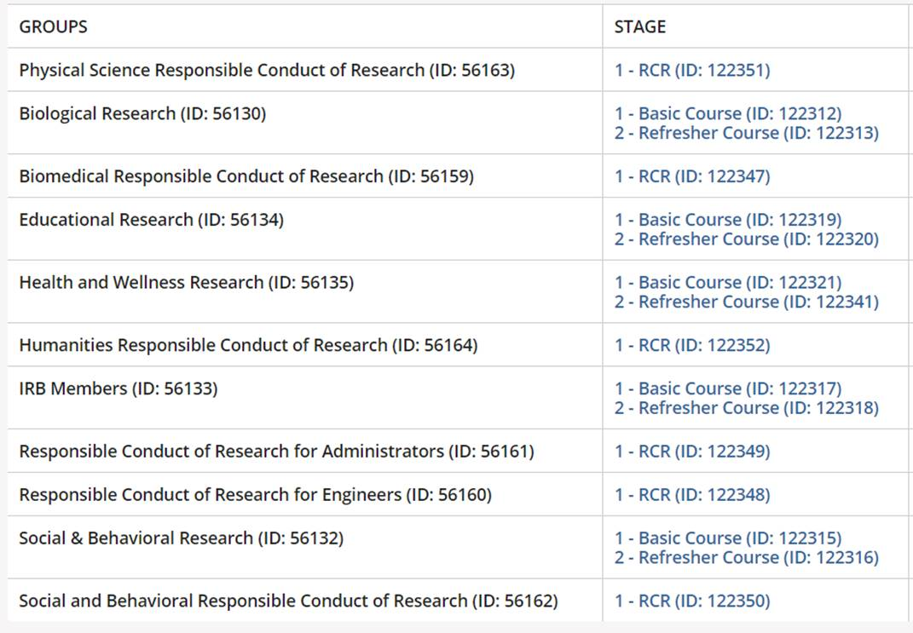

Slide 10
Levels of IRB Review
Exempt
Class Assignment
Expedited
Full

Slide 11
Levels of IRB Review Exempt Review (No Application)
Exempt research that is conducted to benefit ATU only, does not require submission of an IRB application:
1. ATU teacher and student evaluations;
2. Program evaluation research to benefit ATU and carried out by ATU administrative officials and/or their designees;
3. Projects designed to enhance or improve curricula offerings;
4. ATU employee performance evaluations;
5. State of Arkansas mandated program evaluations;
6. Marketing research (designed to market the institution as a product).

Slide 12
Levels of IRB Review Exempt Review (Requires Application)
Research is conducted in established or commonly accepted educational settings, involving normal education practices.
Research involves the use of educational tests, survey procedures, interview procedures or observation of public behavior.
The research involves the collection or study of existing data, documents, records, pathological specimens, or diagnostic specimens, if these sources are publicly available or if the information is recorded by the investigator in such a manner that subjects cannot be identified, directly or through identifiers linked to the subjects.

Slide 13
Exempt Review Process
BLUF: There is no such thing as an emergency exemption and no university official other than the IRB Chair may designate research as exempt.
Except for the examples above, all other research involving human subjects MUST complete an application to be deemed exempt. Exempt categories of research do not require a full IRB hearing, but must be reviewed by the IRB Chair or his/her designee. Funding agencies do not allow investigators to make this determination on their own, nor does Arkansas Tech University.
The IRB Chair must approve any exempt proposal before the proposed research may proceed.

Slide 14
Class Assignments for Students
BLUF: Does not include honors projects, theses, or dissertations
Assignment is part of a class and is conducted under faculty supervision.
Purpose of the assignment is for students to learn about the process of engaging in research or applying a pedagogical technique.
Project is eligible for exempt or expedited review.
Instructor has completed the on-line research ethics training (CITI)

Slide 15
Class Assignments for Students Faculty Responsibilities
BLUF: Faculty must submit an IRB proposal for all research assignments.
Submit a research proposal to the Chair of the IRB indicating the course, the assignment, and a copy of their certificate of completion of research ethics training.
Require students to complete the on-line research ethics training and submit their certificate of completion to the instructor.
Require students to submit an IRB application for approval by the instructor.
Review and approve the exempt and expedited review forms submitted by the student to the instructor.
These files must be maintained for no less than three years by the faculty member (the length of the approval of a protocol). The instructor must require students to complete the online training on the IRB process as part of the course work.

Slide 16
Expedited Review
Research activities that present not more than minimal risk to human participants.
Expedited review as defined by the federal regulations allows the IRB chairperson or one or more experienced reviewers among members of the IRB to evaluate and approve specific types of research.
Expedited reviews are conducted by the IRB chairperson and a second member of the IRB Committee.
Reviewers conducting an expedited review may exercise all of the authority of the IRB except that they may not disapprove a study.
Review IRB policy manual for specific activities approved for expedited review.

Slide 17
Full Review
Research that requires full committee review includes:
Research that involves greater than minimal risk;
Non-exempt research that involves children or other vulnerable populations
Research that involves experimental drugs or devices;
Research that involves invasive procedures; and
Research that involves deception

Slide 18
Full Review
Survey research that involves sensitive questions or information about sexual practices or illegal behavior is subject to full review.

Slide 19
IRB Decisions
All research proposals will be screened IRB Chair/Designee before they are assigned to the IRB. If a proposal is incomplete, it will be returned to the investigator. The IRB only reviews complete applications.
After review, the IRB will act on the application. Possible committee decisions
include:
- approved as submitted;
- approved with requests for minor changes
- approved with contingencies (conditions that must be met before final approval is granted)
- deferred pending receipt of additional information or major revisions; or
disapproved.

Slide 20
The Process of Consent
BLUF: The informed consent form is critically reviewed.
No investigator may involve a human being as a participant in research covered by this policy unless the investigator has obtained the legally effective informed consent of the participant or the participant's legally authorized representative.
No informed consent, whether oral or written, may include any exculpatory language through which the participant or the representative is made to waive or appear to waive any of the participant's legal rights, or releases or appears to release the investigator, the sponsor, the institution or its agents from liability for negligence.

Slide 21
The Process of Consent Basic Elements
A statement that the study involves research, an explanation of the purposes of the research and the expected duration of the participant's participation, a description of the procedures to be followed, and identification of any procedures which are experimental.
A description of any reasonably foreseeable risks or discomforts to the participant.
A description of any benefits to the participant or to others which may reasonably be expected from the research.

Slide 22
The Process of Consent Basic Elements
A disclosure of appropriate alternative procedures or courses of treatment, if any, that might be advantageous to the participant.
A statement describing the extent, if any, to which confidentiality of records identifying the participant will be maintained.
For research involving more than minimal risk, an explanation as to whether any compensation and an explanation as to whether any medical treatments are available if injury occurs and, if so, what they consist of, or where further information may be obtained

Slide 23
The Process of Consent Basic Elements
An explanation of whom to contact for answers to pertinent questions about the research and research participants' rights, and whom to contact in the event of a research-related injury to the participant.
A statement that participation is voluntary, refusal to participate will involve no penalty or loss of benefits to which the participant is otherwise entitled and the participant may discontinue participation at any time without penalty or loss of benefits to which the participant is otherwise entitled

Slide 24
The Process of Consent Variations to Consent
An IRB may approve a consent procedure which does not include, or which alters, some or all of the elements of informed consent set forth in this section, or waive the requirements to obtain informed consent provided the IRB finds and documents that:
The research involves no more than minimal risk to the participants;
The waiver or alteration will not adversely affect the rights and welfare of the participants;
The research could not practicably be carried out without the waiver or alteration; and
Whenever appropriate, the participants will be provided with additional pertinent information after participation.

Slide 25
The Process of Consent Waived Consent
An IRB may waive the requirement for the investigator to obtain a signed consent form for some or all participants if it finds either:
That the only record linking the participant and the research would be the consent document and the principal risk would be potential harm resulting from a breach of confidentiality. Each participant will be asked whether the participant wants documentation linking the participant with the research, and the participant's wishes will govern; or
That the research presents no more than minimal risk of harm to participants and involves no procedures for which written consent is normally required outside of the research context.

Slide 26
Waiver of Liability
BLUF: Applications involving possible physical risk to research participants will likely require a Waiver of Liability.
The IRB identifies the potential of physical risk to participants.
The full application is submitted to Legal Counsel for review.
If required, Legal Counsel provides the required Waiver of Liability

Slide 27
Institutional Review Board
QUESTIONS?

