Slide 1
CAMPUS RESOURCES
FOR GRADUATE
STUDENTS

Slide 2
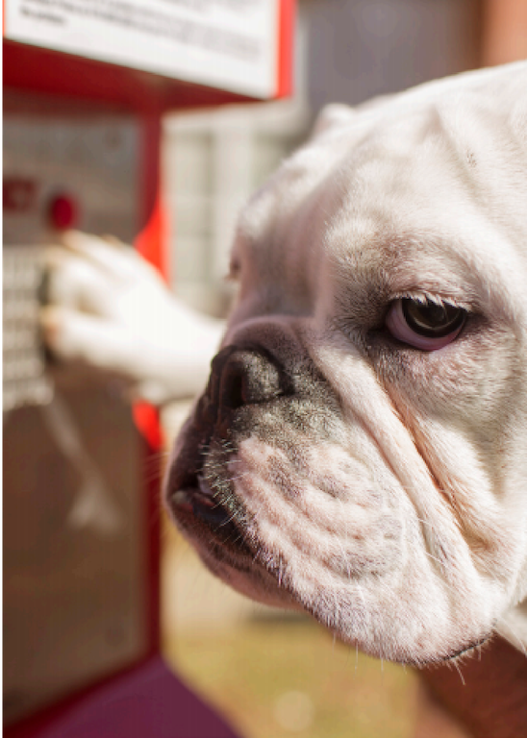
JERRY CARES
Just like any family, university families face tough issues together. We share in the responsibility of working together to ensure that we have a safe and supportive learning and working environment, free from sexual misconduct, hazing, alcohol and drug abuse, and any other negative behaviors that are counterproductive to the environment needed for us all to feel valued and respected. The Jerry Cares program offers resources to equip and empower students with the tools, training, and resources to take necessary action.
VISIT THE FOLLOWING LINK FOR MORE INFORMATION
Jerry Cares

Slide 3
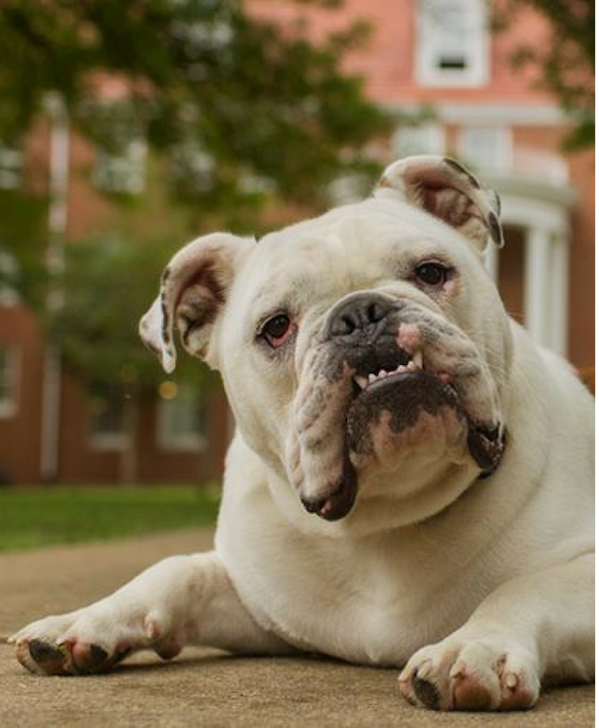
CARE Team
The CARE Team serves the university community by assessing and responding to all reports of threatening, disruptive, or concerning behaviors.
TO SUBMIT A REPORT
Call or email Amy Pennington, AVP/Dean of Students and CARE Team Chair, at (479)968-0407 or apennington@atu.edu
Call or email any member of the CARE Team (complete list available at www.atu.edu/careteam)
Submit a CARE Team Referral

Slide 4
THE GREEN & GOLD CUPBOARD
The Green and Gold Cupboard exists to fight hunger right here at home by providing healthy, nutritious food to all members of the Tech community, including students, faculty, and staff.
The GGC is open to anyone with a valid Tech ID, including all current faculty, staff, and students at ATU and the ATU Ozark campus. We welcome requests for food and donations any time during our regular open hours.
Current Pantry Hours
GREEN AND GOLD CUPBOARD | 1019 N. ARKANSAS AVE. | GGC@ATU.EDU

Slide 5
DIVERSITY AND INCLUSION
The Department of Diversity and Inclusion (DDI) focuses on enhancing and supporting the experiences of students within underrepresented populations and marginalized groups. DDI is the primary support to several registered student organizations and presents training, workshops, and cultural celebration events designed to support the success of underserved students and strengthen the cultural competency of the campus community.
DIVERSITY AND INCLUSION | (479)880-4372 | DIVERSITY@ATU.EDU

Slide 6
VETERAN SERVICES
Whether you're a veteran, a dependent, or currently serving, the Office of Veteran Services is here for you. Come in for assistance with benefits, questions and concerns, or even just to utilize the Veteran's Lounge. We are here to guide you through your journey of higher education.
VISIT THE FOLLOWING LINKS TO LEARN MORE
Apply for VA Benefits
Tuition
Assistance
Student
Organizations
VETERAN SERVICES | DOC BRYAN 104 | (479)968-0445 | WWW.ATU.EDU/VETERANS/

Slide 7
DISABILITY SERVICES
We value disability as an aspect of diversity and are committed to moving our campus towards an equitable and inclusive environment for all students. If you have questions about our department, or have a need for academic or on-campus housing accommodations, please contact any member of our staff at (479) 968-0302 or stop by and visit with us in the Doc Bryan Student Services Center, Suite 141.
Apply for Disability Services
DISABILITY SERVICES | DOC BRYAN 141 | (479)968-0302

Slide 8
ATU CAREER SERVICES
ELEVATE: The Online Career Advancement Academy
HIGHLIGHTS
A self-paced online professional development program
Graduate students must have earned six credit hours with a 3.0 GPA to enroll
Students have a maximum of 10 semesters to complete six milestones at their own pace
MILESTONES (may be completed in any order)
M1: Self Assessment
M2: Career Action Plan
M3: Resume & Cover Letter
M4: Practice Interview
M5: Attend Two Career Fairs
M6: Industry Experience Hours (i.e. job shadow, internship)
HANDSHAKE:
HIGHLIGHTS
One platform for professional development AND job search needs
Search and apply for on-campus/part-time jobs, full-time jobs, internships, and sign up for interviews
Customize your profile, upload resumes, become visible to employers, and research professional & career resources
WHY HANDSHAKE?
Explore 700K+ active jobs and internships
300K+ employers with opportunities in full-time, on-campus/part-time, startups, non-profits, & Fortune 500 companies
Access employers from all 50 states and 165 countries
APPLY FOR ELEVATE CAREER
ADVANCEMENT ACADEMY
LEARN MORE ABOUT
CAREER SERVICES
DOWNLOAD THE MOBILE
HANDSHAKE APP
ATU Career Services At a Glance
ATU CAREER SERVICES | DOC BRYAN 153 | (479)968-0278 | CAREERSERVICES@ATU.EDU

Slide 9
ROSS PENDERGRAFT LIBRARY AND TECHNOLOGY CENTER
Take advantage of the wide variety of programs and services available to you through the Ross Pendergraft Library and Technology Center as you prepare for your research projects, thesis, or dissertation.
TO LEARN MORE, CLICK THE LINKS BELOW
ProQuest® RefWorks
A – Z
Journals
A – Z
Databases
Find It…

Slide 10
OFFICE OF SPONSORED PROGRAMS & UNIVERSITY INITIATIVES
The Office of Sponsored Programs and University Initiatives (SPUI) supports Arkansas Tech University faculty and staff in securing external funding for research and collaboration projects. OSPUI aims to offer expertise in grant administration and provide a clear avenue for the submission process. Office responsibilities include:
Assist in securing external funding
Assist in grant budget development
Review and approve proposals
Provide technical support for electronic submissions
Maintain IRB and IACUC protocols
Coordinate the Interdisciplinary Research Program
Connect ATU faculty and staff with university and community partners
Develop policies and procedures to ensure agency compliance
Provide grant writing training and professional development
Locate and provide upcoming project opportunities
TO LEARN MORE, CLICK THE LINKS BELOW
SPUI
Website
GrantForward.com
OFFICE OF SPONSORED PROGRAMS & UNIVERSITY INITIATIVES | ADMIN. BLDG. 207 | (479)880-4329

