Slide 1
GROWTH
OPPORTUNITIES

Slide 2
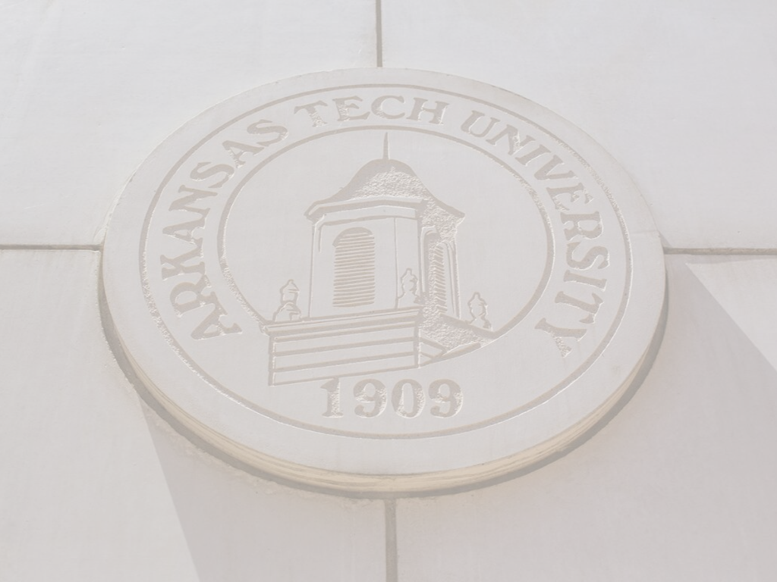
GRADUATE STUDENT COUNCIL
BENEFITS:
Develop leadership capacity and gain transferrable, administrative skills as you advocate for and collaborate with peers from various disciplines
Increase your academic and professional network
Affect positive change for your peers in graduate programs at ATU
REQUIREMENTS AND ELIGIBILITY:
3.0 minimum GPA (cumulative) and good standing with the University
Excellent work ethic and desire to grow in leadership ability
RESPONSIBILITIES:
Serve on the council for the entire academic year (fall and spring semesters)
Regular attendance at GSC meetings and participation in GSC events
Prompt response to GSC communications
Significant contribution to efforts made in advancing the position of graduate students and enhancing the graduate experience for all students
For more information: Contact Lindelle Fraser, Coordinator of Graduate Student Support Services, at lfraser@atu.edu

Slide 3
GRADUATE STUDENT COUNCIL EVENTS
Each semester, the Graduate Student Council provides enrichment opportunities that promote networking, academic enrichment, and career advancement.
Examples of events include:
Donuts with the Dean
APA Writing Workshop
Doctoral Discussion Panel
Research Tools Workshop
And More!
CLICK THE LINK BELOW TO VIEW THE CURRENT CALENDAR OF EVENTS
2019 – 2020
Events Calendar

Slide 4
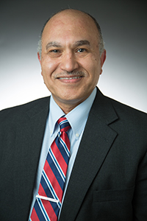
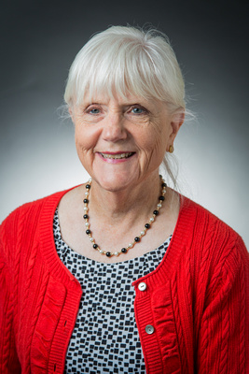
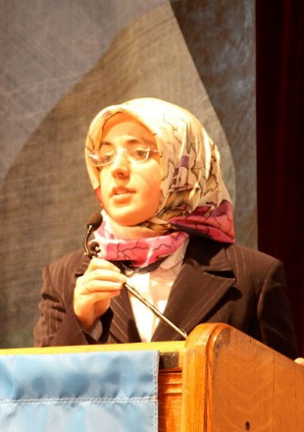
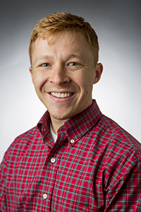
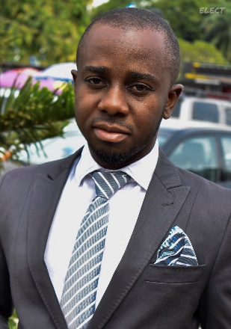
INTERDISCIPLINARY RESEARCH SERIES
Each semester, the Interdisciplinary Research Series invites faculty from a variety of fields to present their current research. The presentations are free and open to students, faculty, and staff.
FOR MORE INFORMATION, CLICK THE LINKS BELOW
Upcoming
Presentations
Past
Presentations
Presentation
Videos
FOLLOW ALL IRS EVENTS ON TWITTER @ATUResearch, #ATUResearch | EMAIL AT atuirs@atu.edu

Slide 5
ON TRACK: GRADUATE SCHOLAR
Graduate students, who complete the Graduate Scholar track and three other tracks of their choosing, become eligible to apply for payment of their graduate hood prior to their graduation. Tracks can be completed at any time while enrolled as a graduate student.
TO LEARN MORE ABOUT ON TRACK AND GRADUATE SCHOLAR, CLICK THE LINKS BELOW
On Track
Program
Current Graduate Scholar Events
CAMPUS LIFE | DOC BRYAN 233 | (479)968-0276 | CAMPUSLIFE@ATU.EDU

Slide 6
GRADUATE STUDENT SYMPOSIUM
GRADUATE STUDENT SYMPOSIUM
The graduate student symposium provides graduate students with an opportunity to practice presentation skills on research, assessment, or work related to their time spent as a graduate student. Currently, students may compete in one of four categories: 3-Minute Thesis, Poster Session, 15-Minute Presentation, and Online (available to online only students). Cash and scholarship prizes are available to the top three winners in each category.
TO LEARN MORE, PLEASE VISIT THE FOLLOWING LINK:
Graduate Student Symposium

