Slide 1

Stroupe Building
&
Roush Hall

Slide 2

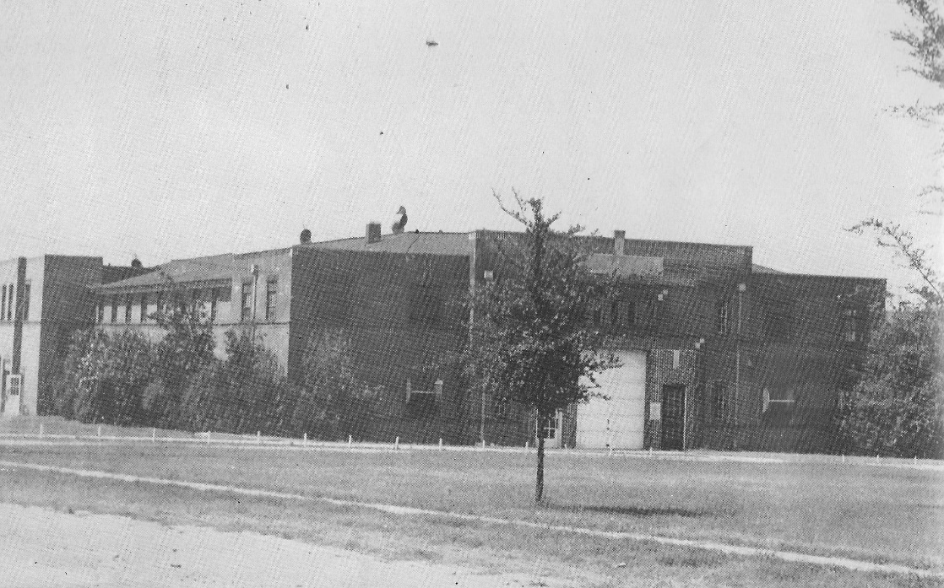
Stroupe Building
Construction completed in the winter of 1925-1926; funding totaled $30,000
Dedicated in August 1926 as a dual-purpose facility: to house two National Guard units and provide an indoor area for basketball & PE
Named for Henry Stroupe who served on the Board of Trustees 1911 - 1933
Stroupe Building circa 1946

Slide 3
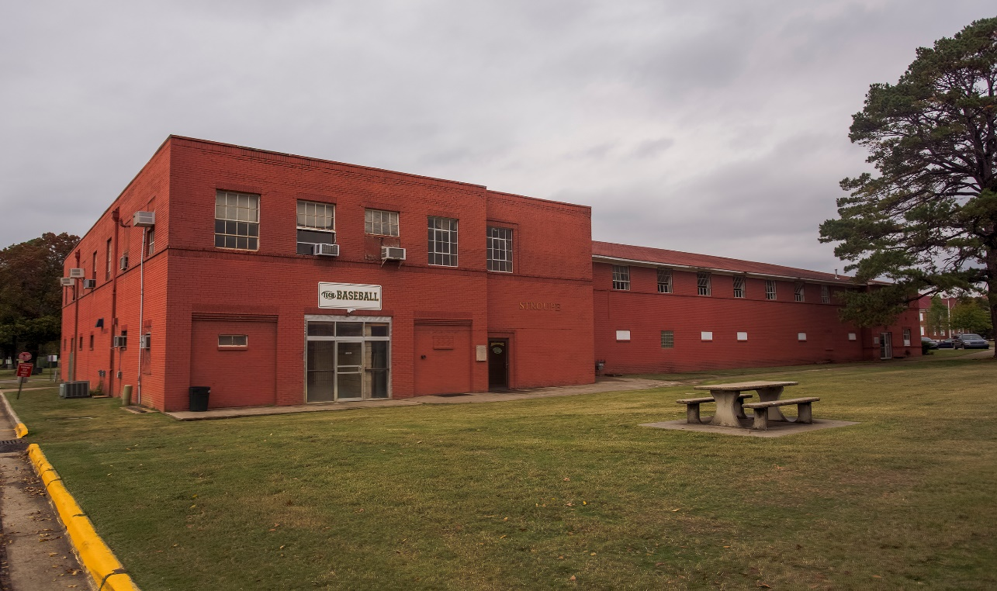
Stroupe Building
Former home of Arkansas Tech Baseball program
Replaced by Multi-Sport Complex in February 2018
Demolition in March 2018
Stroupe Building
Notes:
*Enrollment breakdown on Rsvl campus: 8,819 undergraduate and 1,049 graduate.
**Stackable degrees: certificates of proficiency, technical certificates, associate degrees, bachelor degrees, master degrees, and doctoral degree.

Slide 4
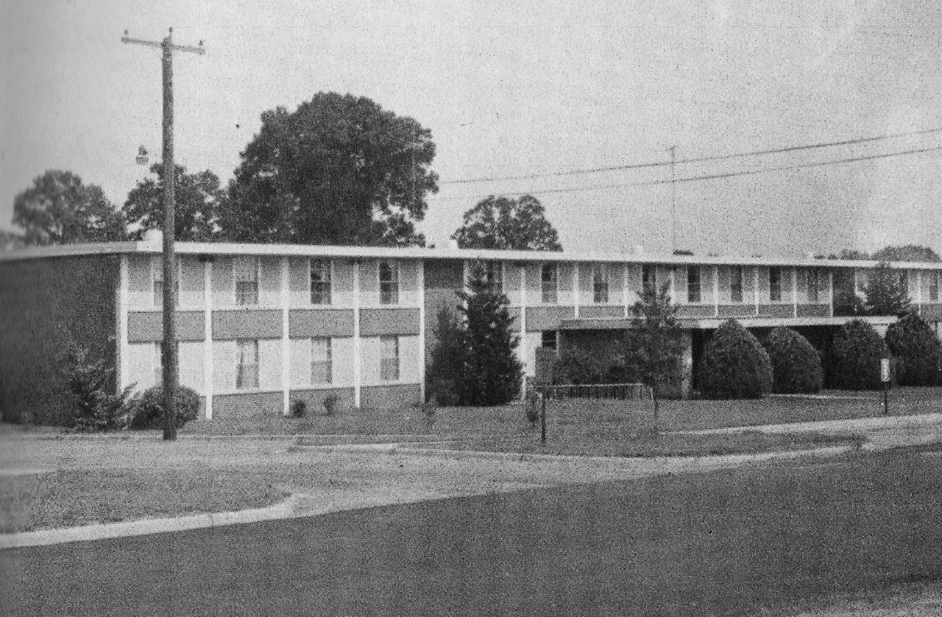
Roush Hall
Built as a women’s dormitory; completed late summer of 1963 at a cost of $335,692
Dedicated at Homecoming 1963
Named for Myrtle Roush who was the first full-time librarian to be put in charge of the library
Roush Hall circa 1980

Slide 5
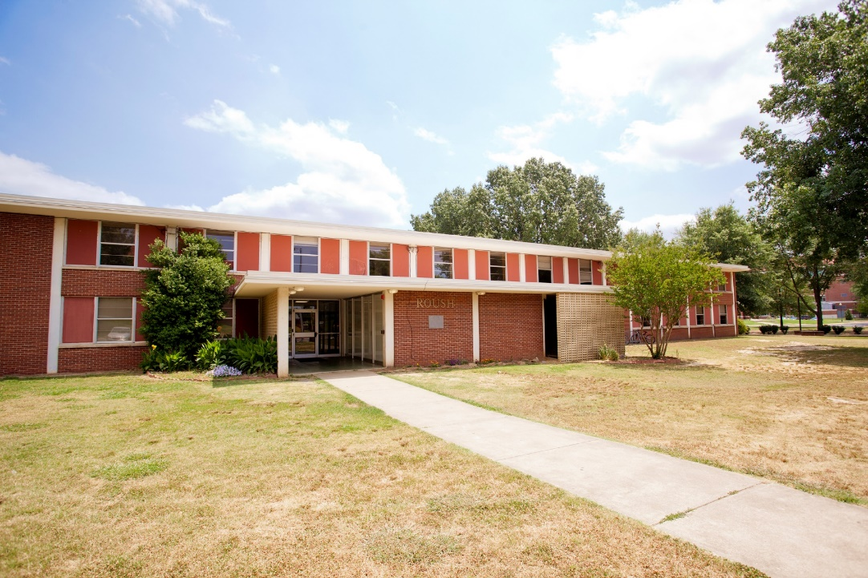
Roush Hall
Men’s residence hall in later years
Reached the end of its useful life in August 2016; vacant for eighteen months
Demolition in March 2018
Roush Hall
Notes:
*Enrollment breakdown on Rsvl campus: 8,819 undergraduate and 1,049 graduate.
**Stackable degrees: certificates of proficiency, technical certificates, associate degrees, bachelor degrees, master degrees, and doctoral degree.

Slide 6
Demolition
Demolition of Stroupe Building and Roush Hall in process
Contractor: Bowden Specialties
Cost of demolition:
  Stroupe Building $165,454
  Roush Hall $167,460

Slide 7
Demolition
  Timeline:
  Temporary fencing installed March 1
    Closing part of Fargo Street west of Stroupe, one-half of the south parking lot at Stroupe, and parking spaces north of Stroupe
  Interior demolition began in both buildings on March 2
  Fiber hub in Stroupe relocated to the ground vault in the northeast corner of the Stroupe lot
  Asbestos abatement began the week of March 5-9
    Stroupe: abatement expected to take two days
    Roush: abatement began after completion at Stroupe; expected to take fourteen days

Slide 8
Demolition
  Timeline, continued:
  Water to be shut off March 16, the day before Spring Break begins in order to disconnect Stroupe and Roush
    Shut off at 1 p.m.; work anticipated to take no longer than 3.5 hours
    Twelve buildings affected: Administration, Crabaugh, Wilson, Williamson, Critz, Hughes, M Street, Caraway, Tomlinson, Browning, Public Safety, Techionery/Museum
    Pre-shutdown work will begin on Wednesday, March 14. The chance of a water line rupture exists and would out of necessity accelerate the shut off
  Exterior demolition to begin March 17
  Expected completion of demolition:
    Stroupe: April 8
    Roush: May 6

Slide 9
Historic Preservation
To celebrate and preserve the history of our buildings:
  Dedication plaques have been removed; the smaller dedication plaques are housed in the Tech Museum while the large “National Guard Armory 1926” concrete building marker that was in the north wall of Stroupe is in storage until a suitable re-use is determined.

Slide 10
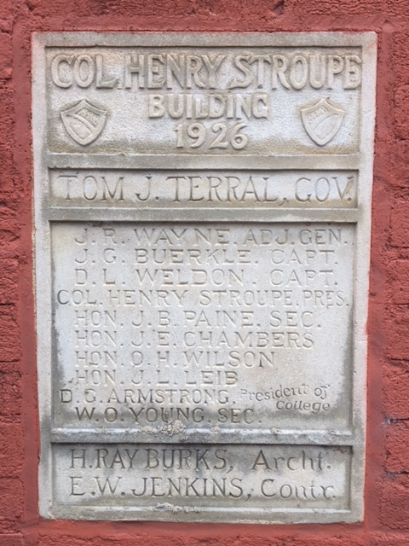
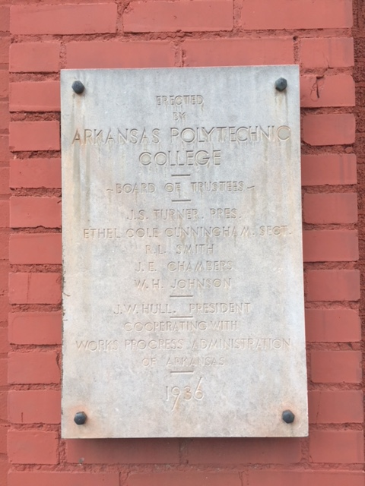
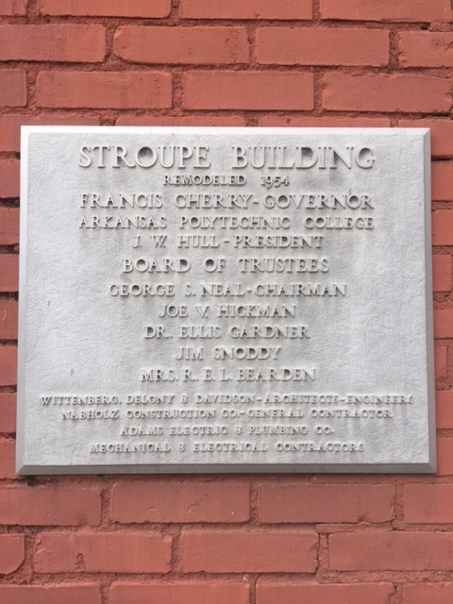
Historic Preservation
Stroupe plaques
Remodeled 1934
1926 Plaque
1936 Plaque

Slide 11
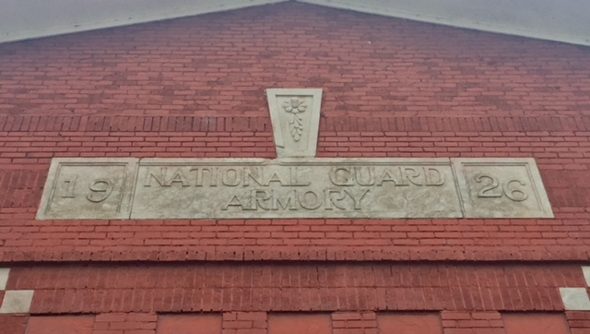
Historic Preservation
Feature under the eaves of the north wall of Stroupe

Slide 12
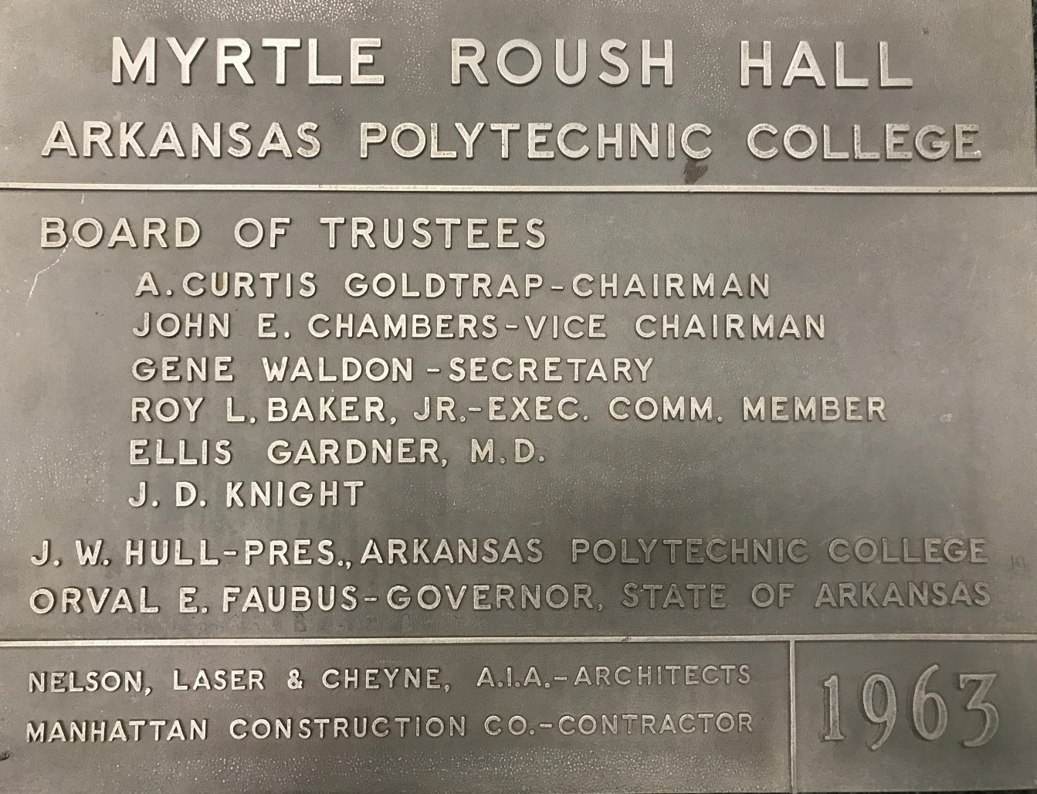
Historic Preservation

Slide 13
Historic Preservation
To celebrate and preserve the history of our buildings:
  The Community and Campus Heritage Task Force established during the Master Plan process recommends that a historical marker program be initiated on the Arkansas Tech campus.
    The Task Force has researched such programs and has identified a grant opportunity through the Arkansas Department of Heritage for historical markers. Grants provide one-half of the cost of each marker, which is currently $2,000.

Slide 14
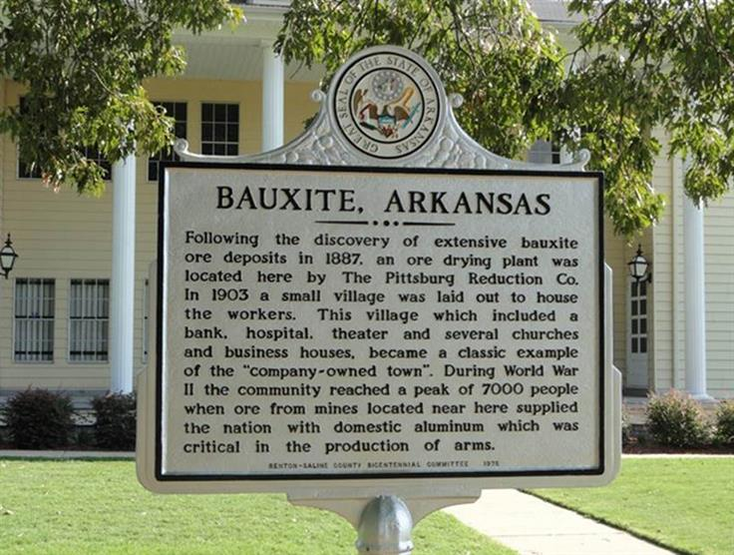
Historic Preservation
Historical marker example

Slide 15
Rebirth
Plans are in place for the areas once occupied by Stroupe Building and Roush Hall:
  Stroupe: plans call for the addition of parking
    Initially to be a graveled parking lot
    Eases a need identified in the Master Plan for parking to service the adjacent residence halls, Multi-Sport Complex and events
  Roush: plans from the Department of Residence Life call for a student recreation area with a sand volleyball court, picnic tables, and a grove for hammocks
    Scheduled to be available for student use by the beginning of the fall semester 2018

Slide 16
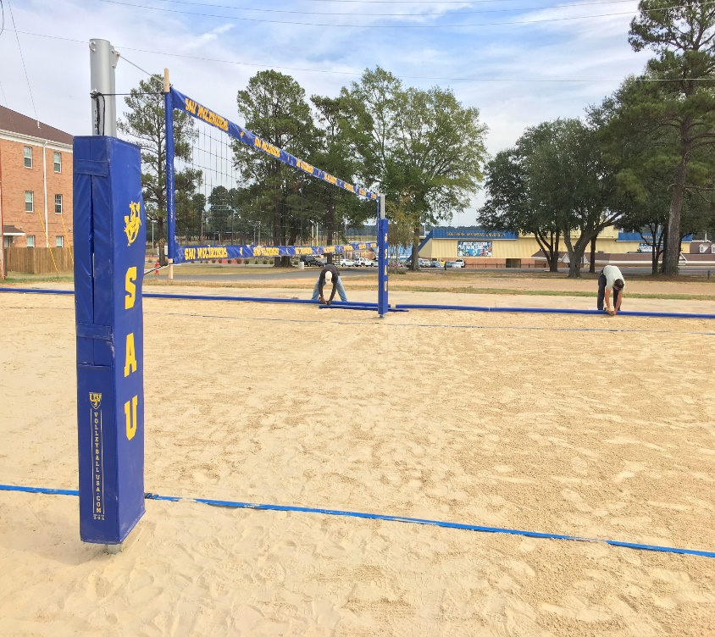
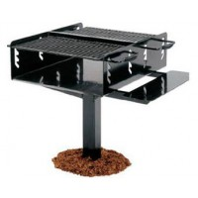
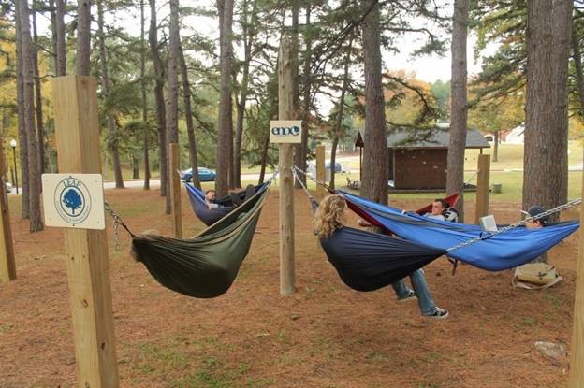
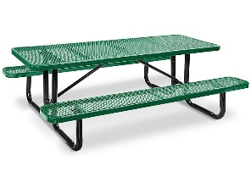

Examples of ideas for the area
Hammock grove
Grill and picnic tables
Sand volleyball court

Slide 17
Demolition Photos

Slide 18
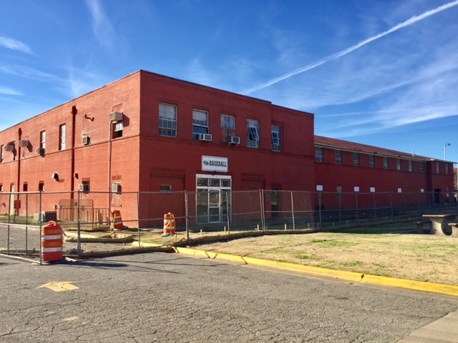
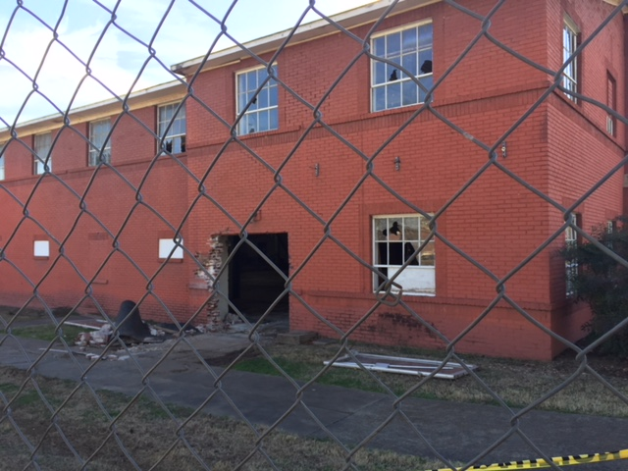
Stroupe – March 5, 2018

Slide 19
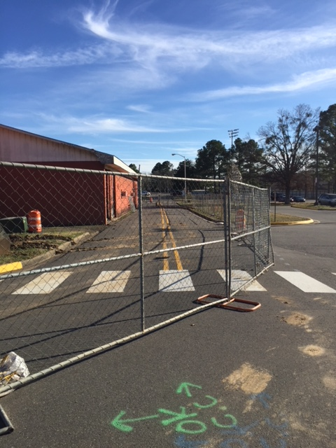
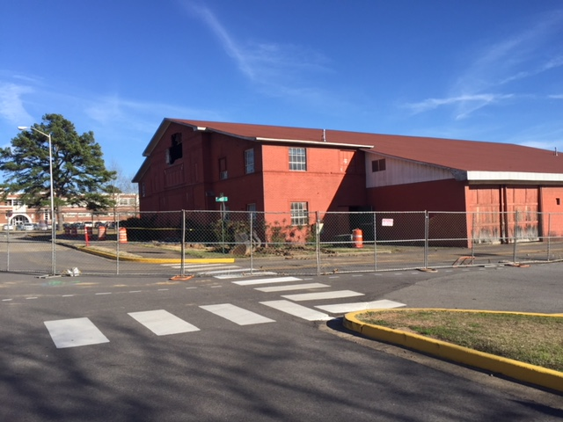
Stroupe – March 5, 2018
Portion of Fargo Ave; traffic routed through parking lot

Slide 20
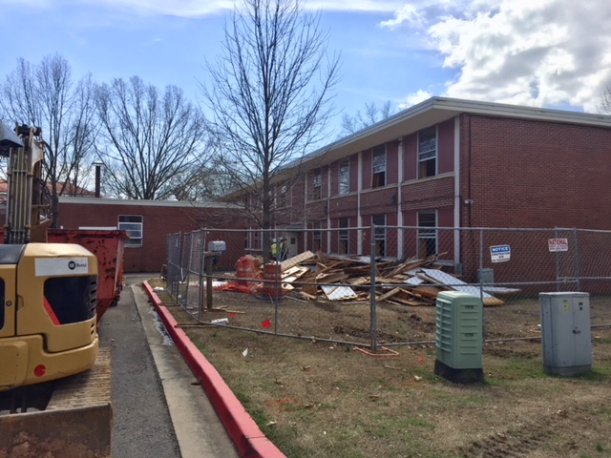
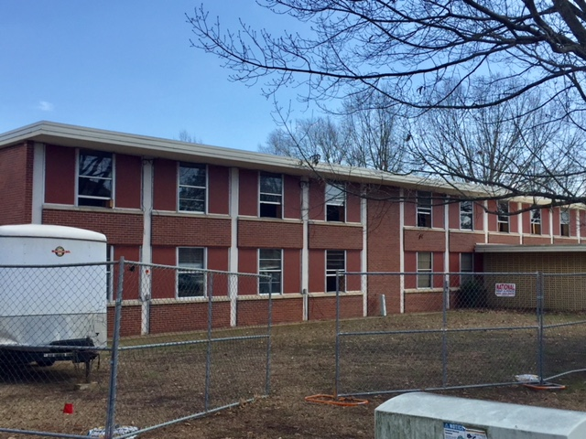
Roush – March 5, 2018

Slide 21
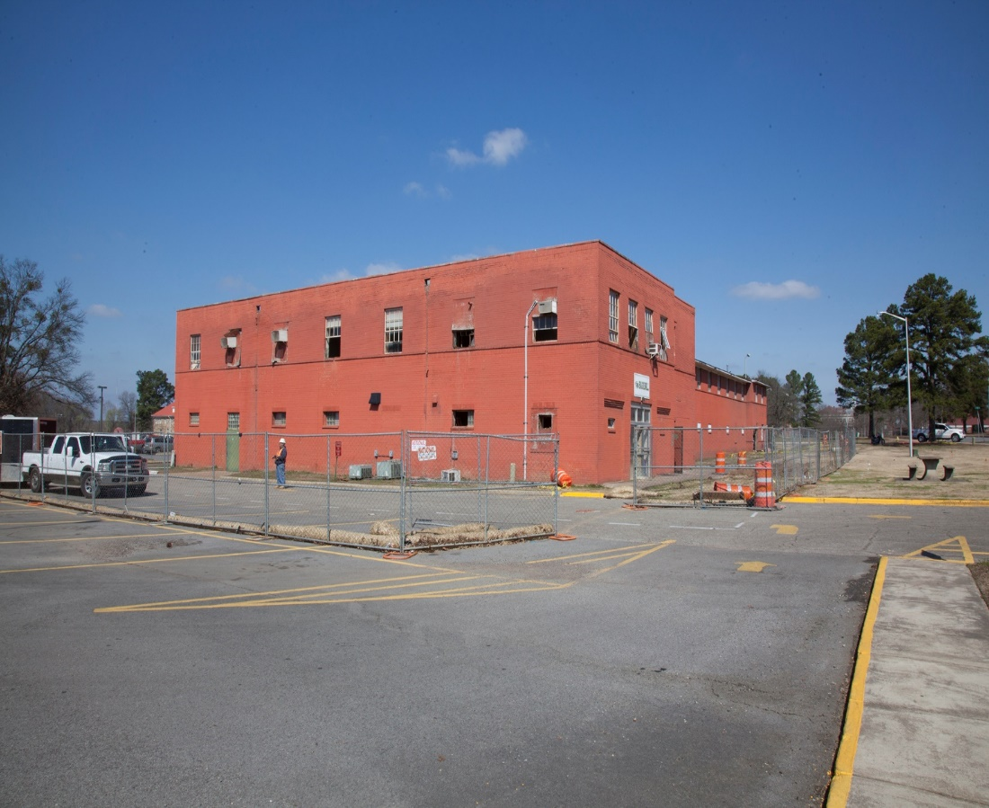
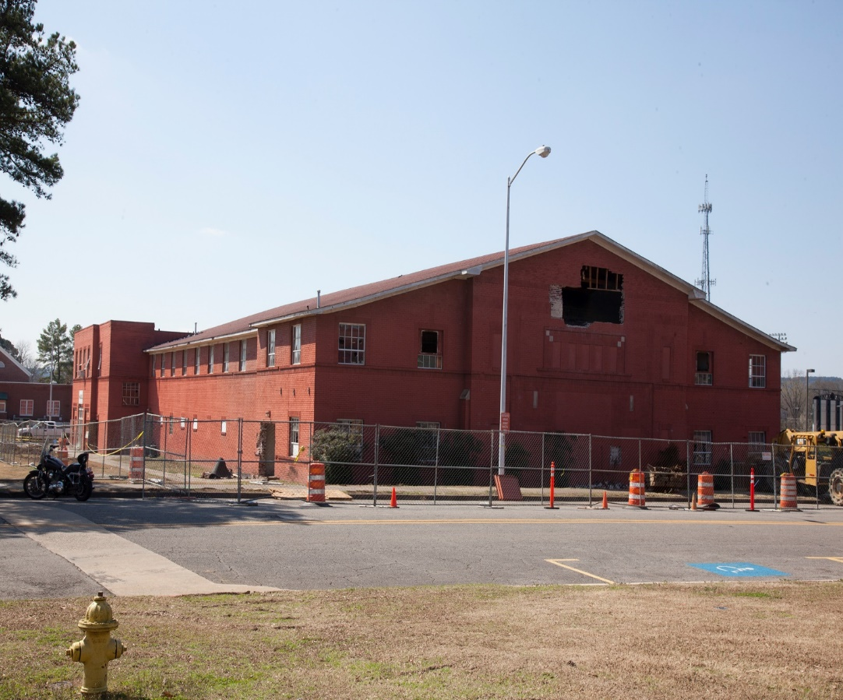
Stroupe – March 12, 2018

Slide 22
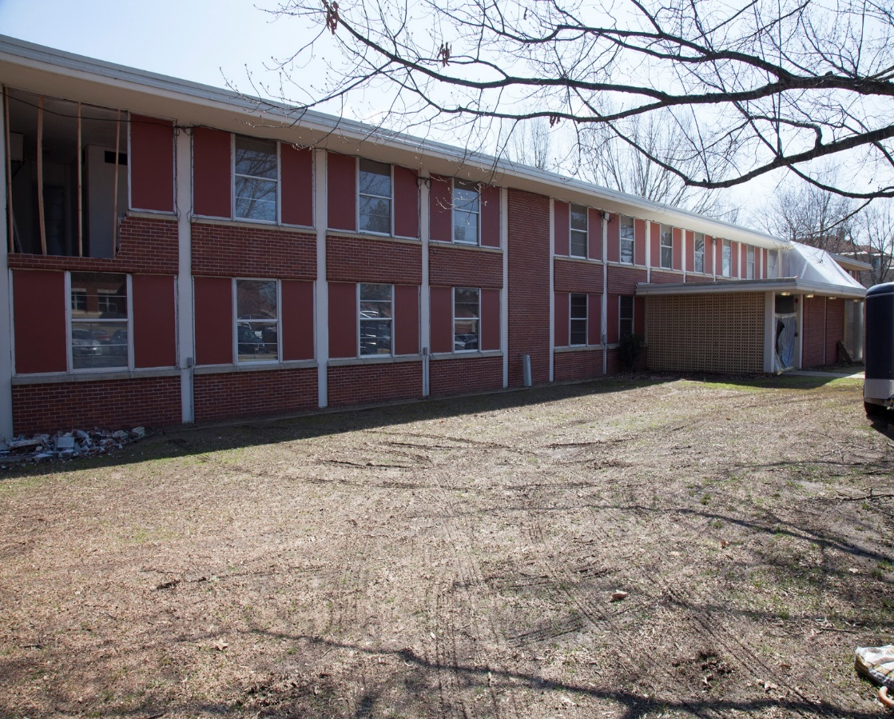
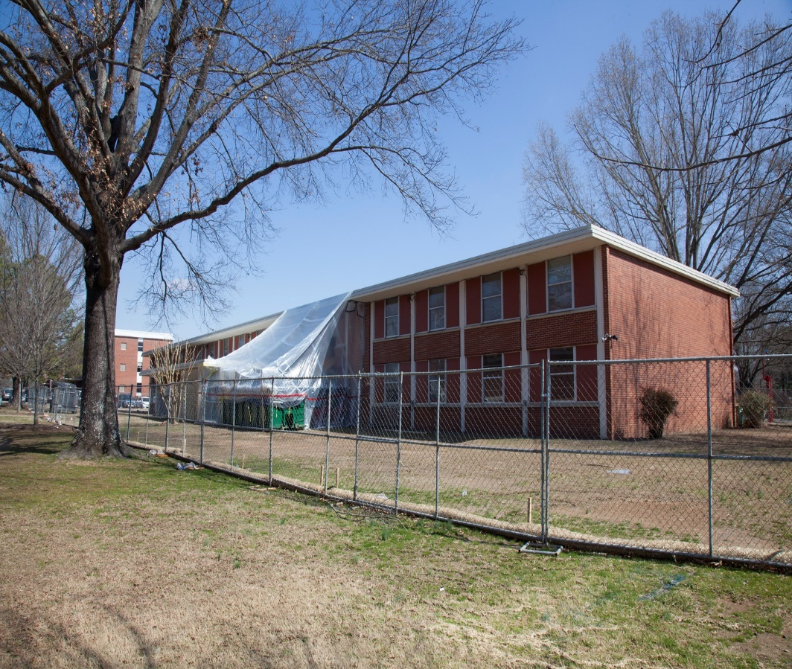
Roush – March 12, 2018

Slide 23
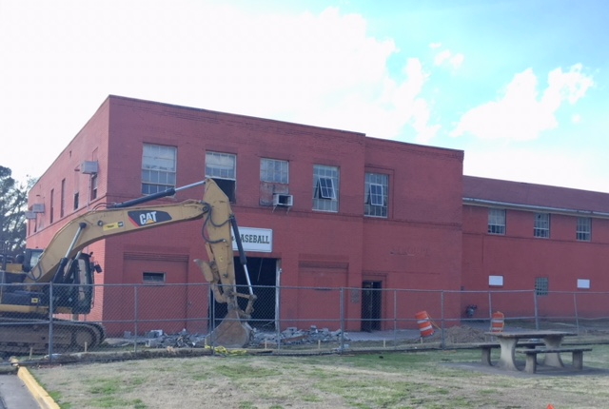
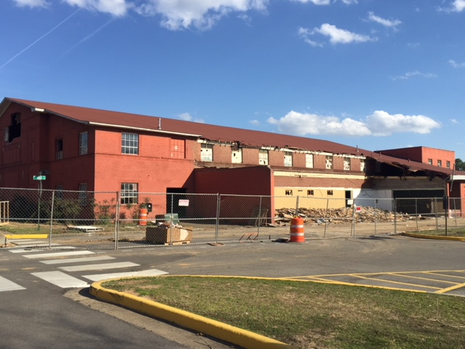
Stroupe – March 16, 2018

Slide 24
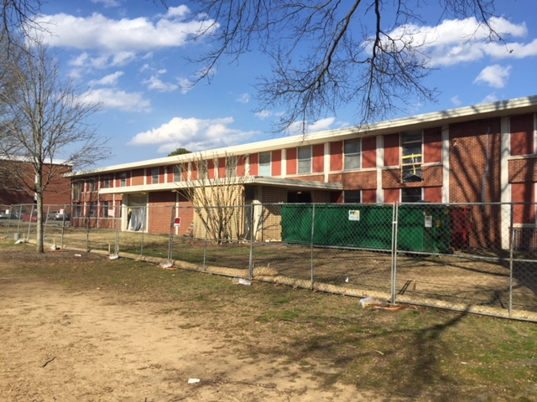
Roush – March 16, 2018

Slide 25
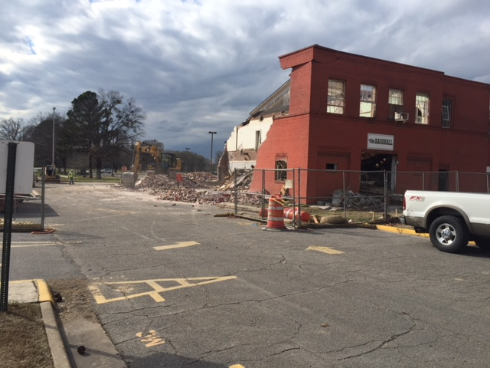
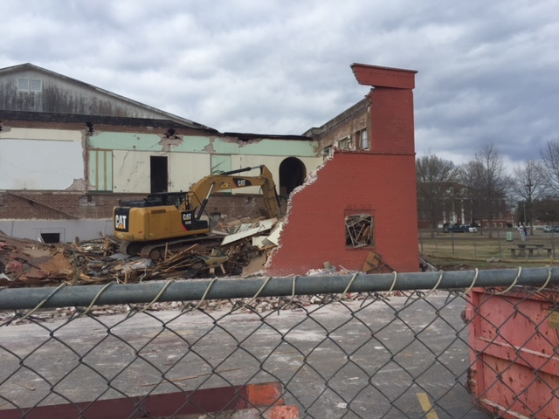
Stroupe – March 19, 2018

Slide 26
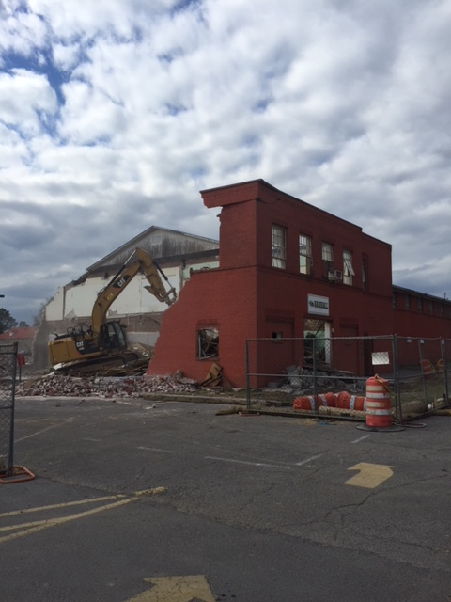
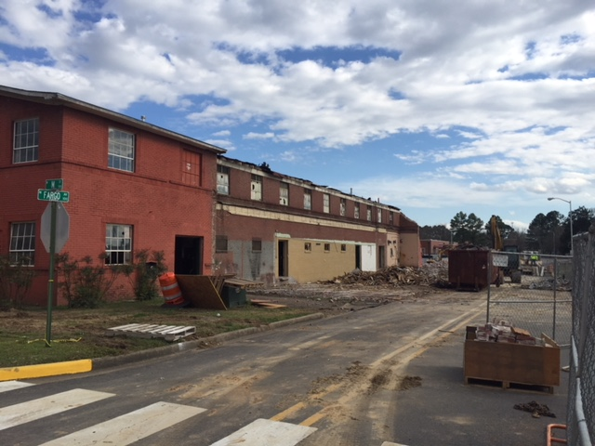
Stroupe – March 19, 2018

Slide 27
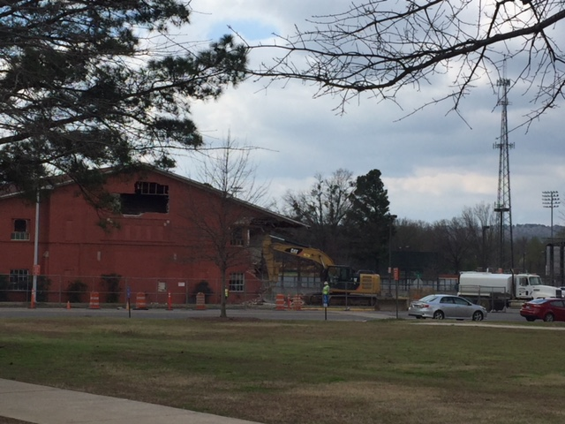
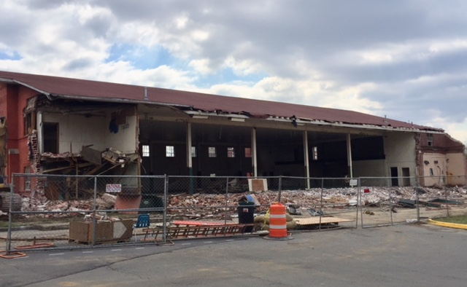
Stroupe – a.m. March 20, 2018

Slide 28
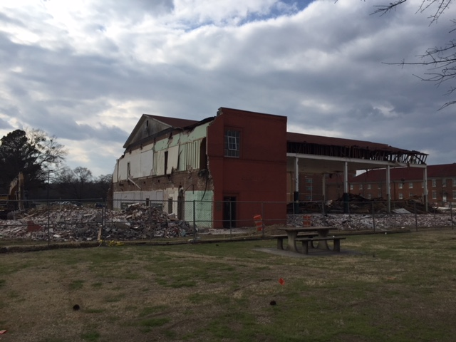
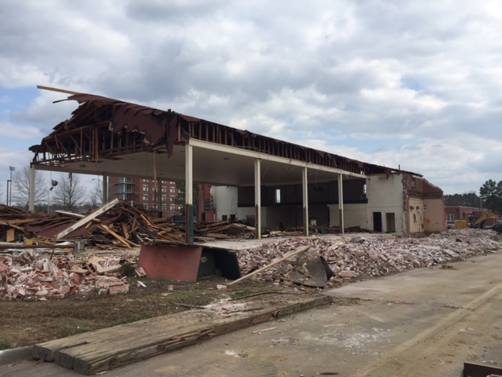
Stroupe – p.m. March 20, 2018

Slide 29
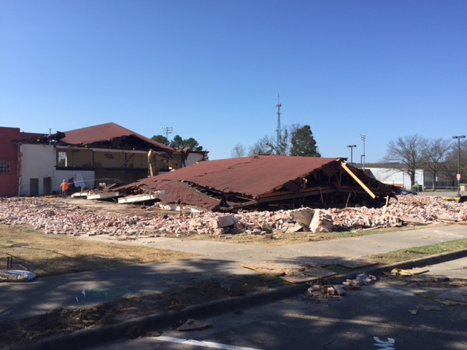
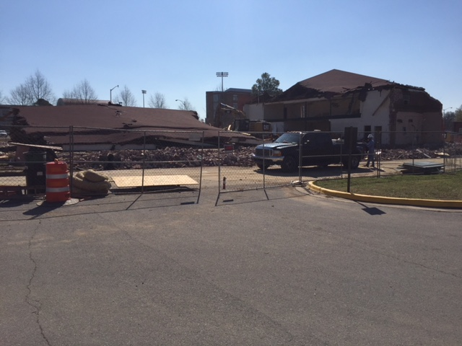
Stroupe – March 21, 2018

Slide 30
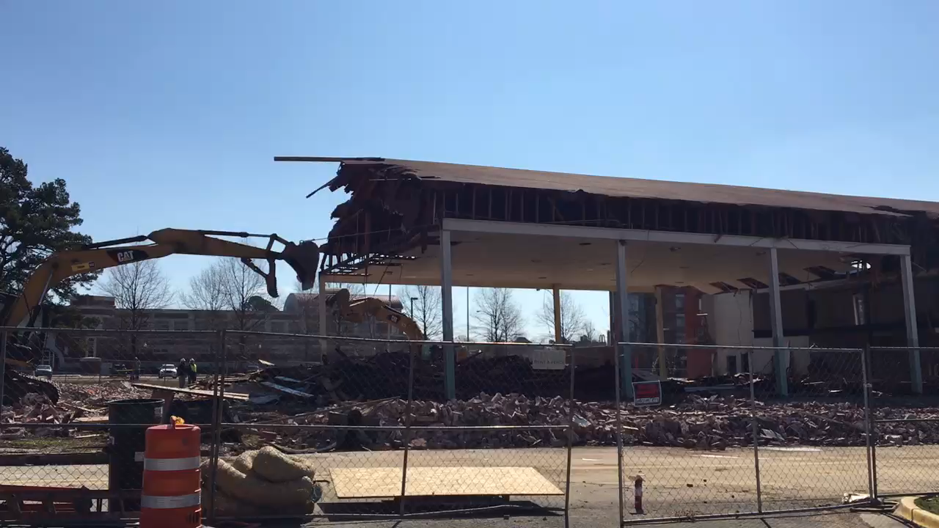
Stroupe – March 21, 2018 (video)

Slide 31
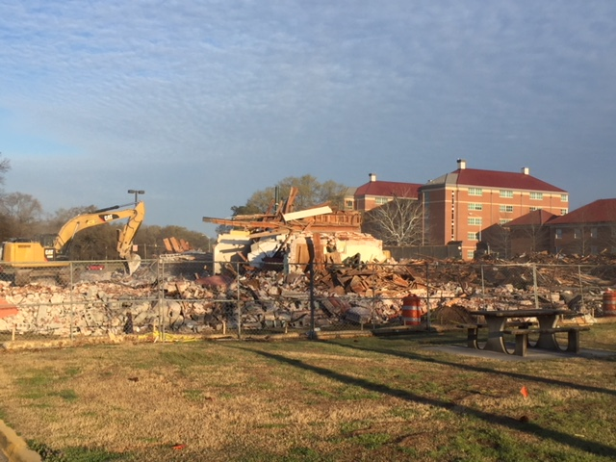
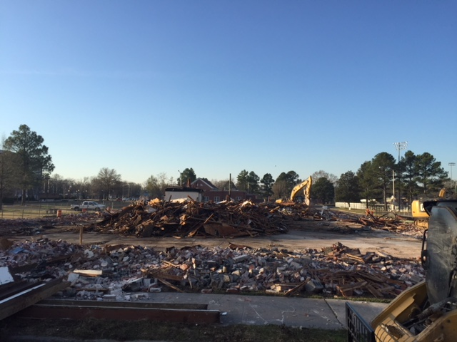
Stroupe – March 22, 2018

Slide 32
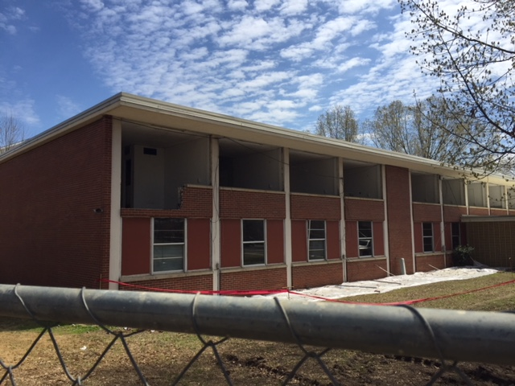
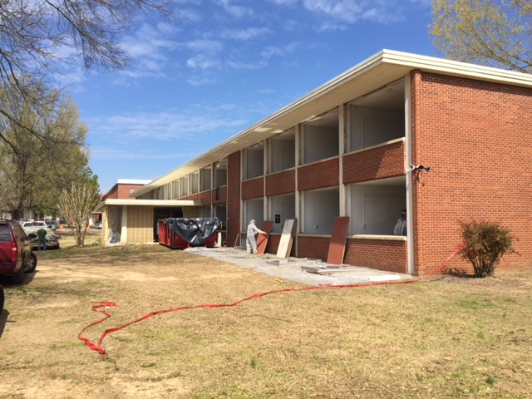
Roush – March 22, 2018

Slide 33
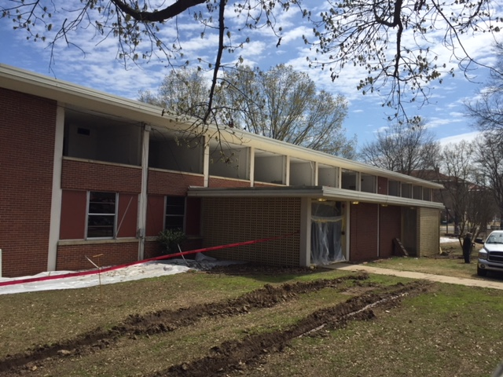
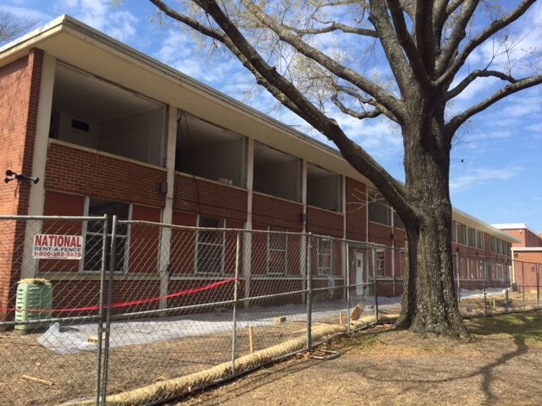
Roush – March 22, 2018

Slide 34
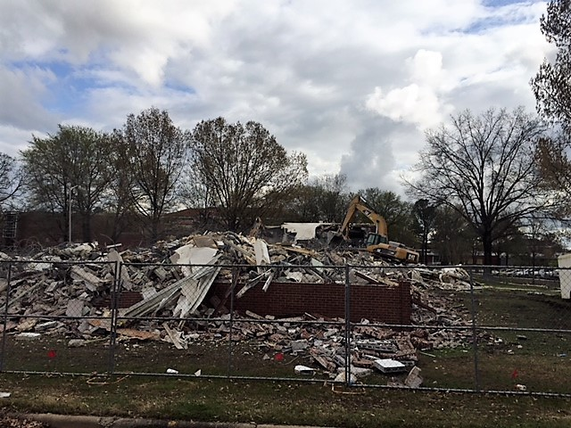
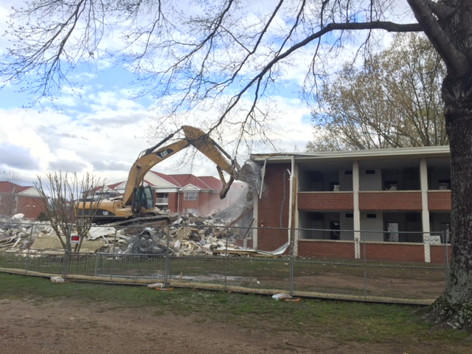
Roush – March 29, 2018

Slide 35
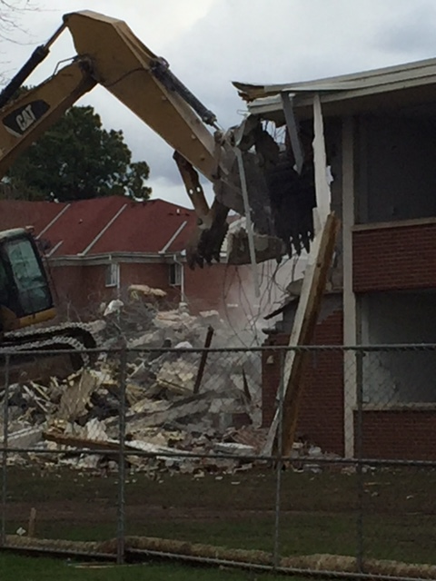
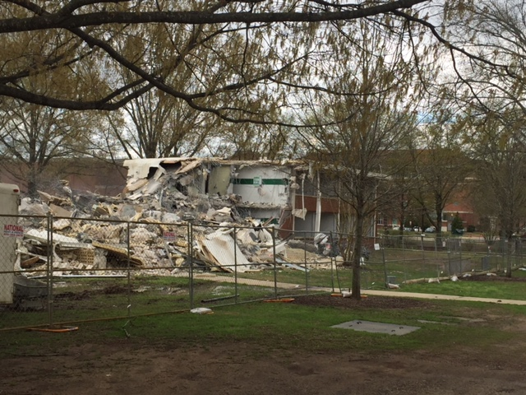
Roush – March 29, 2018

Slide 36
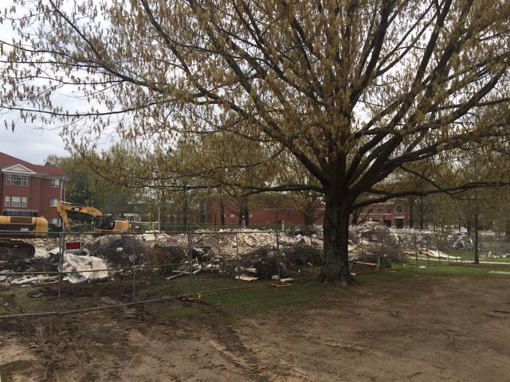
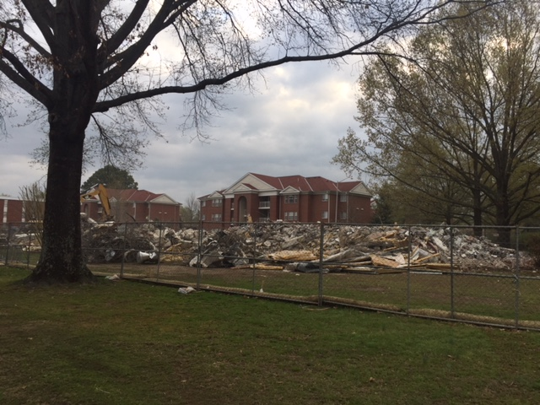
Roush – April 3, 2018

Slide 37


April 4, 2018
Stroupe
Roush

Slide 38


June 7, 2018
Stroupe Parking Lot
Roush Student Recreation Area – In Progress

