Slide 1
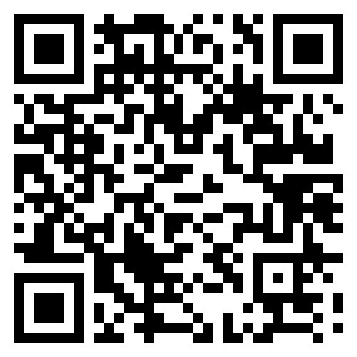
Arkansas Junior Science and Humanities Symposium
Save the Date! Feb, 21-22 2025
What is the Arkansas Junior Science and Humanities Symposium?
The Arkansas Junior Science and Humanities Symposium (AJSHS) is a STEM research competition that serves as the regional qualifier for the National JSHS symposium.
JSHS promotes original research and experimentation in the sciences, technology, engineering, and mathematics (STEM) at the high school level through competition at regional and national levels.
Who can compete?
U.S. Citizens and Lawful Permanent Residents
Arkansas students in 9th–12th (public, private, or homeschool)
8th grade and 9-11th grade students who are interested in competing may attend as observers for one year
When and where?
The 2025 AJSH will be held on the Arkansas Tech University Russellville campus on February 21st -22nd.
Students are required to attend all activities (unless permitted by the director)
Papers for the oral presentation competition are due January 22nd
The registration deadline for observers and poster presenters is February 14th.
Awards
Scholarships and cash prizes
All expense paid trip to Nationals for oral presenters
How much?
Registration for AJSHS is FREE
Meals and housing during the event are paid for by AJSHS (students and chaperones are housed in a local hotel Friday night)
More information
Contact Dr. Jessica Young at jyoung35@atu.edu
For Information and registration, visit www.atu.edu/jshs
Interested in attending but don’t have research to present this year?
Students are invited to attend as observers for one year!
Sponsored by the DoD and the Departments of the U.S. Army, Navy, and Airforce

