Slide 1
Session 5
Policies and handbook review

Slide 2
Jerry cares
As a student, faculty, or staff member at Arkansas Tech, you’re part of something big. You’re part of a family - a strong family, sharing life together.
These relationships make Tech a special place.
Just like any family, university families face tough issues together.
We share in the responsibility of working together to ensure that we have a safe and supportive environment.
Ignoring or pretending problems don’t exist is not the answer. We need to get involved. We need to speak up.
This session isn’t designed to scare you. It is designed to equip you with tools, training, and resources necessary to take action. The Jerry Cares campaign is all about taking care of your family, watching their backs, helping you be successful, and keeping our campus safe!
We support. We inspire. We act. Together We Fight On!

Slide 3
Student handbook

Slide 4
The 2017-18 Student Handbook is located online at http://www.atu.edu/studenthandbook
It is your responsibility to make time, read, understand, and follow all of the rules, regulations, and policies that shape the structure of our campus community.

Slide 5
Important info Welcome
The Student Handbook contains lots of good information, like…
A complete list of campus departments with a description of services provided
Important safety, security, and traffic information
The Student Code of Conduct, which outlines rules and regulations as well as the campus disciplinary process
An overview of campus facilities available to students, including policies such as the tobacco-free, bike/skates/skateboard, hoverboard, pet, and publicity policies
An On-Campus Living section containing important information for students who live in residence halls
All of the details related to how the 100+ Registered Student Organizations operate
And much, much more! REALLY, consider reading it!
Dr. Bowen, Tech President, and Matthew Smith, SGA President

Slide 6
Student code of conduct

Slide 7
Rules and regulations
Each member of the Tech family assumes an obligation to comply with all of the rules and regulations contained in the Student Handbook.
These rules are in place to create an environment that will support the success of all students.
We're going to highlight just a few of the policies in this session…

Slide 8
Key policies to keep in mind
Student ID Cards should be carried at all times for identification purposes as well as for use at University events, Tech Fit, access to your residence hall/some academic buildings, and as a meal card/DCB, etc.
Tobacco products are prohibited on campus, including smoking, using electronic cigarettes/vapor pens (with or without tobacco products), dipping, or chewing tobacco.
Alcohol, including the use, possession, distribution, public intoxication, or being found under the influence of alcohol is prohibited. The parents of students under the age of 21 found responsible for this violation will be notified. The same rules apply for illegal drugs, including the improper use of prescription drugs or medical marijuana.
No alcohol or drugs are allowed on campus!
Weapons are prohibited too. No guns, explosive materials (including fireworks), archery equipment, bullets, knives (with blades larger than 3 inches), sling shots, paintball guns, toy guns, etc. Check out the Student Handbook for a complete list and more information on concealed carry laws.
Other serious policy violations to keep in mind include:
Theft
Sexual harassment
Physical abuse
Threats
Hazing
Cyberbullying
Illegal downloading/file sharing
Sexual misconduct

Slide 9
Important residence hall policies Keep these in mind even if you don’t live on campus!
Escort policy
Visitation policy
All non-residents of a building must be escorted by a resident, even to the restroom. Visitors can’t be wandering around the building alone.
Residence hall guests can visit during the hours of 9:00 am until 11:59 pm, Monday through Thursday and 24 hours from 9:00 a.m. Friday until 11:59 pm on Sunday. Noise and disruption policies are outlined in the Student Handbook.

Slide 10
Sexual misconduct
Key concepts of the sexual misconduct policy

Slide 11
First of all, the entire policy can be found in the Student Handbook so take time to read it.
If you or someone you know is a victim of sexual misconduct, this policy provides you with clear information on:
How to get immediate help (police and medical)
How to get on-going help (campus assistance)
How to report an incident (with police, with campus officials, anonymously)
How incidents are investigated and resolved
Information about the ATU Title IX Coordinator, Jennifer Fleming

Slide 12
Understanding consent
Consent has not been obtained if the person, male or female:

Slide 13
Is under the influence of drugs/alcohol or otherwise incapacitated such as sleeping or unconscious
Is forced or pressured
Changes his or her mind and wants to stop engaging in sexual activity
Feels threatened or coerced
Has said, “no” or “I‘m not sure” or “I don’t know”
Uses non-verbal cues such as a head nod, failure to resist, silence, or any hint of uncertainty
Previous sexual activity with you or another does not grant future consent.
Just remember, affirmative consent, “yes”, must be given each and every time for each and every activity.

Slide 14
Consent has only been obtained if the person says “yes!”

Slide 15
Understanding confidentiality when reporting

Slide 16
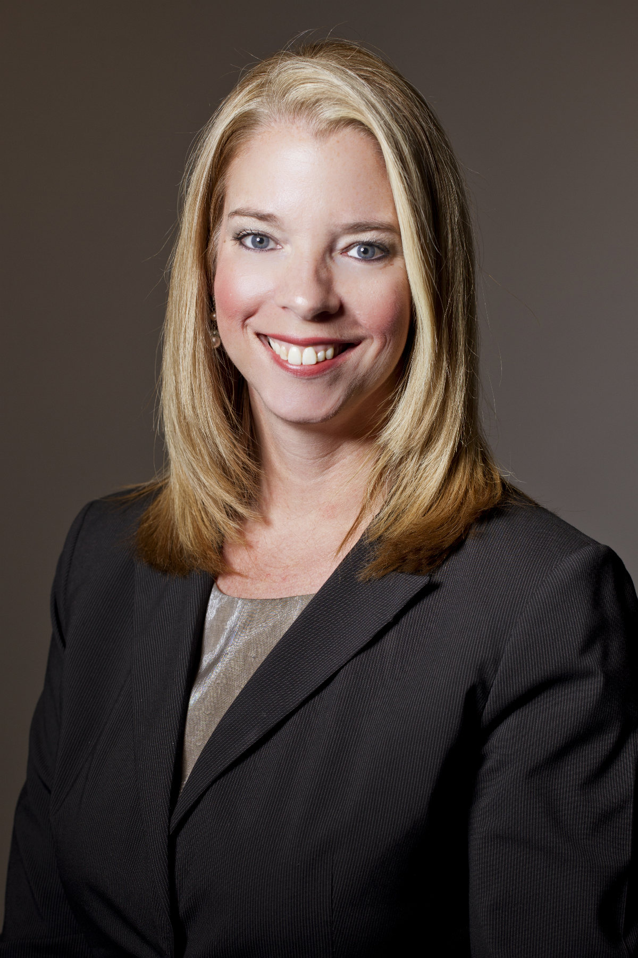
The University encourages victims of sexual misconduct to talk to somebody about what happened so that victims can get the support they need, and so that the University can respond appropriately.
Different employees on campus have different abilities to maintain a victim’s confidentiality.
Some employees are required to maintain near complete confidentiality; talking to them is sometimes called a “privileged communication.”
Professional, licensed counselors who provide mental-health counseling are generally not required to report any information about an incident to the Title IX coordinator without a victim’s permission.
At Arkansas Tech, these employees are the licensed counselors staffed in the Health and Wellness Center:
Kristy Davis Craig Witcher Hunter Bramlitt Janis Taylor

Slide 17
The medical professionals who work in the Health and Wellness Center can generally talk to a victim without revealing any personally identifying information about an incident to the University.
A victim can seek assistance and support from these individuals without triggering a University investigation that could reveal the victim’s identity or that the victim has disclosed the incident.
At Arkansas Tech, these employees are the medical professionals staffed in the Health and Wellness Center:
Becky Gray Heather Stout

Slide 18
Other than those just discussed, most employees are known as RESPONSIBLE EMPLOYEES.
A responsible employee must report to the Title IX coordinator all relevant details about the alleged sexual violence shared by the victim and the University will need to begin an investigation to determine what happened. Resident Directors, Resident Assistants, Area Coordinators, Associate Deans, Dean of Students, President, Vice Presidents, Assistant Vice Presidents, Academic Department Heads, Academic Deans, Athletic Director, Assistant Coaches, Head Coaches, Faculty Advisors for Student Groups, employees in the Department of Public Safety.

Slide 19
reporting

Slide 20
Anyone wishing to make a sexual misconduct complaint should contact:
Jennifer Fleming, Title IX Coordinator, whose office is in Room 212 of the Administration Building.
As the Title IX Coordinator, Ms. Fleming receives and investigates reports of discrimination, including sexual misconduct. Ms. Fleming may be contacted during business hours (8:00 a.m. to 5:00 p.m., Monday through Friday) by phone at (479) 498-6020 and email at jfleming@atu.edu

Slide 21
Bystander intervention
See something, do something

Slide 22
You have a role to play!
Taking action and preventing or interrupting dangerous activity doesn’t have to be hard. But many people won’t. Instead, they think…
I don’t know the whole story. Surely, this isn’t happening.
It’s not my problem.
Someone else will do something.

Slide 23
But, It could be as simple as. . .
“Accidentally” spilling a drink on a person who is attempting to take advantage of another at a party. This can interrupt harmful plans and give the victim an out.
Speaking up and not letting friends leave a party or go to a secluded area with a new acquaintance. Staying in groups is safer.
Inserting yourself into a conversation where another person seems unsafe, creating a distraction. (i.e. You see someone in trouble at a party, maybe you approach and say “Hey, your friend needs help. Come with me.”)
Not being afraid to call police if a situation seems to be escalating, like when someone starts yelling at or hitting another.
Remembering to trust your instincts. If you think something is wrong in a situation, chances are most people around you feel the same way. Take action and speak up. Others will typically follow.

Slide 24
Simple actions can make a big difference, just watch snack man. . .
Video #1 https://www.youtube.com/watch?v=Erlw-ODVZxU
Video #2 https://www.youtube.com/watch?v=b58mzz7mQpg

Slide 25
Bystander 101
NOTICE something is not right
IDENTIFY that someone needs help
DECIDE TO ACT, and develop an intervention strategy
INTERVENE SAFELY, either alone or with others

Slide 26
Did you know that 50 percent of sexual assaults on college campuses involve alcohol consumption by the perpetrator, the victim, or both?

Slide 27
Alcohol & Other drug abuse prevention
This is key to your success…
Responsible choices about alcohol is a must.
Even though you may think differently, the facts show that most Arkansas Tech students either don’t use alcohol at all or consume responsibly.
It’s important to know your limits with alcohol and stick to them.
Never drink and drive or ride with someone who has consumed alcohol or used drugs. Don’t let your friends either.
What if you don’t know you’re pregnant and you’re drinking? There is no known safe amount of alcohol consumption during pregnancy. Fetal Alcohol Spectrum Disorders affect 40,000 newborns annually.
Alcohol and drugs are not allowed on the Tech campus.
Students found violating these policies face consequences which can include monetary fines, mandatory alcohol/drug classes, suspension from living in the residence halls, suspension from the University, and/or parental notification for students under the age of 21.

Slide 28
Need help?
If you think you have a substance abuse problem, don’t be afraid to ask for help. The entire Alcohol and Other Drug Prevention policy can be found in the Student Handbook which includes excellent resources on and off campus.
An online screening is available on the Health and Wellness Center website. This might be a good place to start if you’re unsure.

Slide 29
Sinking in yet?

Slide 30
We want you to be safe and successful…and, we’re here to help you!
Just like the online alcohol screening tool, the Health and Wellness Center has many useful resources FREE to students like treatment for minor illness and injury, health history and physical assessments, clinical laboratory procedures, and women’s health services. Another services is pregnancy planning and STI treatment.

Slide 31
I know, this can be a sensitive subject, but…
Did you know that the State of Arkansas has the highest rates of birth in 18-19 year old females in the nation?
Did you know that the topic of unplanned pregnancy is relevant for both men and women, as well as those who are already parents and those who aren’t?
Did you know that unplanned births account for nearly 1 in 10 dropouts among female students and 7% of dropouts among college students overall?

Slide 32
Sex, relationships, and pregnancy are very real in the lives of college students. Check out this video with personal stories from other Arkansas college students…
https://www.youtube.com/watch?v=FaCyQMrSUg8

Slide 33
We hope this video will spark conversation between partners about smart decision making regarding birth control and/or abstinence.
The HWC staff can give you more information about all forms of contraception, planning your next pregnancy if you already have children, what to do if you are pregnant, and how to prevent STIs…So don’t be afraid, embarrassed, or scared to visit and learn more.
Making an appointment is easy. You can go in person to Doc Bryan 119 or schedule online by visiting the HWC website.

Slide 34
Hazing prevention

Slide 35
What is hazing?
Any action or situation created by a member of the university community against another member of the university community that is negligent or reckless in nature, humiliating, degrading, endangers an individual, or unreasonably interferes with scholastic or employment activities.

Slide 36
Examples of hazing
Requiring the consumption of excessive amounts of alcohol or participation in drinking games
Forcing or coercing someone to consume foods, drinks, alcohol, or drugs
Completing tasks in order to obtain signatures
Paddling or striking in any manner
Unreasonable exposure to the weather
Preventing or restricting class or other activity attendance
Blindfolding
Kidnapping or abandonment

Slide 37
Signs to watch for
Your friend becomes withdrawn and quiet, has a drastic personality change after joining an organization
You notice changes in his or her sleeping and eating patterns
Things that were once important become a low priority, such as a drop in academic performance
Unexplained or poorly explained physical injuries

Slide 38
Hazing prevention policy
The entire Hazing Prevention Policy can be found in the Student Handbook.
Arkansas Tech University has a zero tolerance policy for the practice of hazing activities by any member of the university community.
Members of the university community involved in, encouraging, aiding, and/or assisting in hazing or hazing related activities are subject to disciplinary action and reporting of involvement to local police.
Failure to report known hazing incidents to a university official or to local police may result in disciplinary action.

Slide 39
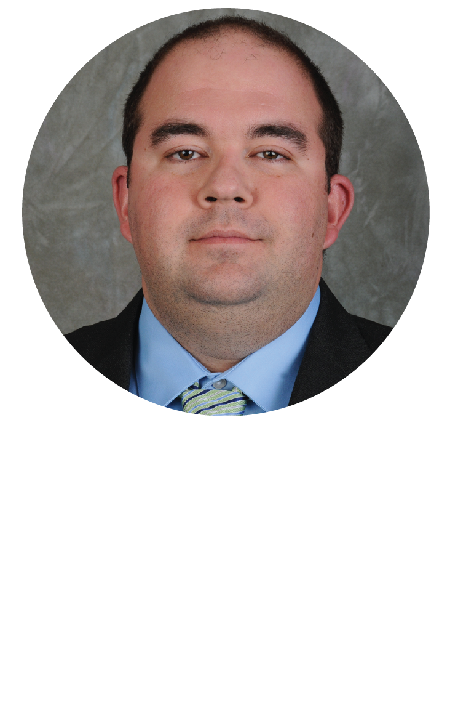
Reporting hazing
If you see something, say something!
Amy N. Pennington Dean of Students apennington@atu.edu 479-968-0407
Megan Edmonds Coordinator of Greek Life medmonds@atu.edu 479-964-0828
Aubrey Holt Director of Campus Life aholt7@atu.edu 479-968-0276
Joshua McMillian Chief of Public Safety jmcmillian1@atu.edu 479-968-0222
Steve Mullins Athletic Director smullins@atu.edu 479-968-0345

Slide 40
Stay safe

Slide 41
Emergency Procedure Guides are available online, in all residence hall rooms, and are in all classrooms and campus offices. Guides provide all types of safety information from tornadoes, active shooter situations, mental health emergencies, and others. If you haven’t already done so, register for ATU Alert so that you are informed of emergencies.
You can’t be too prepared, so take advantage of these resources.

Slide 42
Care team

Slide 43
If you see something, say something
The Campus Assessment, Response, and Evaluation Team, known as the CARE Team, is a group of university personnel who meet regularly to collect and assess all reports of threats or other alarming behaviors by any student or employee as well as others who might impact the safety or well-being of the university community.
If you have a concern about an individual who is displaying behaviors that are concerning, disruptive, alarming, or threatening, please let the CARE Team know.

Slide 44
Examples of behaviors sometimes exhibited by distressed persons
Destructive behavior, including self-destruction such as cutting
Extreme sadness or depression
References to suicide along with statements of hopelessness and helplessness
Violent fantasy content, expression of dark or jarring themes or images
Excessive use of drugs and/or alcohol
Recent and dramatic life changes, including changes in personality, eating habits, hygiene/appearance, sleep patterns
Publishing a video or communicating a plan of harm to self or others

Slide 45
How to report a concern
Make an online referral at www.atu.edu/jerrycares
Call or email Amy Pennington, Dean of Students and CARE Team Chair, at 479-968-0407 or apennington@atu.edu
Call or email any member of the CARE Team (*A complete list of team members can be found at www.atu.edu/jerrycares)
EMERGENCIES
If an incident is currently an immediate threat to self or others, please report directly to the Department of Public Safety by dialing 911

Slide 46
JERRY CARES
You have the tools, training, and resources necessary to take action and report dangerous activity.
You can make a difference in the success and safety of our Tech family.
For more information on Jerry Cares, please visit our website at www.atu.edu/jerrycares or visit our booth at the Involvement Fair tonight.

