Slide 1
Towards an Adaptive Learning Analytics Framework
Prof. Dr. Yasemin Gulbahar
Visiting Scholar at College of Education, ATU
Ankara University, Faculty of Educational Sciences, TURKEY
Dr. Mohamed Ibrahim
College of Education, ATU
Dr. Rebecca Callaway
College of Education, ATU

Slide 2
Introduction
Learning management systems (LMS)
Personal data (LMS databases)
Learning paths & Interactions
Learning difficulties, misconceptions, and their distractors
Learning preferences, best practices, characteristics of high achievers
LEARNERS: provide students with effective and timely feedback to assist and support their learning process.
INSTRUCTORS: advise instructors about how their students are performing based on various assessment results.

Slide 3
E-LEARNING THEORY (MAYER, SWELLER, MORENO)
E-learning theory consists of cognitive science principles that describe how electronic educational technology can be used and designed to promote effective learning.
COHERENCE PRINCIPLE
Irrelevant video, music, graphics, etc. should be cut out to reduce cognitive load that might happen through learning unnecessary content.
SEGMENTING PRINCIPLE
More effective learning happens when learning is segmented into smaller chunks. Breaking down long lessons and passages into shorter ones helps promote deeper learning.

Slide 4
E-LEARNING THEORY
LEARNER CONTROL PRINCIPLE
For most learners, being able to control the rate at which they learn helps them learn more effectively. Having just play and pause buttons can help more than having an array of controls (back, forward, play, pause).
EXPERTISE EFFECT
Instructional methods that are helpful to low prior knowledge learners may not be helpful at all, or may even be detrimental, to high prior knowledge learners.

Slide 5
Faculty Areas for the Application of Learning Analytics
application of learning analytics
teaching evaluation
teaching effectiveness
learning processes
assessment practices
action research
instructional practices

Slide 6
Adaptive Learning Analytics
Adaptive learning analytics deals with the design of the learning analytics system in order to improve the learning processes.
However, there has been no published empirical evidence of any such system which consists of all these features and which has been proven to be effective by both learners and instructors.
personalization of the curricula
Intelligent tutoring system
cognitive modeling of the learner
interactive learning
real-time feedback
adaptive presentation of the content

Slide 7
Framework for Adaptive Learning Analytics
https://brill.com/view/title/54675

Slide 8
Method Phase #1
Purpose:
This research study aims to reveal the most important variables to be considered in any adaptive learning analytics system model through the evaluation of expert opinion.
Research questions:
Which variables are perceived as useful to the provision of feedback to learners, tutors and instructional designers in an adaptive learning system?
What should be the most important goals of an adaptive learning system?
What kind of interventions are perceived as the most important?

Slide 9
Survey Approach
Individual Differences
Online Tutor
Course Design
Computer Logs for Real Usage
Variables (important for intervention)
Sample
Snowball sampling to experts in both the USA and Turkey
(N=16)

Slide 10
Findings

Slide 11
Method Phase #2
For exploring the effect of asynchronous teaching on learner success, this study used a mixed-methods approach in order to answer the following research questions:
What are the characteristics of learners’ who were failures and outperformers?
To what extend learning styles, motivation and self-regulation affects learners’ success?
Does any of Moodle engagement analytics have a positive predictive relationship with learner success and with all other predictors?
What variables come to forefront in the learner's academic success according to the prediction model generated by using learners’ Moodle engagement and characteristic variables?
What are learners’ perceptions about their teaching-learning process?

Slide 12
Course Navigation for Adaptive Learning in Moodle

Slide 13
Sample of the Study
The course named Information and Communication Technologies 101 (ICT 101) at beginner level is offered to 3765 registered users of 17 faculties and 75 departments as fully asynchronous online activities. Of 2345 freshmen students who used learning management system actively, a total of 1449 students were considered for this study who answered all the scales and surveys besides actively using the Moodle learning management system.
Hence, 476 female and 973 male learners aged between 19-75 of whom having 1322 unemployed and 117 employed status were formed the working group of the study for quantitative measures. However, only 108 students provided answers to the follow-up survey consisting of 8 open-ended questions.

Slide 14
Data Collection
Moodle Analytics (QUANTITATIVE)
Open-ended Questions (QUALITATIVE)
Quantity | Quality
Total clicks on the exam (viewing) Total submits on the exam (finishing) Total clicks on the scorm (viewing) Total clicks on the external link (viewing) Total clicks on the video (viewing) Total clicks on the discussion forum (viewing) Total creations on the discussion topic (creating) Total creations on the topic post (creating) Total actions on all component (creating, viewing, updating etc.) | Total number of badges received by system interactions. Total working duration in course.
To what extend do you feel self-confident about technology literacy? Can you explain that?
Do you think that you are successfully attending ICT courses? Why is that?
Were the materials presented in the ICT course instructive? Why is that?
How do you think was the structure of the flow of ICT courses? Why is that?
Were the interactive assessment opportunities in the content of the ICT courses adequate? Why is that?
What kind of activities would you like to have in ICT course content? Why is that?
In case of what kind of e-Learning opportunities would you be more actively involved in the system?
Do you think you have a personal digital learning culture? Why is that?
Self-Regulation Survey
e-Readiness Scale
e-Learning Styles Survey
& Academic Success

Slide 15
Findings
Method | AUC | CA | F1 | Precision | Recall | LogLoss
Tree | 0,668 | 0,644 | 0,644 | 0,645 | 0,644 | 0,651
Naive Bayes | 0,678 | 0,633 | 0,633 | 0,632 | 0,633 | 0,701
Neural Network | 0,652 | 0,625 | 0,624 | 0,624 | 0,625 | 0,813
Random Forest | 0,653 | 0,620 | 0,619 | 0,618 | 0,620 | 0,928
SVM | 0,611 | 0,596 | 0,596 | 0,596 | 0,596 | 0,669
CN2 rule inducer | 0,593 | 0,584 | 0,584 | 0,583 | 0,584 | 0,831
kNN | 0,567 | 0,515 | 0,490 | 0,562 | 0,515 | 3,127
The Performance of Algorithms in the Classification Model for Prediction of Learners’ Academic Success
Data Mining Process (Classification Analysis)
Software - ORANGE

Slide 16
Findings
Rules Derived From Decision Tree

Slide 17
Suggestions by Students for Improvement
more online and face-to-face practicing environments (14 students)
more visually appealing and entertaining content (12 students)
more animation, puzzle and games (9 students)
sample exams with answers to questions (8 students)
more interactive content and assessment activities (7 students)
simpler and shorter content (7 students)
more attractive/interactive applications/games (12 students)
virtual live or face-to-face sessions (10 students)
mobile application for those who don't have access to computers (8 students)
shorter and simplified video lectures (8 students)
weekly quizzes or homework’s (6 students)
more trial exams and exam questions (4 students)
more practicing options (3 students)

Slide 18
Conclusion
Although there is no significant difference between the average of midterm grades of males and females, the average number of clicks, pre-test and final grades of males wss higher than females who has higher average working hours.
At least the half of the group was having high technical skills, high motivation and self-regulation skills and almost all learning styles taken equal advantage of learning online although the learning paths were varied.
Technical skills and learning style of logical were among the variables who had a positive effect on academic performance mostly.
It is observed that there is a positive and low level significant relationship between the final grades with the interactions of exams and discussions in online lesson whereas a positive and low level significant correlation was found between content and self-regulation ability.
In prediction model generated by using learner’ Moodle engagement and learner's characteristic variables, it was classified correctly 60% of the failed learners and 67.8% of the successful ones according to best probability.
Technical skills and interactions for discussion purposes increases slightly, the probability of failing the course is decreased.
Motivation or interactions for assessment purposes, are not likely to play a role in the prediction of success.
The higher the prior knowledge, it is likely to get the higher the probability of success for students with a high total system interaction.

Slide 19
Future Research
Converging Learning Styles (audio-visual)
Interactive Multimedia Content (summarized knowledge)
High Self-Regulation Skills
Computer Literate Students
What about the remaining students?
Decreasing Student Drop-out rates (Moodle Inspire)
Dealing with Motivation Strategies

Slide 21
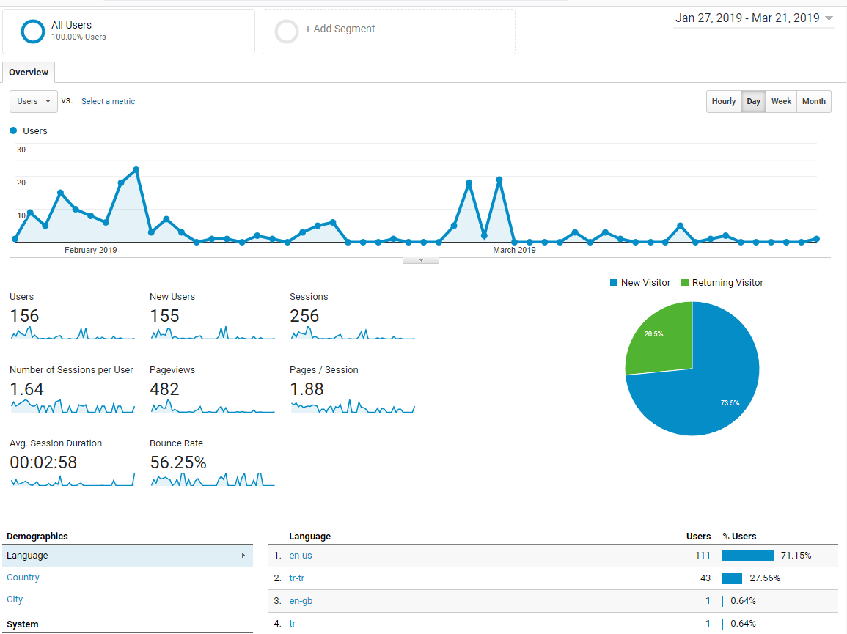

Slide 22
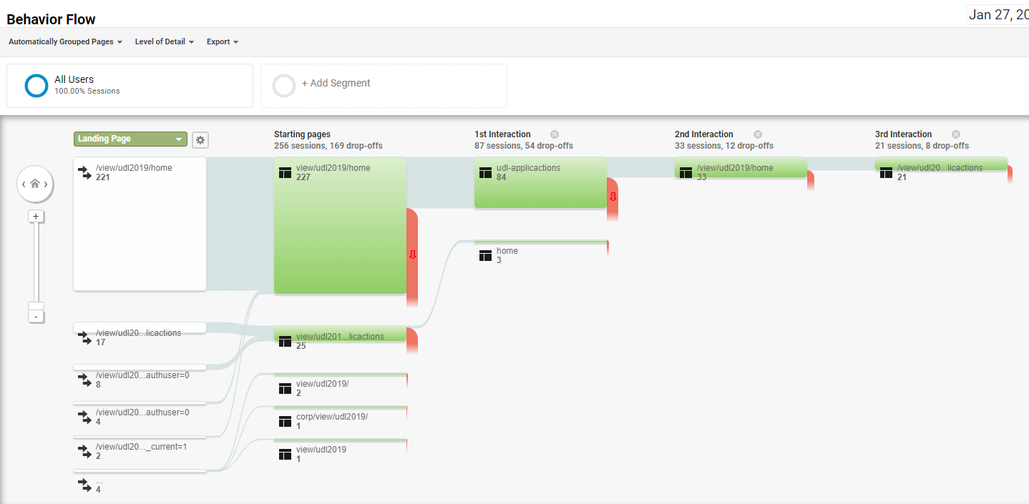

Slide 23
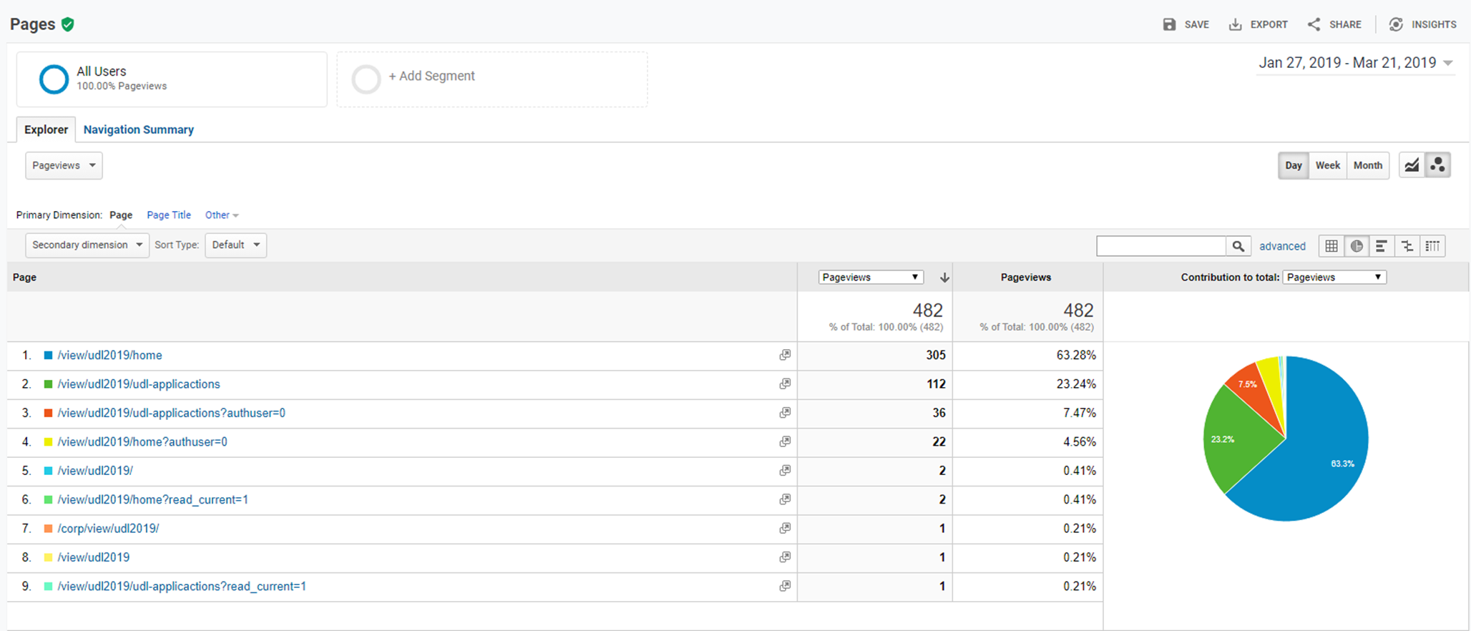

Slide 24
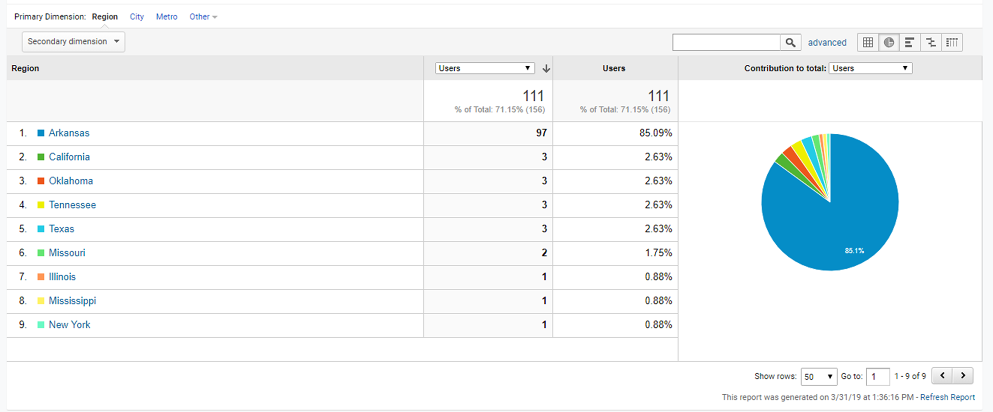

Slide 25
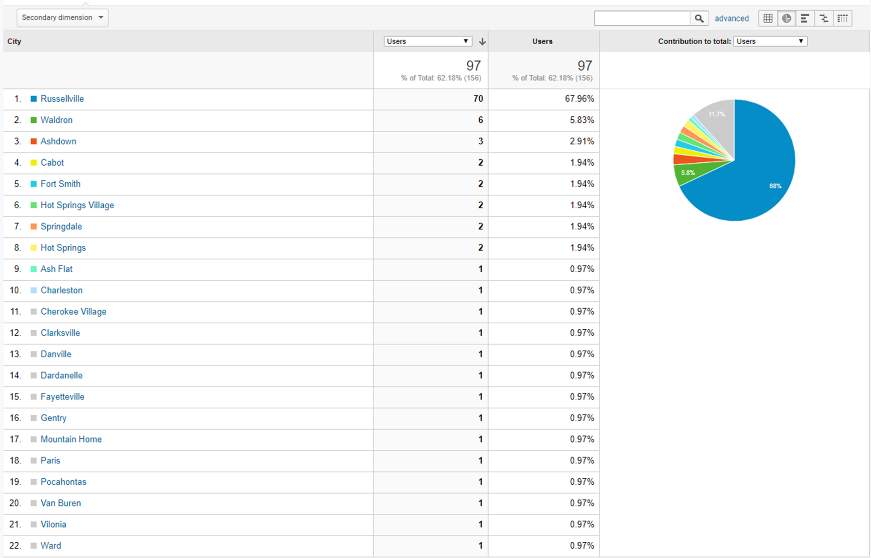

Slide 26
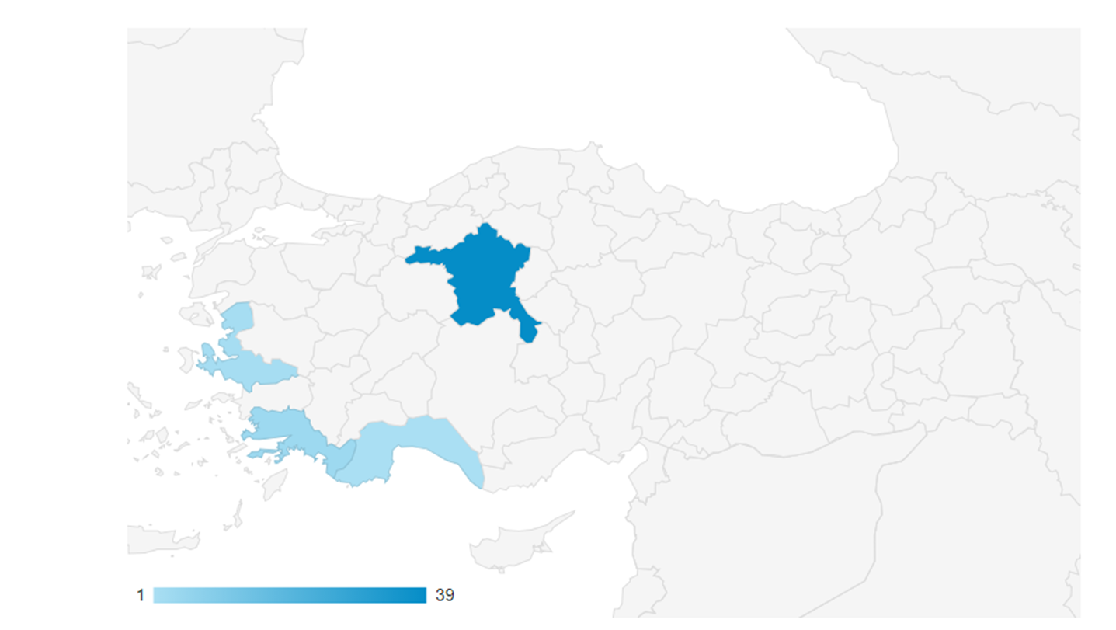

Slide 27
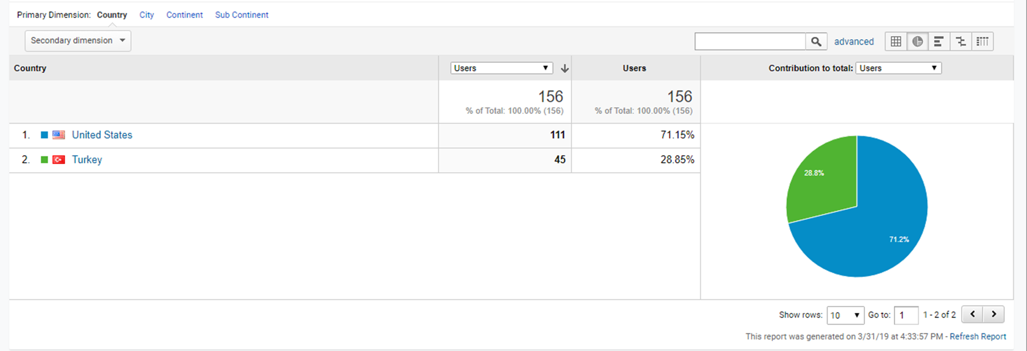

Slide 28
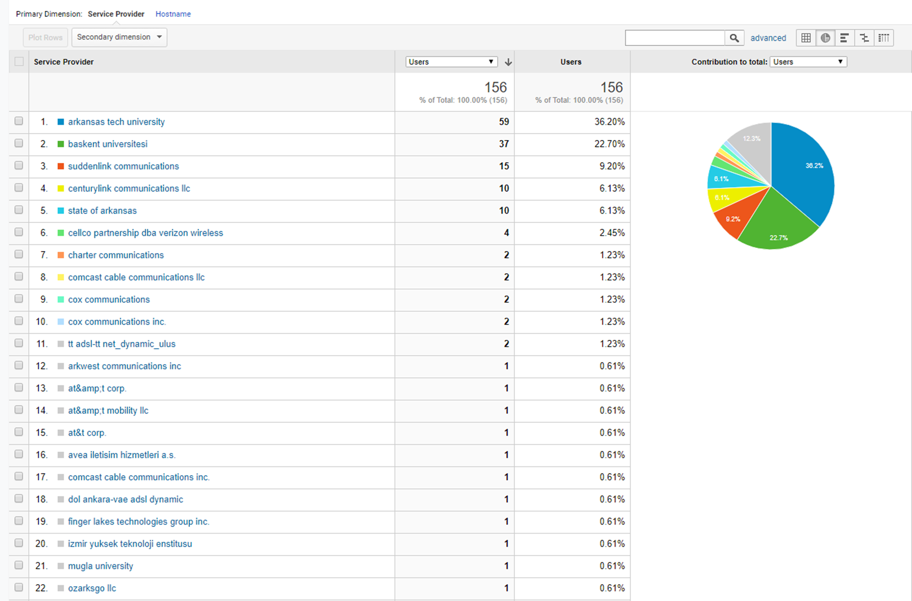

Slide 29
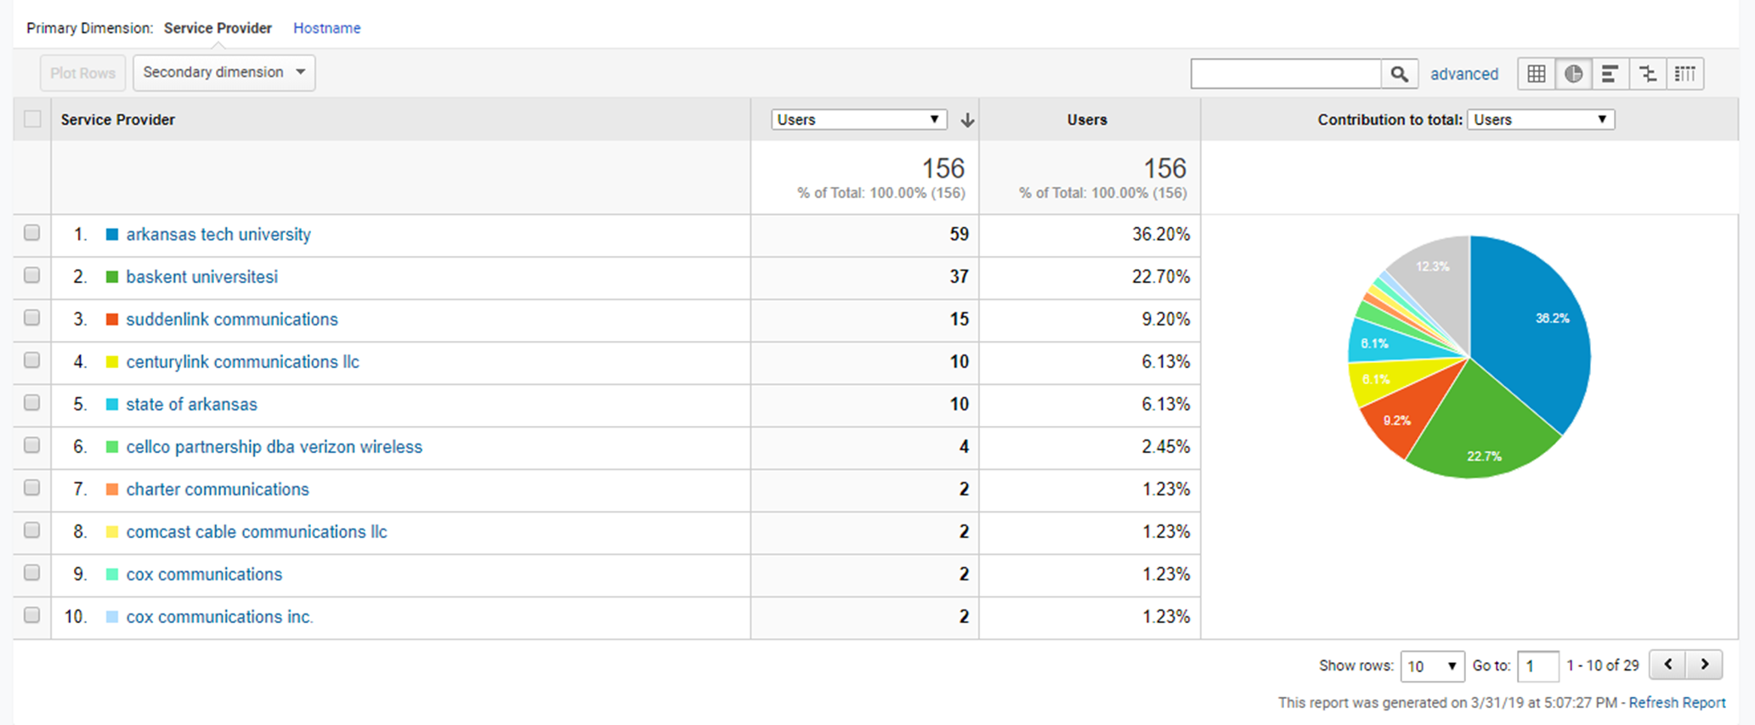

Slide 30
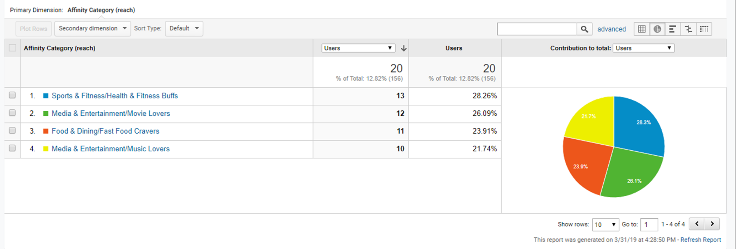
Interests: Affinity Categories

Slide 31
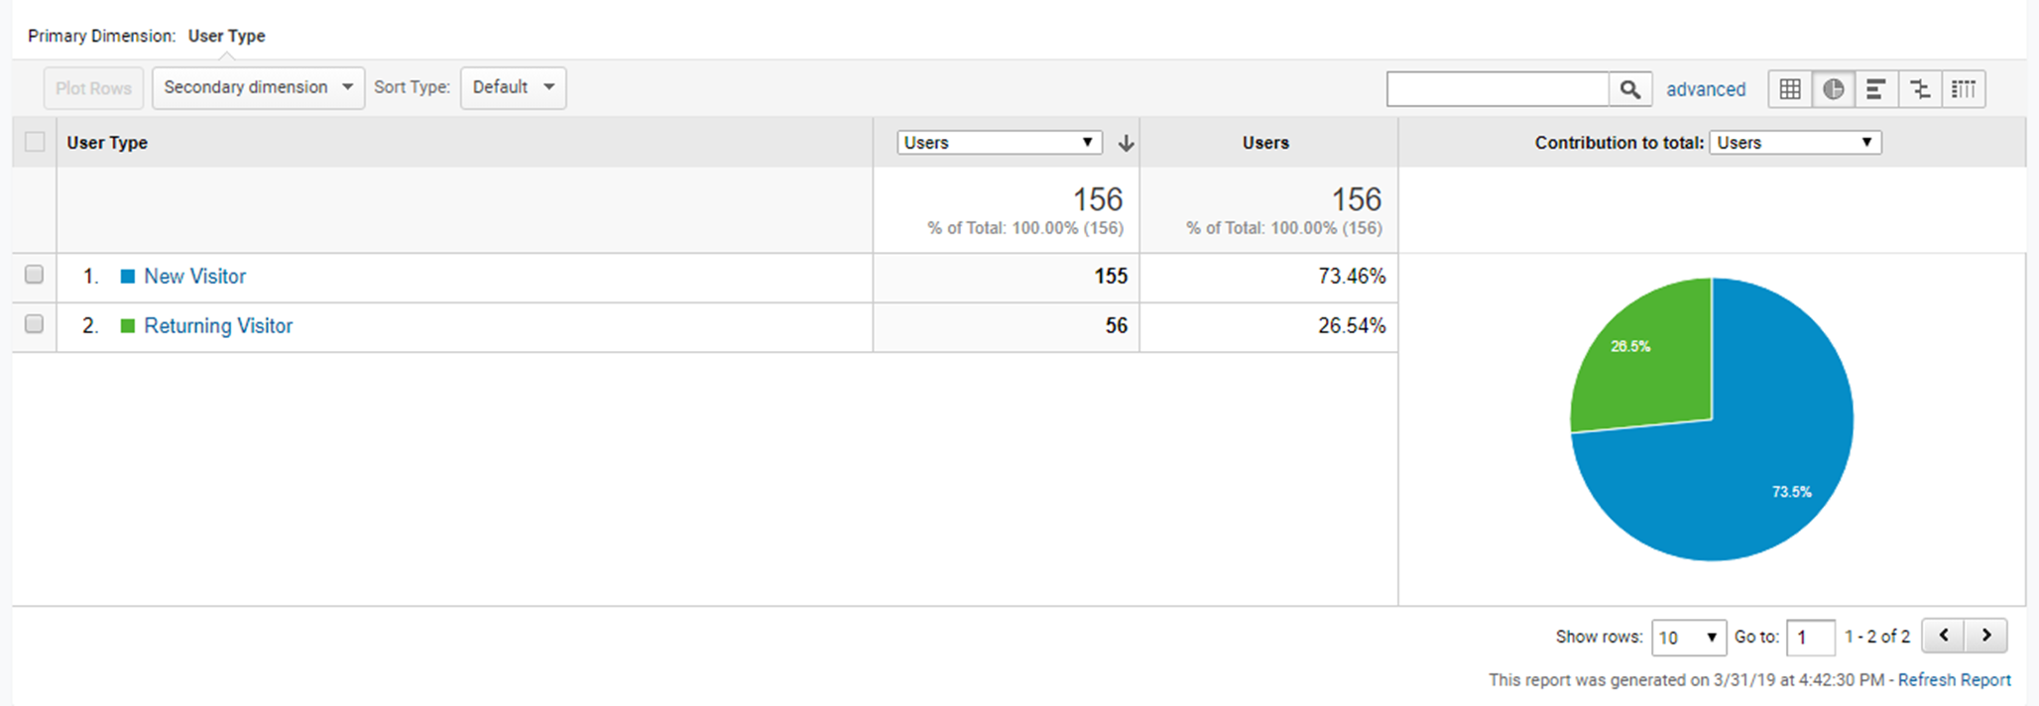

Slide 32
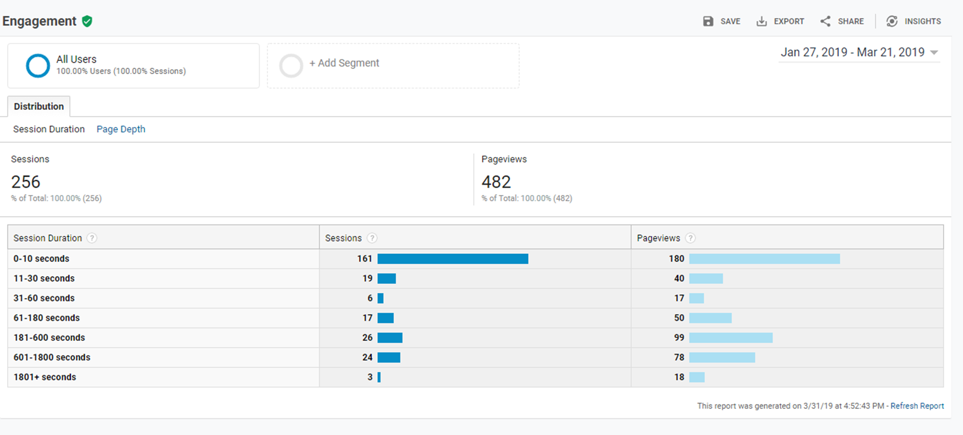

Slide 34
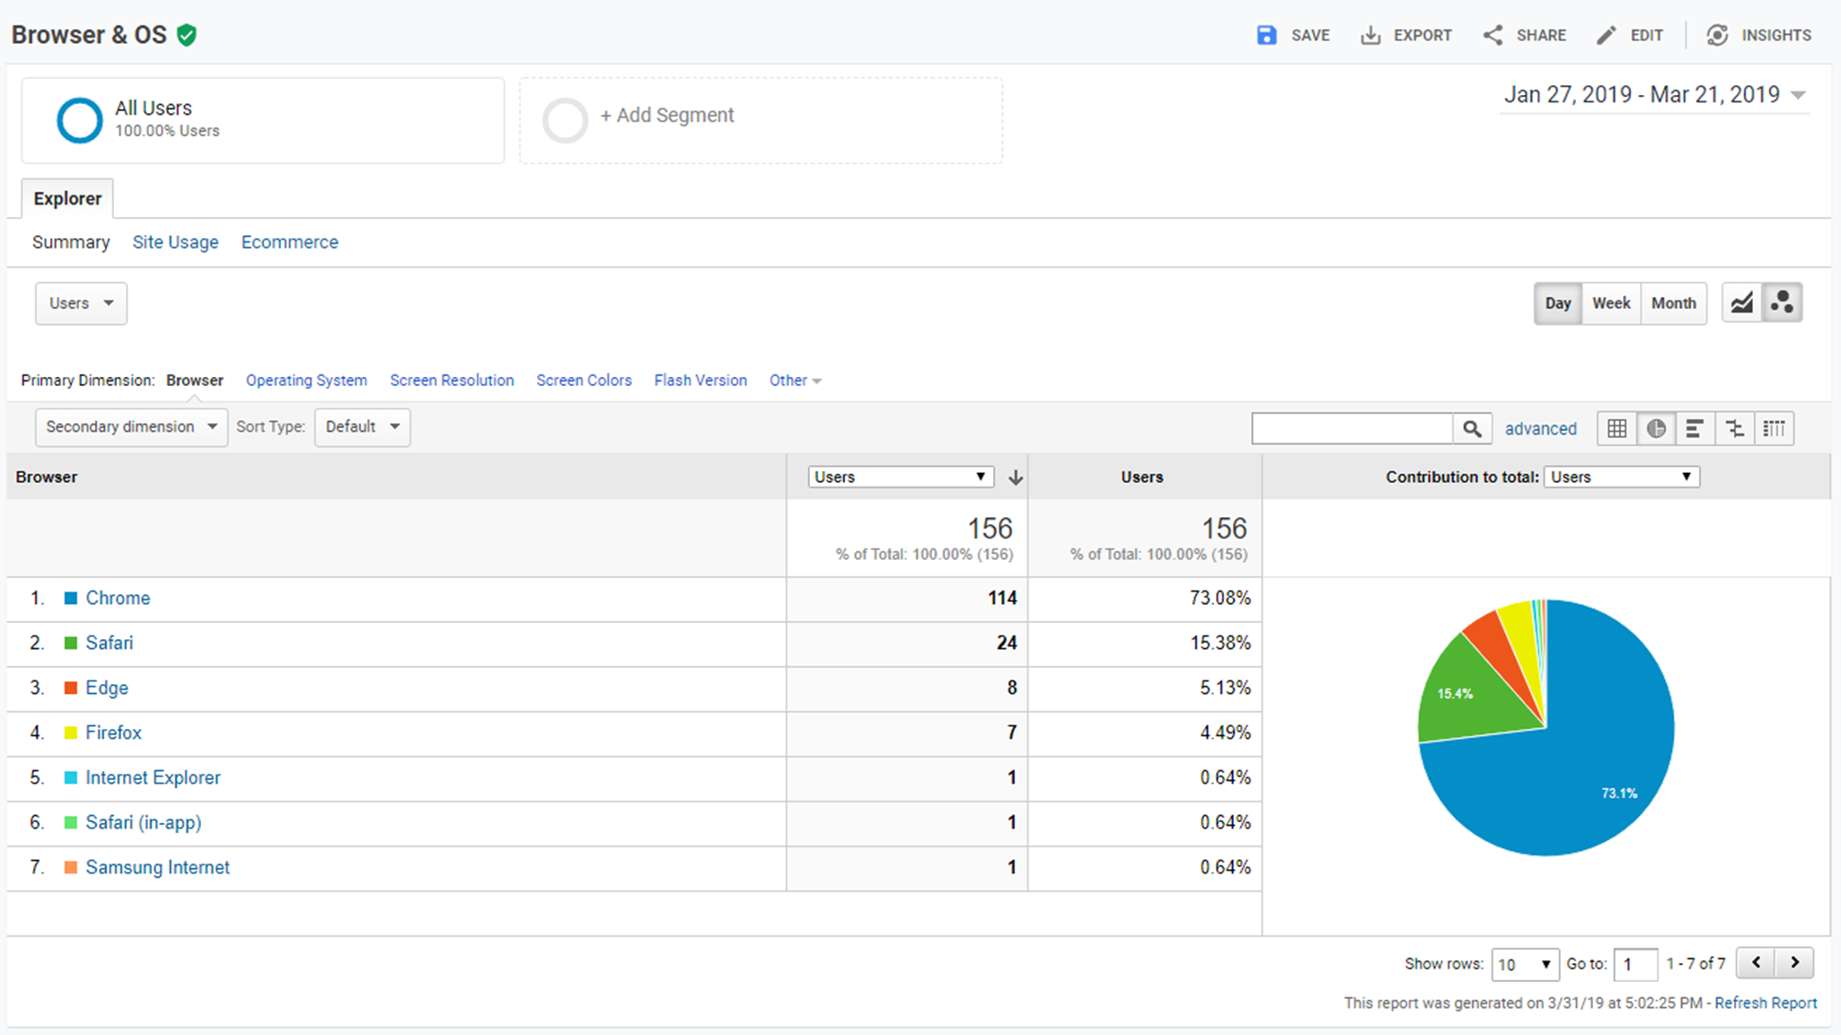

Slide 35
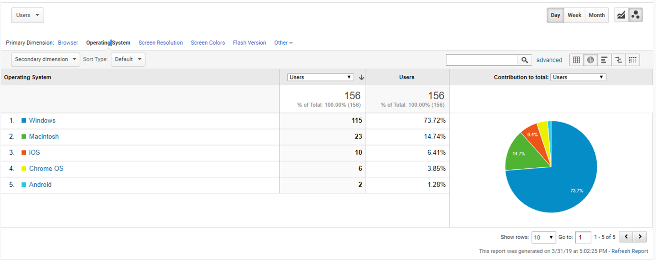

Slide 36
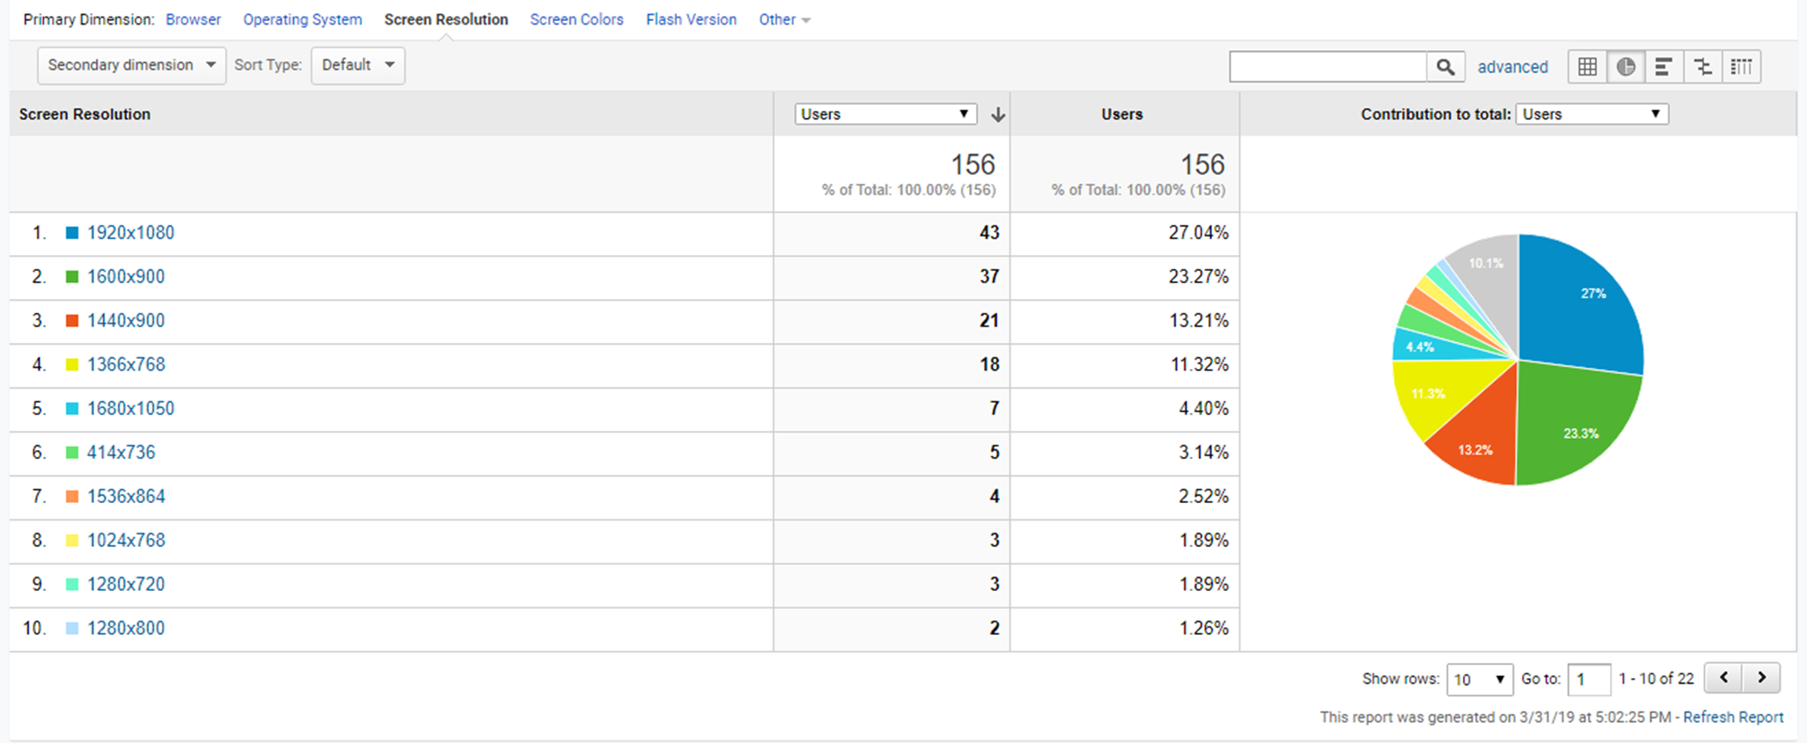

Slide 37
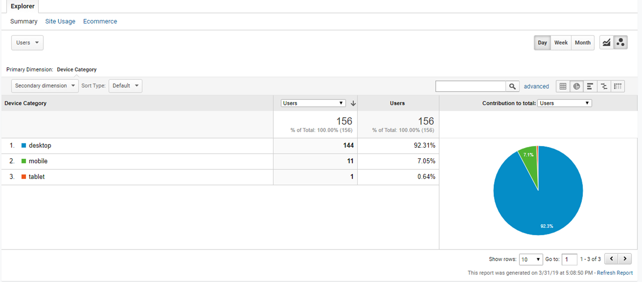

Slide 38
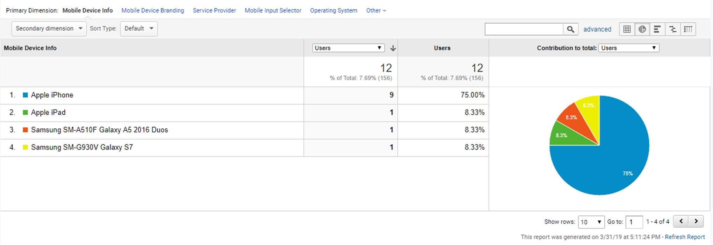

Slide 39
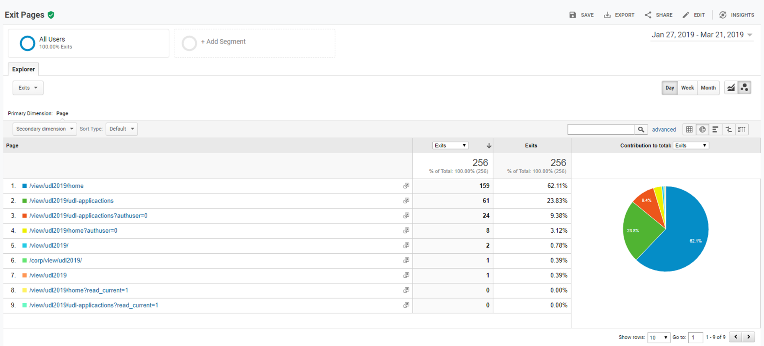

Slide 40
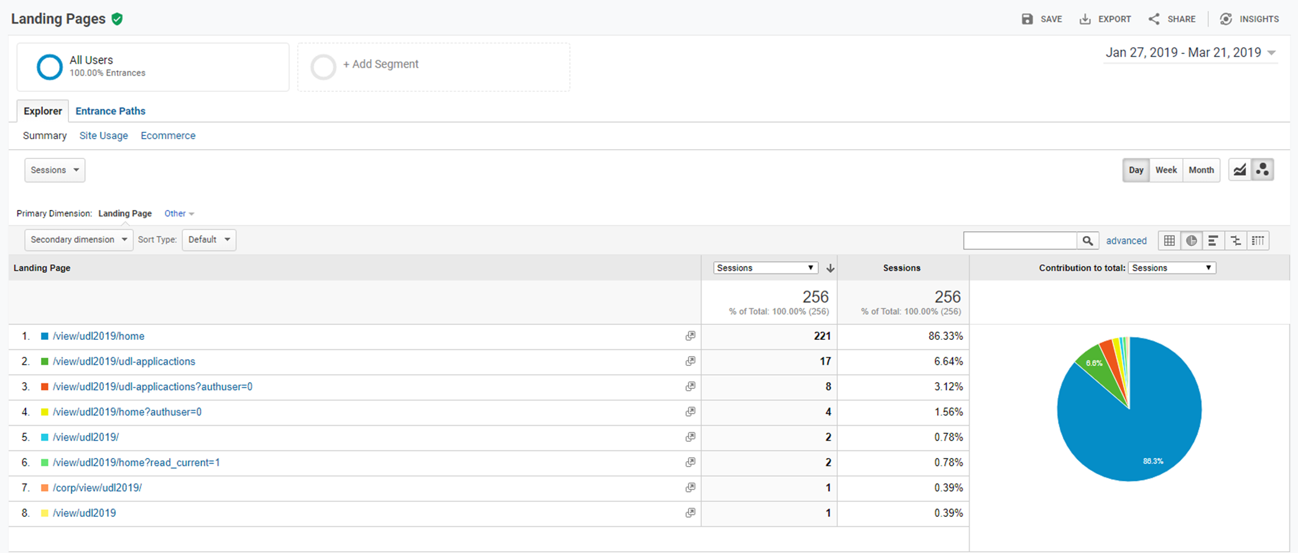

Slide 41
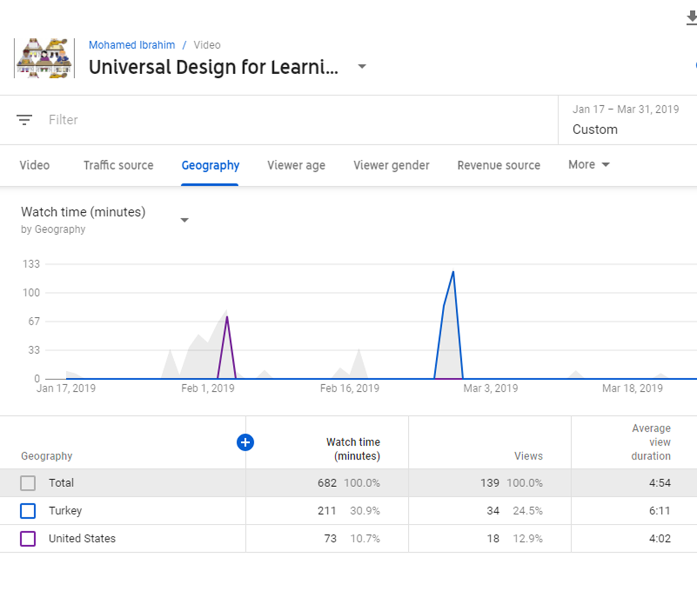

Slide 42
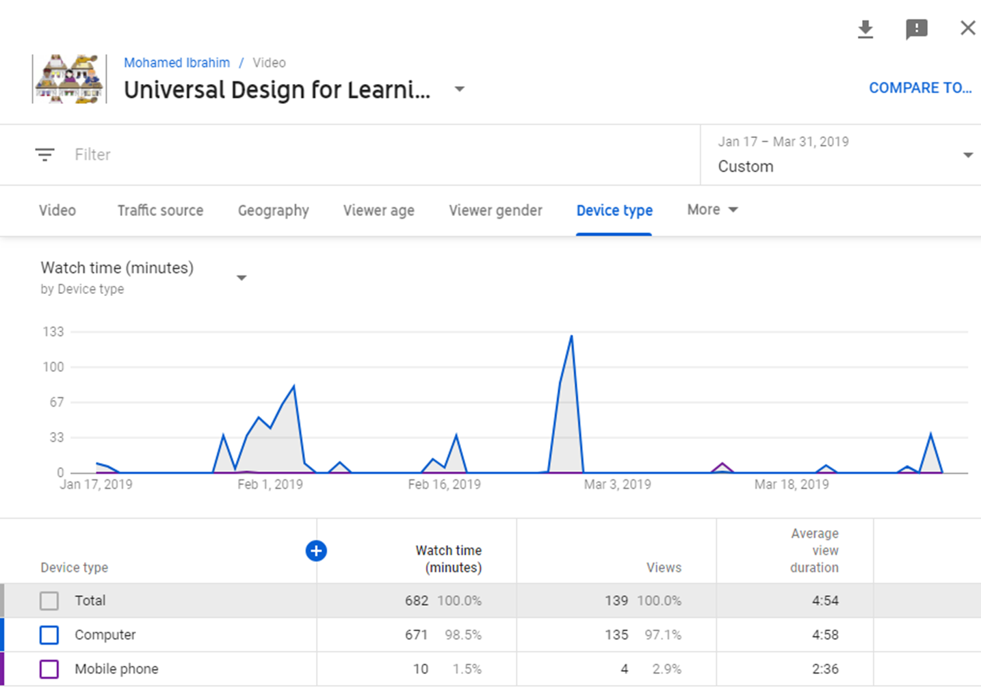

Slide 43
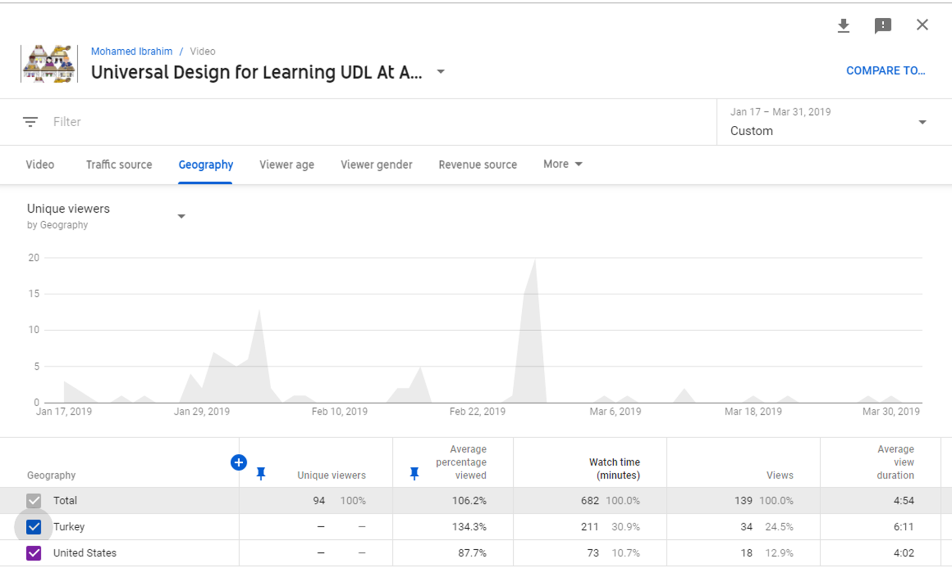

Slide 44
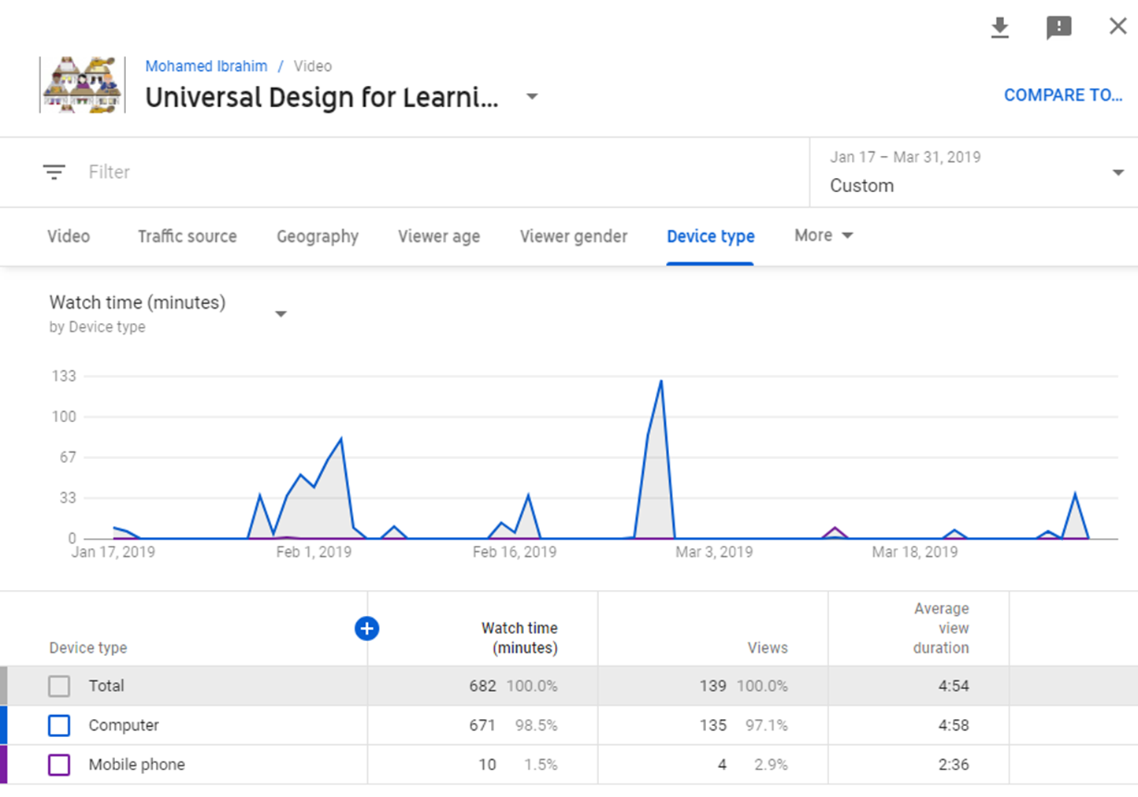

Slide 45
Becoming a Visiting Scholar & Having a Driver License

Slide 46
Crystal Bridges

Slide 47
Game Day

Slide 48
Thanksgiving

Slide 49
Halloween

Slide 50
Christmas

Slide 51
Robotics Competition

Slide 52
SITE Conference @Las Vegas

Slide 53
Questions? Comments?
Prof. Dr. Yasemin Gulbahar
gulbahar@ankara.edu.tr
Dr. Mohamed Ibrahim
mibrahim1@atu.edu
Dr. Rebecca Callaway
rcallaway@atu.edu

