Slide 1
Grant tips and tricks from the IRC Directors
Dr. Turaj Ashuri
Dr. Newton Hilliard
Dr. Rebecca Wiewel

Slide 2
Tips for any proposal
Make sure the grant is a good fit for your project
Look at what’s been funded recently
Use similar language to the RFP or from the agency’s goals
Read and carefully follow provided guidelines/review criteria
Sounds basic, but it’s a big deal!
Communicate with Program Officers and staff about your project

Slide 3
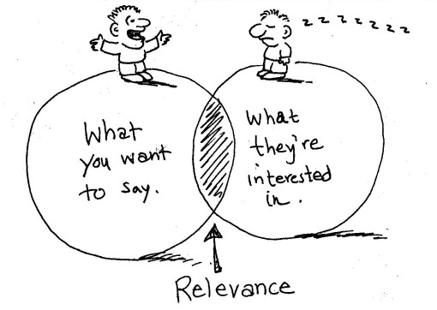
Tips for any proposal
Know your audience
Who will be reviewing the proposals?
Use jargon only when appropriate
Consider becoming a reviewer – and share insider tips with the rest of us!
Make your idea stand out…somehow
Unique collaborations/interdisciplinary work
Highlight new contributions or differences in scale
But make sure the project is still feasible
Notes:
Start early – allow time for multiple drafts. Allow time to obtain any necessary letters of support or to find necessary institutional data that may need to be reported
3

Slide 4
Tips for any Proposal
Be clear and concise
When longer narratives are allowed, find ways to succinctly summarize/reiterate your main points along the way.
Use headings and subheadings
Have someone not involved in your project read your proposal
Take advantage of opportunities for draft reviews
Start early
Notes:
Start early – allow time for multiple drafts. Allow time to obtain any necessary letters of support or to find necessary institutional data that may need to be reported
4

Slide 5
Tips for NSF proposals
Notes:
5

Slide 6
NSF by The numbers

Slide 7
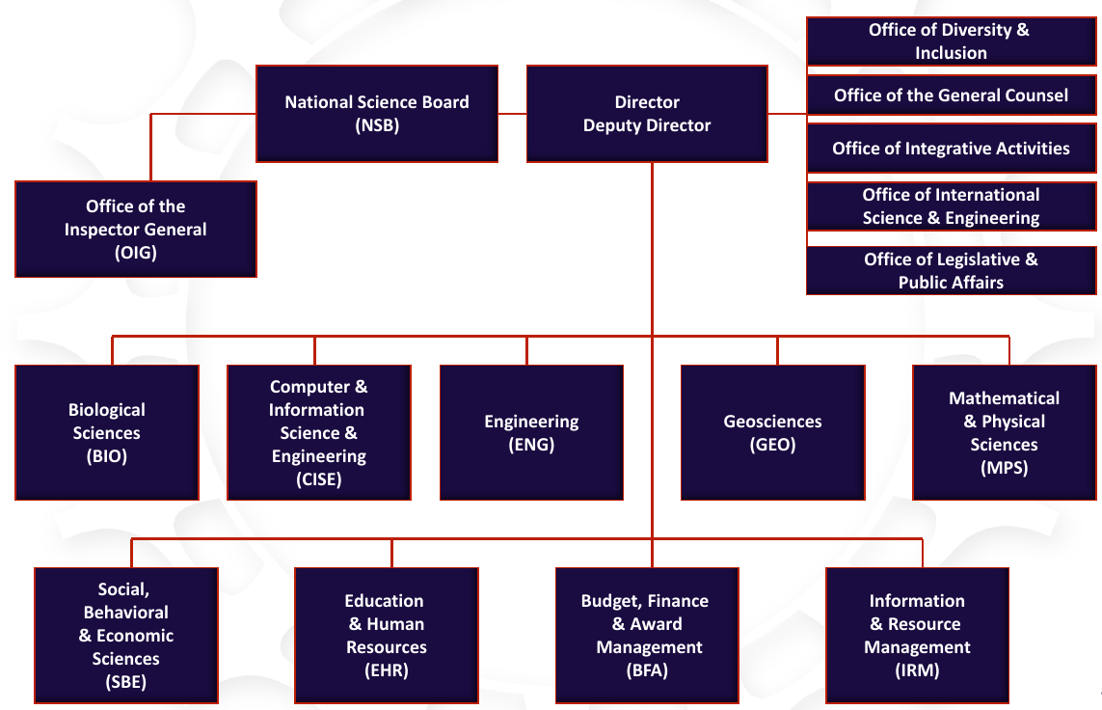
How NSF is organized

Slide 8
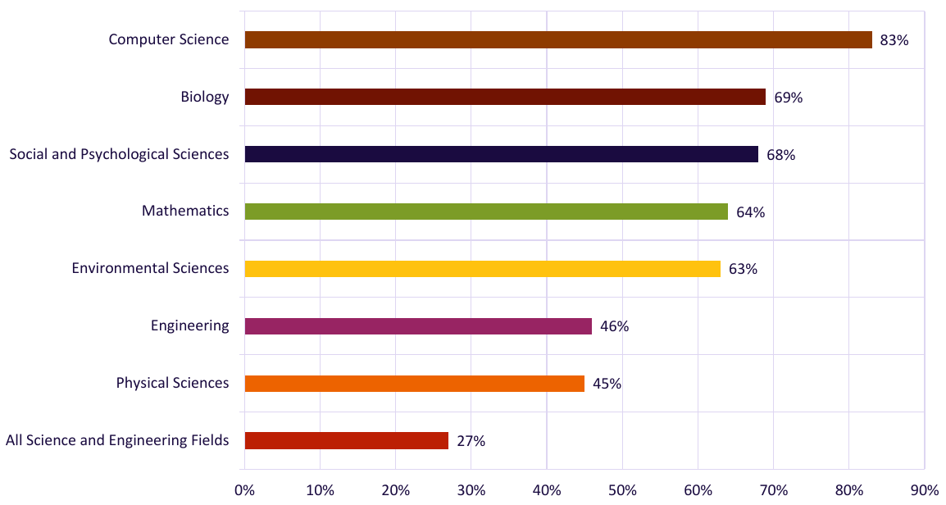
Percentage of funds per area from the total federal funds

Slide 9
5 review criteria for nsf ranked based on their importance
What is the potential for the proposed activity to:
▪ advance knowledge and understanding within its own field or across different fields (Intellectual Merit); and
▪ benefit society or advance desired societal outcomes (Broader Impacts)?
• To what extent do the proposed activities suggest and explore creative, original, or potentially transformative concepts?
• Is the plan for carrying out the proposed activities well-reasoned, well-organized, and based on a sound rationale? Does the plan incorporate a mechanism to assess success?
• How well qualified is the individual, team, or institution to conduct the proposed activities?
• Are there adequate resources/time available to the PI (either at the home institution or through collaborations) to carry out the proposed activities?

Slide 10
Tips for NIH proposals
Notes:
10

Slide 11
4 keys to success with NIH
1. Understand the NIH Mission/Goals, organization and processes
2. Plan
‘Fill a need’ - https://www.youtube.com/watch?v=nFVlyKRVgwg
NIH submission dates –
https://grants.nih.gov/grants/how-to-apply-application-guide/due-dates-and-submission-policies/due-dates.htm
Use a calendar, not a watch
3. R.T.B.I.
4.Communicate with program officials

Slide 12
NIH Mission and Goals
Mission statement https://www.nih.gov/about-nih/what-we-do/mission-goals
Institutes https://www.nih.gov/institutes-nih/list-nih-institutes-centers-offices
Example Institute https://www.niaid.nih.gov/

Slide 13
Grant process overview – phase I
Establish Internal Relationships
Contact SPUI and let them know that you are interested!
Set up any registrations necessary
Grant searching databases (Grants Forward, Grants.gov, etc.)
NIH usernames/registrations
Research compliance issues
SPUI will handle the final submission
Talk with your chain of command!
Faculty load issues
Space utilization issues
Matching funds
Make a copy for each office!!

Slide 14
Grant process overview – phase II
Proposal development (R.T.B.I. starts here)
Parent Announcements
R15 information source page https://grants.nih.gov/grants/guide/contacts/parent_R15.html
R15 file page https://grants.nih.gov/grants/guide/pa-files/PA-16-200.html
Contact your program officer
Contact info – see above
Email an inquiry as to the appropriateness of your idea

Slide 15
Grant process overview – phase II (cont.)
Outline your project
Your fundamental goal is defined for you
NIH R15 goals –
student professional development – skills, skills, skills
Increase interest in pursuing biomedical/behavioral scientist oriented careers
Hypothesis driven
Choose only one or two objectives
Do Not Over Extend Yourself!!!!
Subsections of objectives that can be finalized to a product (i.e. student presentations) make for stronger proposals
Proposals to bring about world peace, end hunger and balance the national debt will NOT be funded!!
Objectives must be related to the hypothesis

Slide 16
Internal funding opportunities
Faculty Research Grant
https://www.atu.edu/research/faculty_research.php
Professional Development Grant
https://www.atu.edu/research/faculty_dev.php
Student Interdisciplinary Grant
https://www.atu.edu/research/interresearch.php
Undergraduate Research Grant
https://www.atu.edu/uresearch/grants.php
Interdisciplinary Research Grant
https://www.atu.edu/ospui/docs/2017-18-IRC-Grant-Guidelines-final-draft2.pdf
Course Redesign Grant
https://www.atu.edu/uresearch/coursedesign.php
Notes:
16

Slide 17
Resources
Contact OSPUI early on
https://www.atu.edu/ospui/
ADMN 207
Funding Sources:
https://grantforward.com (free account with your ATU email)
https://www.getedfunding.com
https://www.arkansas.gov/government/agencies
foundationcenter.org
Check out the 990 finder to find out what foundations are funding
IRC Directors
Let us know what you’re working on so we can help create interdisciplinary connections and collaboration opportunities.
https://www.atu.edu/ospui/irc-directors.php
Notes:
17

