Slide 1


Personal hygiene
Arkansas Tech University
Health & Wellness Center

Slide 2

Hygiene
The definition of hygiene is the conditions or practices conducive to maintaining health and preventing disease, especially through cleanliness. It includes any practice or activity you do to keep healthy and clean. It can include bathing, keeping your mouth clean, clean clothes, and even getting plenty of sleep.

Slide 3

Good and Bad Hygiene
The difference between good and bad hygiene:
Mom was right: Good personal hygiene is essential to promoting good health. Personal hygiene habits such as washing your hands and brushing and flossing your teeth will help keep bacteria, viruses, and illnesses at bay.
Poor hygiene habits can also affect your self-esteem and can be a risk factor for serious health issues including heart disease.

Slide 4
The Benefits of Good Hygiene
According to the Centers for Disease Control and Prevention, addressing the spread of germs in schools is essential to the health of our youth, our schools, and our nation
Good hygiene prevents the spread of germs
It also helps to give a good first impression to others

Slide 5

Healthy Skin: Hand Washing
According to the Centers for Disease Control (CDC) 22 million school days are lost each year due to the common cold.
Some viruses and bacteria can live from 20 minutes up to 2 hours or more on surfaces like cafeteria tables, doorknobs, and desks

Slide 6
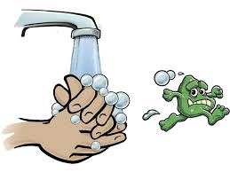
Wash those hands
Use warm running water
Use soap
Scrub hands together and under nails for at least 15-20 seconds
Dry hands on a clean cloth or paper towel or use an automatic hand dryer if possible

Slide 7
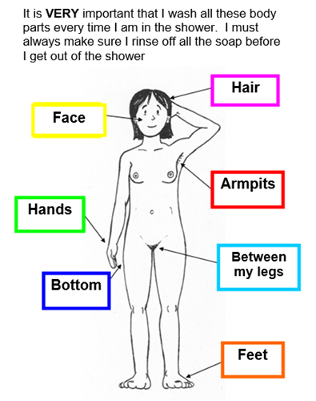
When in doubt… Wash
Washing (bathing or showering) is the most important way of maintain good health and protecting ourselves from infections, illnesses, and ailments. Maintaining cleanliness is also important for our self-confidence, physical and emotional well-being.

Slide 8
Healthy Teeth and Gums
The health and cleanliness of your mouth is important, if you don’t brush and floss…
Cavities (holes in your teeth) may form
Your breath will probably smell bad
You may be at higher risk for serious disease later in life, such as heart disease, stroke, and diabetes

Slide 9

When to Brush and Floss
Brush at least two times a day
One time in the morning, and one time at night
Consider brushing between meals, too!
Floss at least one time a day
Floss if you feel food stuck in your teeth

Slide 10
Brushing Technique and Skills
Place your toothbrush against the gums.
Move the brush back and forth gently in short (tooth-wide) strokes.
Brush the outer tooth surfaces, the inner tooth surfaces, and the chewing surfaces of the teeth.
Clean the inside surfaces of the front teeth, using a gentle up-and-down stroke.
Brush your tongue to remove bacteria and freshen your breath.

Slide 11

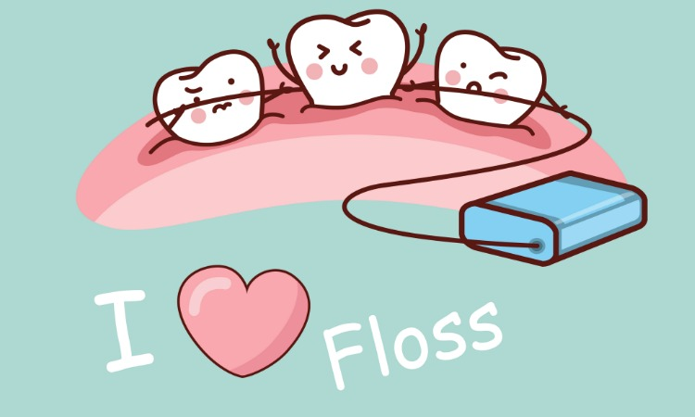
Proper Flossing Skills
Guide the floss between your teeth using a gentle rubbing motion. Never snap the floss into the gums.
Gently rub the side of the tooth, moving the floss away from the gum with up and down motions.
Repeat this method on the rest of your teeth.
VS

Slide 12


Sleep & Hygiene
60% of college students don’t get enough sleep
Not getting enough sleep can make you more prone to illness and disease, weight gain, and poor hygiene practices.
You should get 7-10 hours of sleep a night

Slide 13

Review
Bathe and Wash Your Hands: Lather, Rinse, Repeat.
Teeth: Brush, Floss, Rinse.
Sleep: Get Plenty

Slide 14
Resources
National Food Service Management Institute (2002). Wash Your Hands. http://www.nfsmi.org/Information/handsindex.html
Lesson Plans (2004). Why Wash? http://www.lessonplanspage.com/PEWhyWashHygieneComics2.htm
American Dental Association (2005). Animation and Games. http://www.ada.org/public/games/animation/interface.asp
Centers for Disease Control and Prevention (2004). Stopping Germs at Home, Work, and School. http://www.cdc.gov/germstopper/home_work_school.htm
World Health Organization(1948-2005). Definition of Health. http://www.who.int/about/definition/en/

