Slide 1
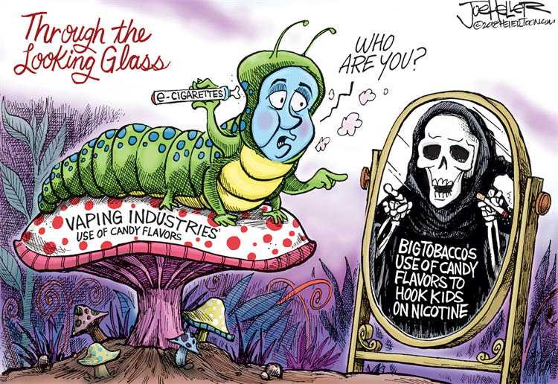
E-CIGS & VAPING

Slide 2
ATU’s Tobacco-Free Policy
Effective August 1, 2009 use of any tobacco product including, but not limited to, smoking, use of electronic cigarettes, dipping, or chewing tobacco is prohibited on campus. This policy shall be enforced by the Arkansas Tech University Department of Public Safety.
"Campus'’ means all property, including buildings and grounds that are owned or operated by Arkansas Tech University.
"Electronic cigarette" (also known as "e-cig" or "e-cigarette") means a battery or USB powered device containing a nicotine-based liquid that is vaporized and inhaled, used to simulate the experience of smoking tobacco.
"Smoking" as that term is used in this policy means inhaling, exhaling, burning, or carrying any:
•Lighted tobacco product, including cigarettes, cigars, and pipe tobacco
•Other lighted combustible plant material
"Student" as that term is used in this policy means an individual enrolled in a credit or non-credit course at Arkansas Tech University.
Notes:
Student discipline Students who violate this policy shall be disciplined as follows:
First Offense: Written warning.
Second Offense: Six months’ probation as defined in the Student Code of Conduct
Third and Subsequent Offenses: $50.00 fine.
Students may appeal their sanction pursuant to the terms of the Student Code of Conduct. All others may appeal the sanction imposed pursuant to this policy by submitting a written appeal to the Human Resources Committee within five (5) business days of the infraction.
Pursuant to Act 734 of 2009, beginning August 1, 2010, any person who smokes on campus shall in addition to the penalties set forth above, be guilty of a violation and upon conviction in Russellville District Court, shall be punished by a fine of not less than ($100) one hundred dollars nor more than ($500) five hundred dollars.

Slide 3
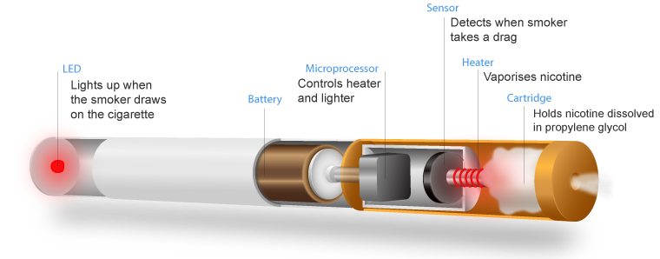
What is Vaping?
“Vaping” is a term introduced by the electronic smoking device industry to refer to any electronic "vaporizer", such as E-cigs, Vapes, vape pens, vaporizers, and E-hookahs.
Notes:
The term can incorrectly lead people to believe that using electronic vaporizers produces a harmless water vapor, but in reality these devices produce potentially harmful aerosols that are inhaled into the lungs and exhaled into the environment. Although not covered in this PowerPoint, these products are also frequently used to consume cannabis (marijuana). Any electronic aerosolized product can commonly be abbreviated as e-cigs/vapes. Keep in mind, with the market and products still evolving, the favored terminology used by young people changes quickly.

Slide 4
Nicotine not just in Cigarettes
Notes:
Nicotine can be found in tobacco and comes from tobacco leaves.
Most hookah contains nicotine and overall, can have a lot of the same negative health effects of cigarettes
E-juice used in e-cigs/vapes can contain varying levels of nicotine.

Slide 5
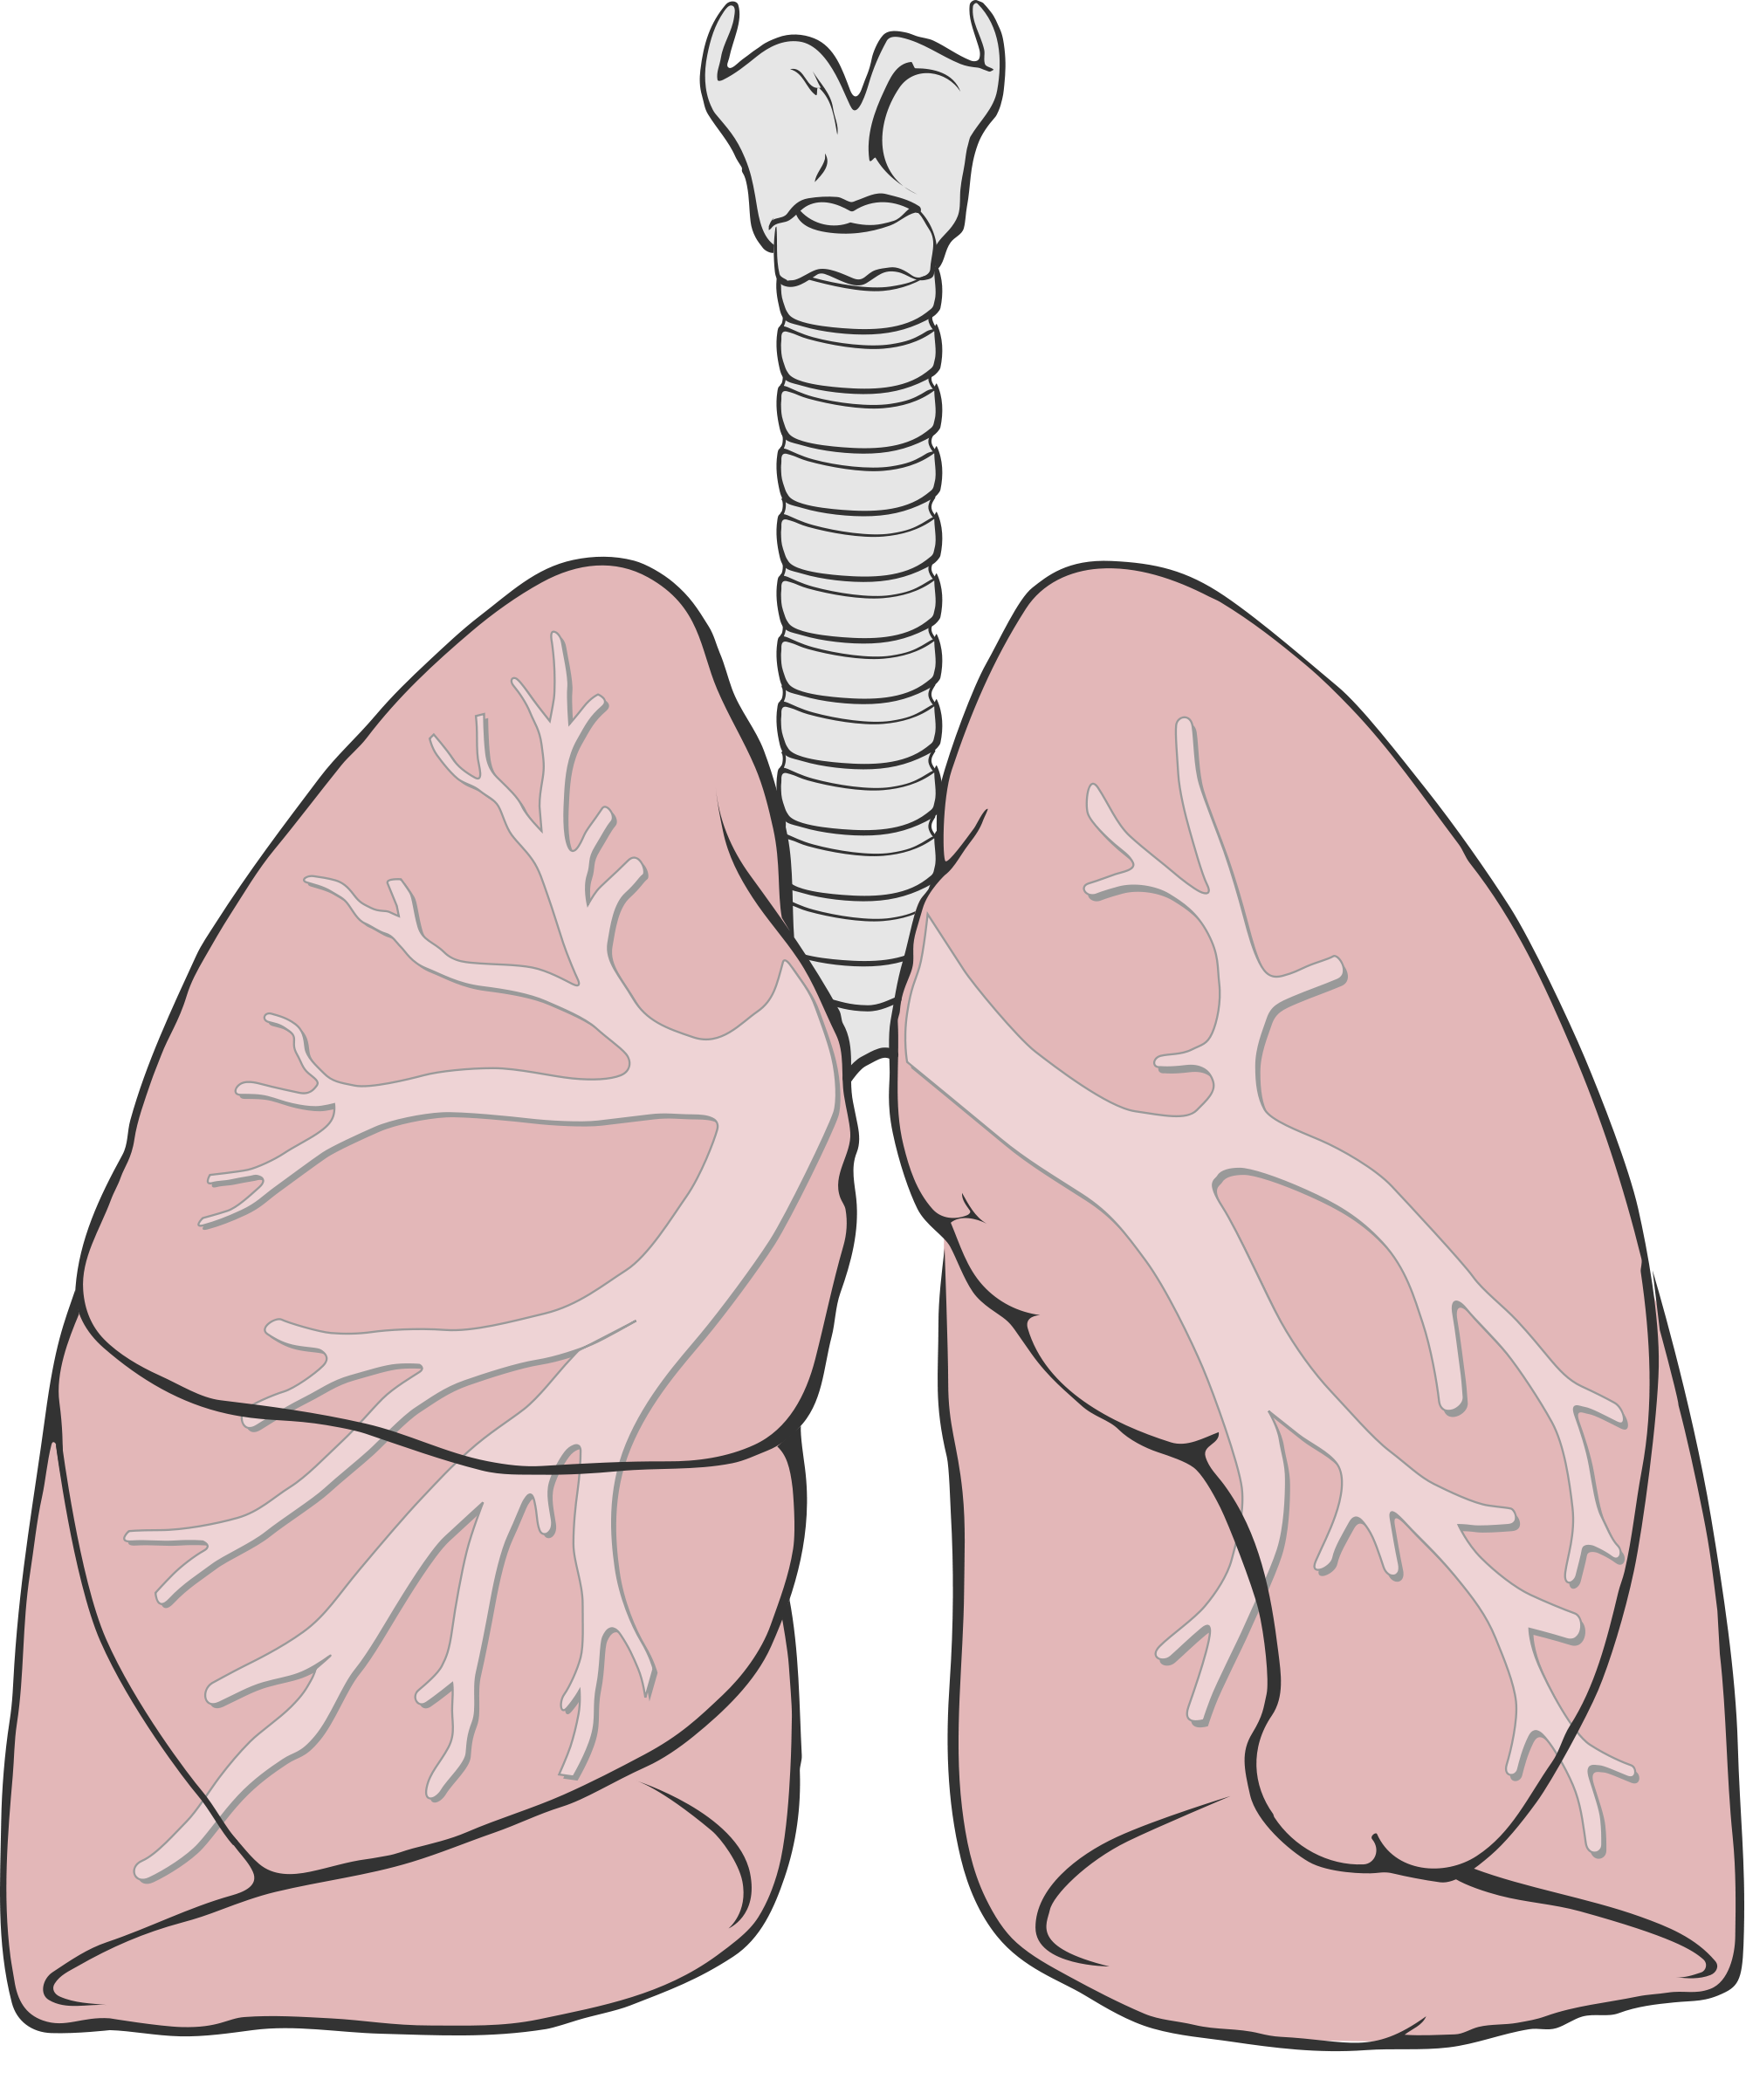
Nicotine Side Effects
Most Common
Mouth sores, blisters, or irritation
nausea or vomiting
Sore throat
Common
Acid or sour stomach
belching
diarrhea
dizziness
heartburn
hiccups
mouth, tooth, jaw, or neck pain
problems with teeth
unusual tiredness or weakness
Notes:
Nicotine doesn’t just have an effect on your brain it can also have effects all over your body
For example, using nicotine can also make your heart beat faster, because it can activate your “fight or flight response”
Nicotine can independently cause trouble breathing and damage to your lungs, outside of all the chemicals and toxins in cigarettes
Nicotine can cause you to have increased acid reflux
Also, it can cause insulin resistance, making it potentially more dangerous for those with diabetes
Nicotine can even negatively impact your reproductive organs

Slide 6
Thirdhand Smoke
Nicotine & other chemicals
Notes:
Another way that e-cigarettes/vape pens pose a danger to people other than the smoker is through third hand smoke.
Although it is not yet known whether secondhand smoke from e-cigarette/vape pen devices is harmful, there is evidence to show that third hand smoke is dangerous to others.
Third hand smoke is chemicals in e-cigarette/vape pen aerosol that remain on surfaces and in dust, even after the aerosol is gone, and react with other chemicals in the environment to form toxic chemicals.
These potentially harmful chemicals can be exposed to other people or animals through the respiratory system, through ingestions, and through skin exposure.
Small children are especially at risk for third hand smoke exposure because they tend to put things into their mouths and they have more vulnerable skin.

Slide 7
Addiction
Addiction is defined as a chronic, relapsing brain disease that is characterized by compulsive drug seeking and use, despite harmful consequences.
Notes:
Now that we have brainstormed our definitions of “addiction,” let’s take a look at the exact definition from the National Institute on Drug Abuse (NIDA)
It is considered a brain disease because drugs change the brain—they change its structure and
how it works. These brain changes can be long-lasting, and can lead to the harmful behaviors seen in people who abuse drugs.
Let’s break down this definition to better understand what it is saying.

Slide 8
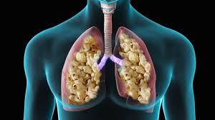
Consequences
Notes:
Incidents of e-cigarette explosions have skyrocketed over the past eight years.
This has raised public concern around the regulation of e-cigarette devices, since current regulation is not strict.
“Even though this is rare, is it really worth it to run the risk of this happening from even just one try of a cool flavor?”
There continues to be debate as to vaping and the incidence of popcorn lung (a condition that damages your lungs' smallest airways and makes you cough and feel short of breath).

Slide 9
References
Benefits of Quitting http://www.smokefree.gov
Quick Facts on the Risks of E-cigarettes http://www.cdc.gov/tobacco/basic_info

