Slide 1
Accounts Payable
Training

Slide 2
Accounts Payable Mission & Information
The primary mission of Accounts Payable is to ensure all payments processed by the department are done timely, accurately, and in compliance with the University; along with the federal and state rules and regulations, with excellent customer service and a commitment to continuous process improvement.
The following are some examples of the procedures in place for requesting payments for Vendors, Memberships, Subscriptions, Accreditation Fees, Agency, Stipends, and other types of payments.
All forms, instructions, and other pertinent information can be found on the Controller’s web site at http://www.atu.edu/controller/forms.

Slide 3
Accounts Payable
Request for Payment
Purchase Order Check Request
Non-Purchase Order Check Request
The following documents are required and must be received by Accounts Payable in order to process payments.
Purchase Order (signed & dated by authorized supervisor)
Original Invoice
Upon receipt of the above documents, Accounts Payable will process the invoice for payment in accordance with the established payment terms for that vendor. We ask that all purchase orders are forwarded to Accounts Payable directly after receiving goods or services. When applicable, contracts or quotes are required.
The following documents are required and must be received by Accounts Payable in order to process payments for non-purchase order check requests.
Check Request Form
Invoice or Itemized Receipts
Memo from Department Supervisor (in certain circumstances, *please see slide eight (8) for additional information)
Upon receipt of the above documents, Accounts Payable will process the check request for payment. We ask that all check requests and documents are forwarded to Accounts Payable directly after receiving goods or services.
An explanation of required documents to follow.

Slide 4
Supporting Documentation
Purchase Order Check Request
Acceptable Documentation:
Invoice (original)
  Vendor name, address, & phone number
  Invoice date & number
  Purchase order number
  Description of goods/services
  Amount of goods/services
  Sales tax (if applicable)
  Shipping charges (if applicable)
  Total amount due
  Additional Supporting Documentation (if applicable):
    When available – forward packing slips with PO.
  When applicable – quotes or contracts are required. However, a quote or contract does not take the place of an invoice.
    Unacceptable Documentation:
    Personal Checks or Bank Statements
    Credit Card Statements or Receipts
Non-Purchase Order Check Request
Acceptable Documentation:
Invoice (original)
  Vendor name, address, & phone number
  Invoice date & number
  Purchase order number
  Description of goods/services
  Amount of goods/services
  Sales tax (if applicable)
  Shipping charges (if applicable)
  Total amount due
  Itemized Receipt
  Memo (*please see slide eight (8) for additional information)
  Unacceptable Documentation:
    Personal Checks or Bank Statements
    Credit Card Statements or Receipts
    Agency Check Request
    Please visit the Forms page at www.atu.edu/controller for Agency check request instructions.

Slide 5
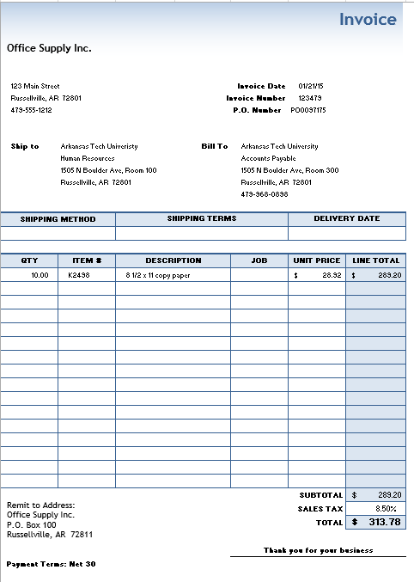
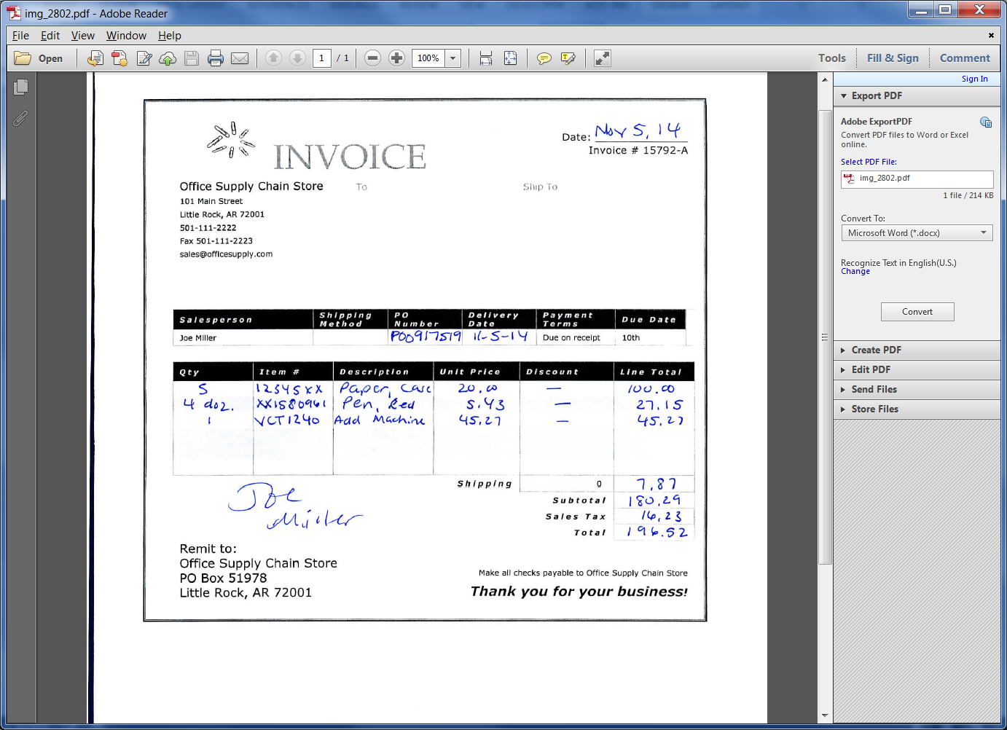
Supporting Documentation Examples
Sample Invoice
Sample Handwritten Invoice
  Vendor name, address, & phone number
  Invoice date & number
  Purchase order number
  Description of goods/services
  Amount of goods/services
  Sales tax (if applicable)
  Shipping charges (if applicable)
  Total amount due
Handwritten invoices require all information as other invoices, as well as, a company representative signature.
If an incomplete invoice is received, it will be returned for corrections to the appropriate department.

Slide 6
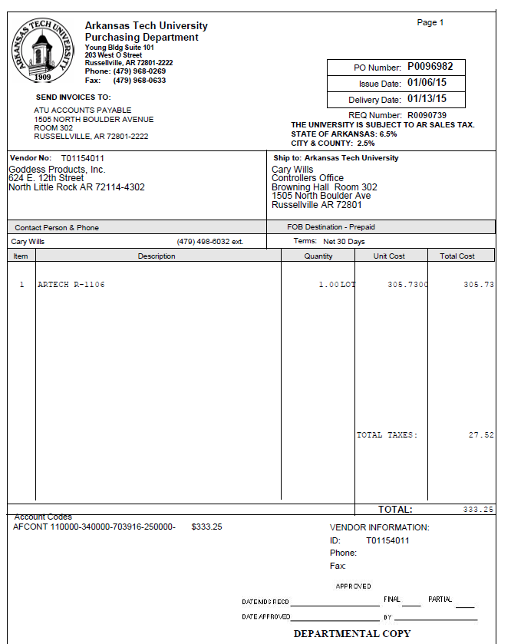
Purchase Orders
Prior to making a purchase with a vendor, a requisition must be entered and a purchase order created. For questions regarding requisitions and purchase orders, please contact Purchasing at www.atu.edu/purchasing or 968-0269.
Upon receiving goods/services, print purchase order
Complete bottom right portion of the purchase order:
  Enter the date goods/services are received
  Mark Final, if order is complete, or Partial, if order is incomplete
  Enter date of approval
  Departmental Supervisor signature is required

Slide 7
Paperclip the following forms together and forward to: Accounts Payable, Browning Hall, 3rd Floor
  Signed and approved Purchase Order
  Invoice
  *Packing Slip
  **Quote (if applicable)
  **Contract (special services)
  *If available – forward packing slips with purchase order.
  **When applicable – quotes or contracts are required. However, a quote or contract does not take the place of an invoice.
Contract (special services)
Quote (if applicable)
Invoice

Slide 8
Non-Purchase Order Check Request
Examples of check requests that do not require a purchase order are:
Memberships
Subscriptions
Accreditation Fees
Agency
Stipends
Postage
FedEx or UPS
A Request for Check Form will need to be completed and the following attached:
Invoice
Itemized receipt (if applicable)
*Memo (if applicable)
Contract (if applicable)
*A Purchase Order is required for all standard purchases, with the exception of those listed above. If the purchase order policy has not been followed for a standard purchase, please contact the Accounts Payable department at 968-0691 or 964-0512 for further instructions.

Slide 9
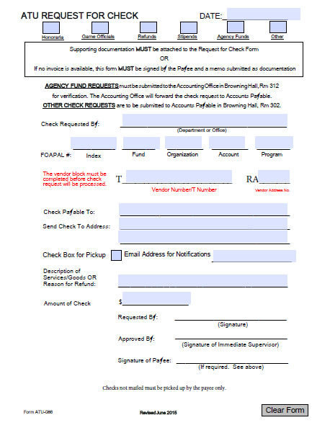
Request for Check Instructions
The Request for Check Form must be completed and submitted to Accounts Payable with supporting documentation in a timely manner. Incomplete forms will be returned, which will delay the payment process.
Please make sure that all required areas are filled in or marked appropriately.
Mark the type of check
Check Requested by: Department or Office
FOAP: Fund, Organization, Account, & Program code for your department. (Account information can be found at www.atu.edu, under Purchasing, Faculty & Staff, Account Code Listing.)
Vendor Number/T Number (Refer to Banner – Self-Service)
RA number (Remit Address, Refer to Banner – Self-Service)
Check Payable To
Send Check to Address
Description of Goods/Services or Reason for Refund
Amount of Check
Requester Signature
Approval Signature
Signature of Payee (required when an invoice is not present, i.e. Stipends)
For Agency check request instructions, please visit the Forms page at www.atu.edu/controller.
  If, for any reason, the check issued is no longer required, please write VOID on the check and return the check to the Controller’s Office, with an explanation, so that the check can be cancelled. Please do not shred the check.

Slide 10
Contract (special services)
Paperclip the following forms together and forward to: Accounts Payable, Browning Hall, 3rd Floor
  Signed and approved Check Request Form
  Invoice/Itemized Receipt (all receipts smaller than a standard sheet of paper should be taped to an 8 ½” x 11” sheet of paper, please do not staple)
  Memo (if applicable)
  Contract (special services)
Memo (if applicable)
Invoice/Itemized Receipt

Slide 11
Accounts Payable Contact Information
For questions regarding the Accounts Payable process please contact us at 968-0691 or 964-0512.
All forms, instructions, and training are located on-line at: http://www.atu.edu/controller or under on-line forms at www.atu.edu.
Arkansas Tech University
Controller’s Office, Browning Hall, 3rd floor
1505 N Boulder Ave
Russellville, AR 72801

