Slide 1

Agency Account Training
How to Complete an
Agency Check Request Form

Slide 2
Accounts Payable Mission & Information
The primary mission of Accounts Payable is to ensure all payments processed by the department are done timely, accurately, and in compliance with the University; along with the federal and state rules and regulations, with excellent customer service and a commitment to continuous process improvement.
The following information is in place to assist all Agencies on campus with detailed instructions on how to complete an Agency Check Request form.
All forms, instructions, and other pertinent information can be found on the Controller’s web site at https://www.atu.edu/controller/forms.php

Slide 3
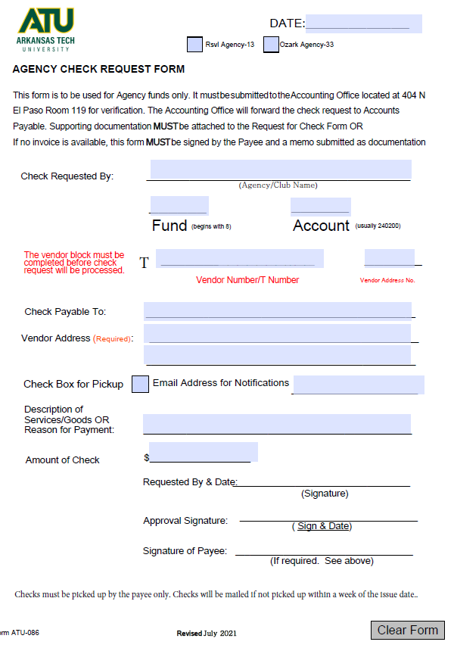
Request for Check Instructions
The Request for Check Form must be completed and submitted to the Accounting Office with supporting documentation in a timely manner. Incomplete forms will be returned, which will delay the payment process. All complete forms will be reviewed by the Accounting Office for funding availability & forwarded to A/P for processing.
Please make sure that all required areas are filled in or marked appropriately.
Mark: Russellville or Ozark Agencies
Check Requested by: Name of Agency/Club
FOAPAL: Agency fund(begins with 8) and account (usually 240200).
Vendor Number/T Number (Refer to Banner – Self-Service)
RA number (Remit Address, Refer to Banner – Self-Service)
Check Payable To
Send Check to Address/or email address for pick-up
Description of Goods/Services
Amount of Check
Requester Signature
Approval Signature (Authorized Personnel Signature – Agencies/Organizations should maintain a copy of the approved personnel)

Slide 4
Supporting Documentation
The following supporting documentation must be attached to the Request for Check form. Please do not staple documents or forms together.
Acceptable Supporting Documentation
  Invoices – listing goods/services
  Receipts – listing goods/services
    Hand-written receipts must be signed by company representative and include the company name & address on the receipt
  Memos
    For donations to other organizations
Unacceptable Supporting Documentation
  Debit/Credit Card Receipts
  Bank Statements
  Credit Card Statements
Receipts should be securely taped to an 8 ½ X 11” sheet of paper

Slide 5
Additional Information
Payees may not request or approve their own check
Checks will be mailed to Payee, unless otherwise noted
  Make a note on the Request for Check form if Payee would prefer to pick-up the check
    Include Payee’s email address. The Disbursing office will email Payee when the check is ready to pick-up
    Checks made out to individuals must be picked up by the Payee only (ID is required)
  Checks made out to vendors that are picked up will have a Receipt of Check Statement attached
    Individual picking up the check must sign out the check
    Vendor must sign Receipt of Check Statement, showing receipt of the check
    Receipt of Check Statement must be returned to the Disbursing office within 5 business days of delivery (Disbursing, Browning Hall, Room 307)
If a Vendor does not have a T number, please contact the Procurement office to set one up before submitting a request
Incomplete forms will be returned
If there are errors on the form or with the back up information, the individual who requested the check will be contacted via email in order to correct the errors
Please allow 3-5 business days to process requests
Agency checks are printed on Tuesday’s and Thursday’s only
  If, for any reason, the check issued is no longer required, please write VOID on the check and return the check to the Controller’s Office, with an explanation, so that the check can be cancelled. Please do not shred the check.

Slide 6
Gifts/Prizes/Awards
All purchases for Gifts/Prizes/Awards must have prior approval from the Controller’s Office before purchases are made. Please forward the completed Pre-Approval form to Suzanne McCall through campus mail or via email at smccall@atu.edu.
For goods over $50, gift cards, or cash, the Gift/Prize/Award Reporting Form must be filled out by each recipient and returned to the Controller’s Office within five days of receiving the gifts/prizes/awards.
Request for checks will not be processed until the correct forms are received for purchases of stated gifts/prizes/awards.
Please carefully review all procedures prior to making purchases and submitting requests.

Slide 7
Agency Contact Information
For questions regarding the Agency check request process, please contact the Accounting department at 968-0395 or accting@atu.edu.
All forms, instructions, and training are located on-line at: http://www.atu.edu/controller or under on-line forms at www.atu.edu.
Arkansas Tech University
Accounting Office
404 N El Paso Ave
Russellville, AR 72801
Phone: 479-968-0395
email: accting@atu.edu

