Slide 1
ATU Blackboard Expectations
Dr. Jeff Aulgur
jaulgur@atu.edu

Slide 2
Blackboard Ally

Slide 3
Transitioning to Teach Online (T2TOL)

Slide 4
https://thelearner101.wordpress.com/2019/03/11/eds-131-module-1-andragogy-and-adult-learners/

Slide 5
Simon Sinek – Start with Why
https://thriveglobal.com/stories/focus-on-the-why-instead-of-the-what/

Slide 6
Blackboard Expectations
“Regular and Substantive” Interactions
Post your syllabus
1. New School: Banner Syllabus Repository
2. Old School: Post in Bb as an “item”
Post your course schedule
Contact Information and Virtual Office Hours
Announcement and Email via Blackboard

Slide 7
“Regular and Substantive” Interaction
Differentiates between distance learning and correspondence education.
The Department of Education, to date, has not provided a clear and concise definition for “regular and substantive” interaction.
Distance education includes the internet, open broadcast, fiber optics, satellite or wireless communication devices.

Slide 8
Okay, so what is your point?
Simple answer: Title IV funding eligibility
Western Governors University (2017)
62% of students – one of 69 courses
Enrollment: 100,000 plus student
Audit called for $713 million federal aid payback
Eligibility for future financial aid (Title IV)

Slide 9
“Regular and Substantive”: 4 Elements
Interaction initiated by the instructor
Initiation of interaction must be regular and pretty frequent (strive for weekly)
Interaction must be meaningful or of an academic nature
Interaction initiated by qualified academic faculty

Slide 10
What constitutes interaction?
Providing direct instruction
Assessing student work / providing feedback
Providing information or responding to questions
Facilitating a group discussion

Slide 11
Syllabus Repository – New School

Slide 12
Syllabus Repository – Step 2

Slide 13
Syllabus Repository – Step 3 Note: Must be a PDF File

Slide 14
Syllabus Repository - Step 4

Slide 15
Syllabus Repository – Step 5

Slide 16
Syllabus Repository – Step 5

Slide 17
Syllabus Upload – Old School

Slide 18
Syllabus Upload – Old School

Slide 19
Course Schedule – Step 1

Slide 20
Course Schedule – Step 2

Slide 21
Contact and Virtual Office Hours

Slide 22
2 for 1: Announcements/Email

Slide 23
2 for 1: Announcements/Email

Slide 24
But I need a targeted email . . .
Follow these three steps:
Course Management (Left Hand Drop Down Menu)
Course Tools
Send Email

Slide 25
Targeted Email

Slide 26
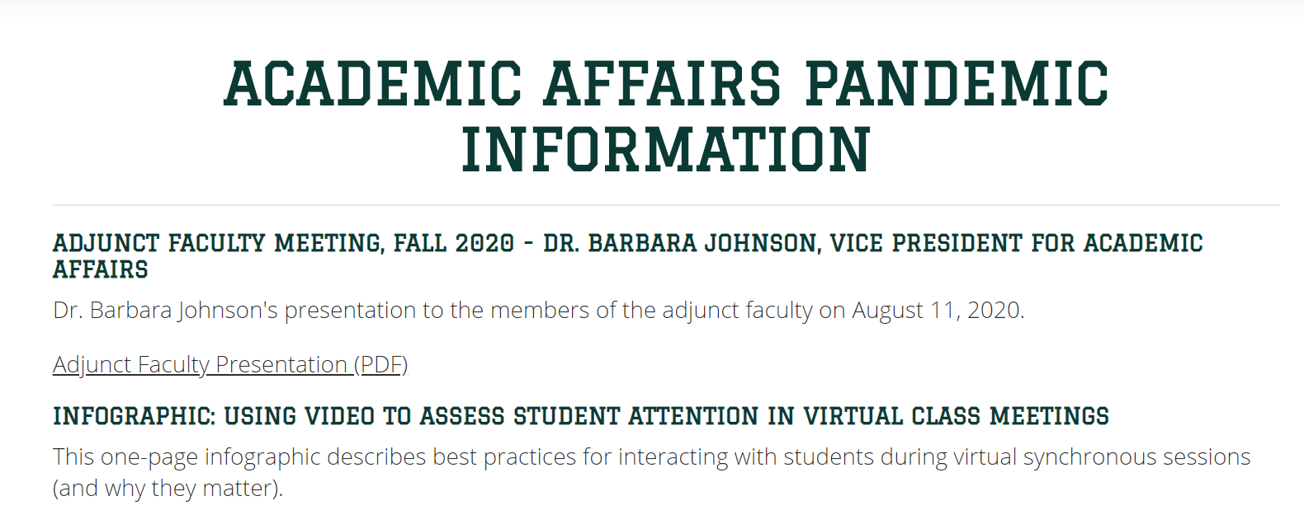
Can you send me the slide deck?
https://www.atu.edu/cetl/afpandemicinfo.php

