Slide 1
Weathering the Storm
After It Passes
Rubby W. Douglas,
LCSW-BACS
Section Chief Preparedness
Governor's Office of Homeland Security & Emergency Preparedness
Understanding Crisis Fatigue/Stress & How These Impacts Affects EM Staff and Those Supporting Survivors
FEMA Region VI
Higher Ed. Collaborative
4/12/2023

Slide 2
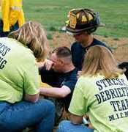
Workshop Objectives
What we'll cover in this session
What is Crisis Fatigue?
How These Impacts Affects EM Staff?
Resolutions & Remedies for Recalibration and Resiliency

Slide 3
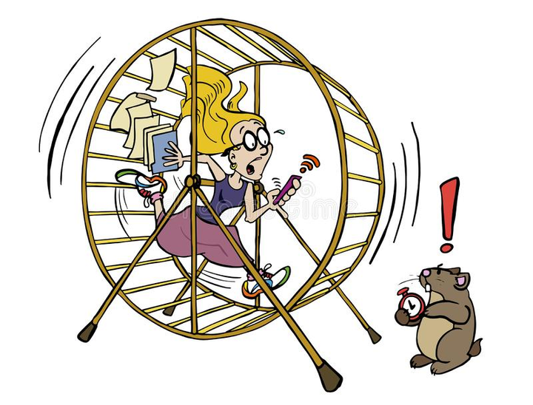
Feel like you are "working" non stop but not feeling like you are accomplishing anything
SELF
Check
Binging or overdulgencing
Negative impact on work performance
Distractibility, unable to complete tasks or remember things, forgetful or can't concentrate
Can you relate?
Had difficulty sleeping
Difficulty unplugging or being able to prioritize YOUrself
Short- tempered, irritability and frustration with others
Felt exhausted physically, mentally, emotionally or all of the above

Slide 4
What Is Crisis Fatigue?
...burnout response to chronic stress that challenging events can cause
Caldwell, et. all (2020)

Slide 5
Pressure Gauge
"Wear and tear on the body" or allostatic load
Cumulative burden from prolonged exposure to repetitive chronic stress and life events.
McEwen and Steller (1993)

Slide 6
THREE PHYSIOLOGICAL PROCESSES
01.
02.
03.
Frequent Stress
Failed Shut Down
Inadequate Response
Magnitude and frequency of response to stress is determines the level of allostatic load
Inability of the body to shut off while stress accelerated and the levels in the body exceeds normal levels
Failure of he body systems to respond to challenges

Slide 7
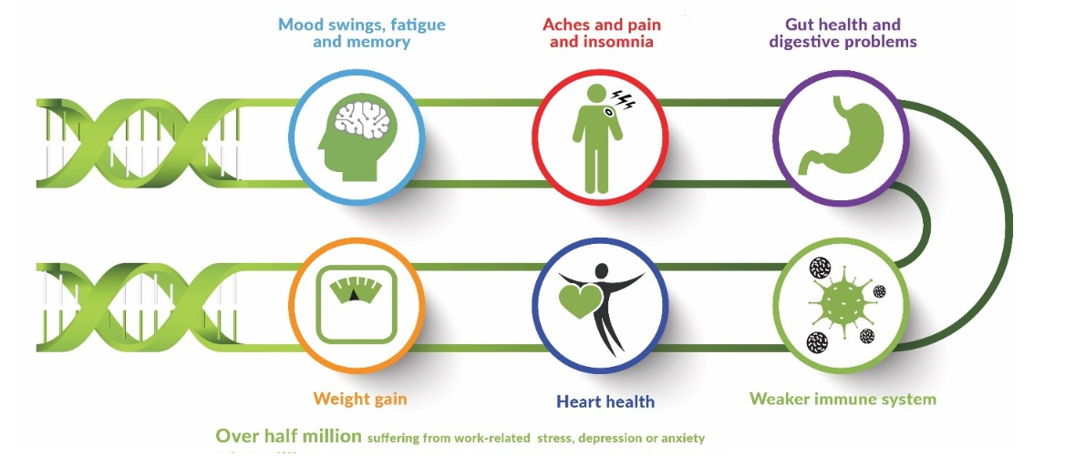
How Prolonge Stress Can
Affect Your Health
Naturally our body's defenses itself by a fight or flight reaction; however, continued exposures can negatively impact health, mood, productivities, relationships and quality of life.
https://mydnahealth.co.uk/how-stress-affects-your-health

Slide 8
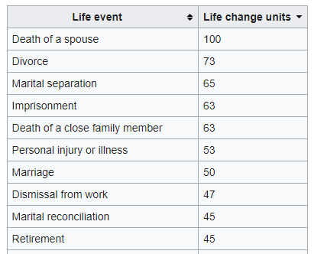
HOLMES & RAHE Stress Scale
Developed by Psychiatrists determine how stress yielded illnesses
Validity of study and development included medical patients and sailors who dropped out of underwater demolitions training due to medical problems.
Identifies 43 stressful life events that can contribute to illness
Scores of 300+: At risk of Illness
Scores of 150-299:
Risk of illness is moderate (reduced by 30% from the above risk
Scores of <150: Have slight risk of illness

Slide 9
Crisis Fatigue and Stress leads to Burn Out
Highest occupations with highest amount of burnout-related job turnover.
Microsoft's 2021 Work Trend Index
September 7, 2022
Mental health and well-being over the past two years have made significant negative impacts to personnel
Physician
Nurse
Retail/Fast Food Workers
Social Worker
Police Officer
Air Traffic Controller
EM Response Worker
Lawyer
Teacher
CPA
0
10
20
30
40
50

Slide 10
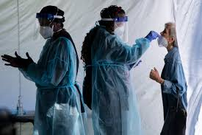
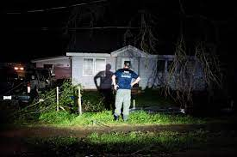
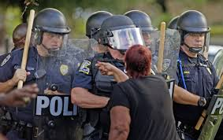
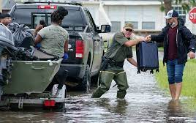
StressorsPRESENT
Share demands, adversities and tipping points familiar to you

Slide 11
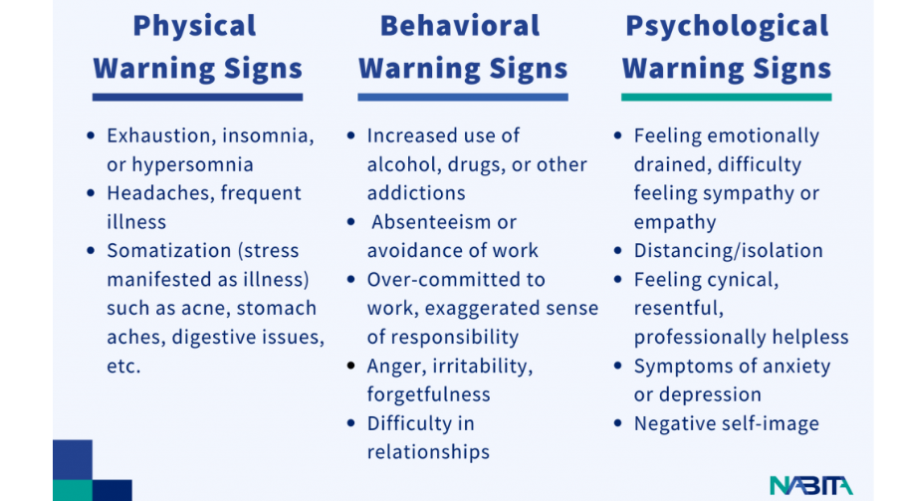

Slide 12
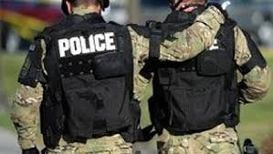
Trained ReActions
Versus
reality of Reactions
Observed and shared experiences from the field
I am having trouble sleeping...
I am so irritable.
I cannot concentrate and am so easily distracted
You seem short-tempered.
I cannot remember that
I am sorry resend that email as I don't recall getting it
My energy is depleted.
All I wanna to do is go home, sleep and watch TV.

Slide 13
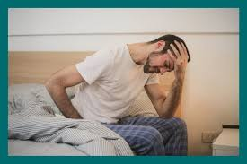
negative Impact
While affects may not be immediate, the results can be life changing.
Resignation
Early Retirement
Strained relationships and even divorce
Healthy issues
Increase behavioral health issues

Slide 14
Rethink
The cure for burnout isn't and can't be
self-care, it has to be all of us caring for each other"
-Emily and Amelia Nagoski
The Secret to Unlocking the Stress Cycle

Slide 15
Key Support Elements &
Priorities
Employee Assistance Programs
Crisis Counseling Support
Individual Therapy
Peer Support
Self-Care, Staff Support and Incorporating Key Touchpoints Embeds Coping Supports
SAMHSA First Response and Disaster Responders Resource Portal
Critical Incident Stress Debriefing
Psychological First Aid

Slide 16
Stop the Stigma.
Encourage Sharing, Supporting and Talking about it.
Lead by example and embed practices routinely

Slide 17
LESSON FROM THE PAST
1
2
3
Program your work with time off, family time and home life.
Check your "Cup".
Secure your Support Network
You cannot pour from an empty cup. Fueling with healthy choices like food, water, exercise and ample rest/sleep allows you to recharge. Recharging is purposeful and must be done with care.
There is no "I" in TEAM and we all share experiences that others may have had. Ask for help and what you need, accept help and know that you are not alone.
Hurricane Laura will be a ten year event and work cannot be done overnight. Pace and protect yourself to avoid burn out, illness and strain on the homefront.

Slide 18
Takeaways
Focus on your people.
In order to press "play" you may need to press "pause"
Maintain continual communication on wellness and acceptance to push pause
Just like you would test your equipment - check, observe and debrief your team
Explore other resources and support as needed

Slide 19
About the speaker
Rubby W. Douglas, LCSW - BACS
Preparedness Section Chief
Governor's Office of Homeland Security & Emergency Preparedness
7667 Independence Blvd.
Baton Rouge, LA 70806
225-358-5656
Rubby.Douglas2@la.gov

