Slide 1

Budget Advisory Committee
March 19, 2025

Slide 2
Anticipated FY26 Cost Increases
Property Insurance is projected to increase by $100,000
Entergy Arkansas has announced a 3% increase for all Arkansas residents utility expense
ADHE announced a $727,121 ($673,075.53 RSVL and $54,045.47 Ozark) reduction in ATU state appropriation
CUPA salary and benefit increase for the Russellville campus: $1,110,903 ($926,153 salary and $184,750 benefits)

Slide 3
Anticipated Funding Increases
Enrollment increase of 1.2% - (1)
Estimated a slight tuition Increase (if approved by BOT in April) – (1)
Identified savings from debt service issuance – (2)
(1) The enrollment and tuition increase will result in the University tuition and fee budget to remain flat with
FY25 budgeted numbers.
(2) The FY25 budget for the 2024 Student Fee Bond was budgeted at the projected 7% interest rate. After the
FY25 budget was completed, the bonds were sold for an actual interest rate of 4.1%. This created savings
that the University plans on using to offset the decrease in the amount of state appropriation.

Slide 4
Proposed Fee Increases
Ozark Fees: Non-Mandatory Fees
CTE General Technology Fee – $17.00 to $18.50 per credit hour resulting in projected new revenue of $8,637.
Allied Health Fee - $31.00 to $32.50 per credit hour resulting in projected new revenue of $14,597.
LGM2033 Course Fee - $186.00 to $191.00 resulting in projected new revenue of $180.00
LPN 1133 Clinical I - $402.00 to $655.00 resulting in projected new revenue of $6,831.00
LPN 1205 Clinical II - $402.00 to $655.00 resulting in projected new revenue of $6,831.00
LPN 1308 Clinical III - $402.00 to $655.00 resulting in projected new revenue of $6,831.00
Student Affairs: Non-Mandatory Fees
Student Activity Fee - $1.00 per credit hour resulting in a projected new revenue of $116,305
Administration and Finance: Mandatory Fees
Technology Fee - $1.00 per credit hour resulting in a projected new revenue of $142,729

Slide 5
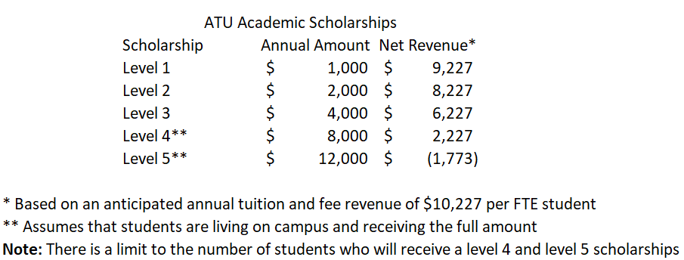
Scholarships

Slide 6
Looking Forward: FY27 and Zero Based Budgeting
Purpose: A zero-based budget (ZBB) is built from scratch to help verify that the supply budgets are cost-
effective, relevant, and the use of resources align with the University mission and priorities.
Benefits: Each department starts its supply budget at zero and must work with your Vice-President to justify
their supply budget, every year. This will create a more transparent and accountable system, ensuring every
dollar spent is directly tied to student outcomes and the University’s mission. All money allocated to a
department will have a purpose and keep waste and discretionary spending to a minimum.
Timeline: Fall 2025, each Vice-President will be given their budget amount and will start working with their
departments in how those funds will be allocated between them based on the actual need and goals of
that department to the University.
*Salaries, benefits, and debt service are fixed cost and will not be affected.
Notes:
For my report this month, I would like to take a look back on the 2023-24 academic year through the lens of the ATU 2025 Strategic Plan
I am pleased to report that Arkansas Tech University made significant strides in its strategic goals during the past year
The achievements and progress I am about to report to you are a direct result of the hard work and dedication of Arkansas Tech students, faculty and staff as well as the alumni and friends of the university who support us in so many ways, including those of you who give of your time to serve on the Board of Trustees

Slide 7

QUESTIONS

