Slide 1
Budget Office
RCB Room 406
Phone: 964-0821
https://www.atu.edu/budget/

Slide 2
WHO WE ARE
The Budget Team
  Sandra Cheffer, Director of Budget
  Matt Fraser, Assistant Budget Director
  Karen Alexander, Coordinator of Grants Management
  Lou Ann Reeves, Business Manager
  Becky Summey, Budget Specialist
  Thomas Walker, Restricted Fund Accountant
Responsible for: budget development, allocation and oversight, financial planning, grant and special projects management (restricted funds accounting), financial reporting
Goal: to ensure funds availability and proper handling of funds in compliance with budget, state, federal guidelines and laws

Slide 3
GRANTS & SPECIAL PROJECTS
Overview of E&G and Restricted Funds
SPUI and Budget Grant roles
  SPUI
  Budget
Expenditure alignment with grant guidelines
Time and Effort reports
P-card purchases
Matching
Indirect Cost

Slide 4
BUDGET ALLOCATION AND OVERSIGHT
FOAPAL
  F: Fund – Russellville, Ozark, Grant, Camp, Restricted
  O: Organization – Department
  A: Account – Expense category
  P: Program – Activity
Budget transfer
  Paper form available on website
  Work Flow
Budget transfer vs. recode of expense
  Transfer – before expense occurs
  Recode – after expense has occurred

Slide 5
NEW TOOLS!!
One Tech Financial Advisor Dashboard
Excel Budget and Payroll Spreadsheet

Slide 6
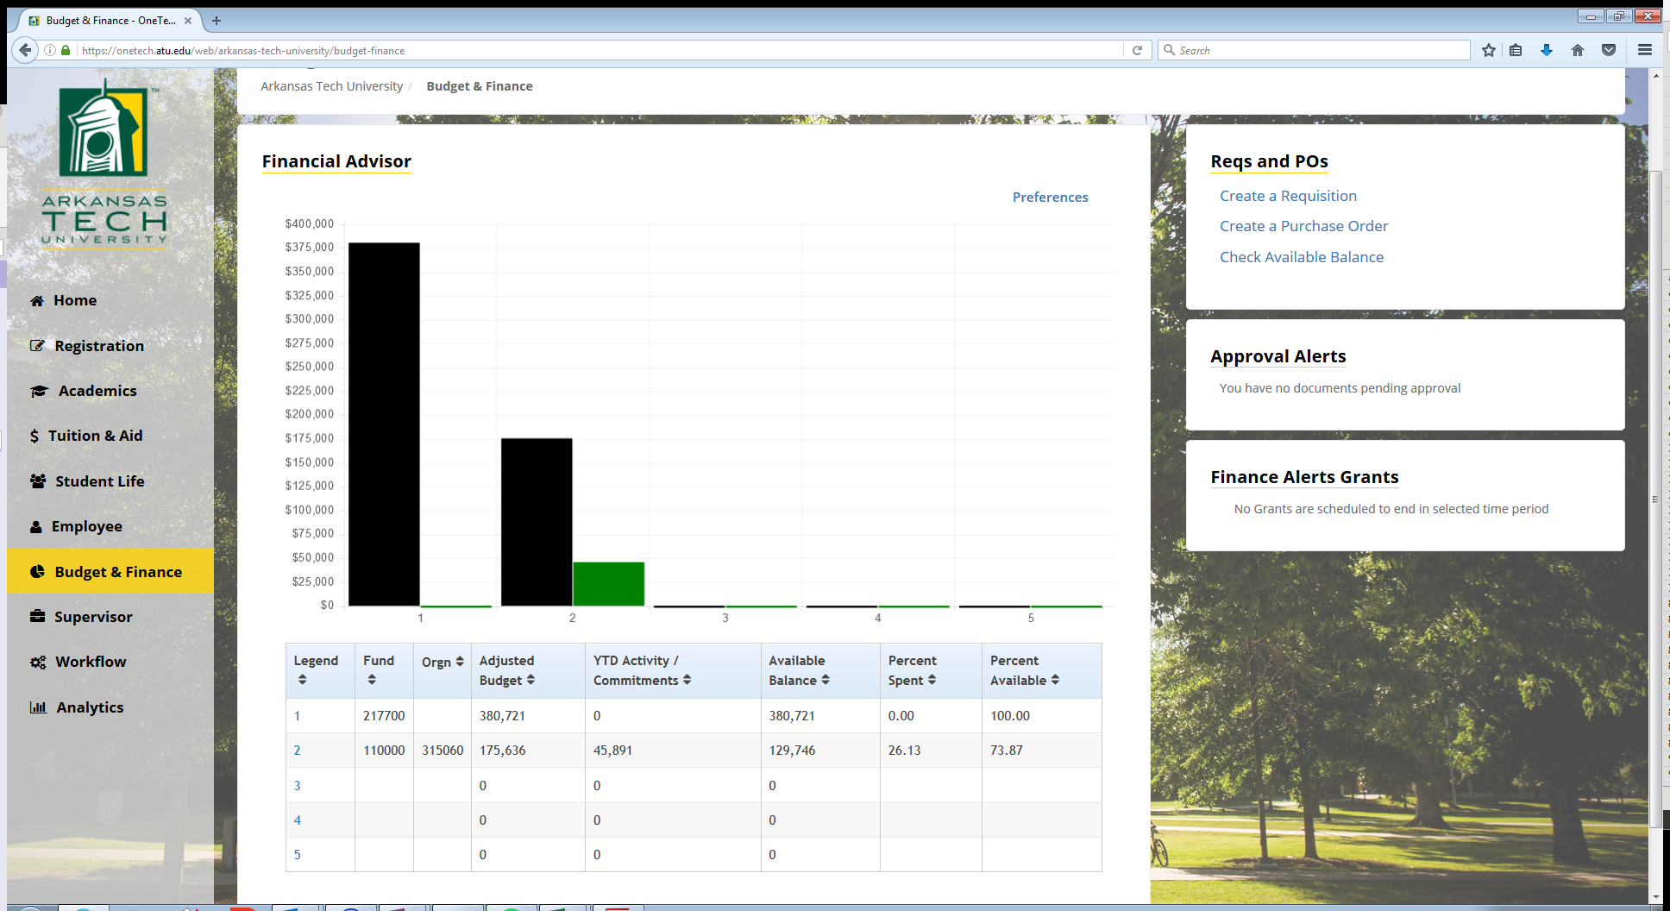
Financial Advisor Dashboard

Slide 7
FUTURE TRAINING SESSIONS
College Work Study
  August 16 in RPL 331
  9:30-11:00 and 2:30-4:00
Self-Service Budget Viewing
  October 30 in RPL 331
  9:00 and 2:00

