Slide 1
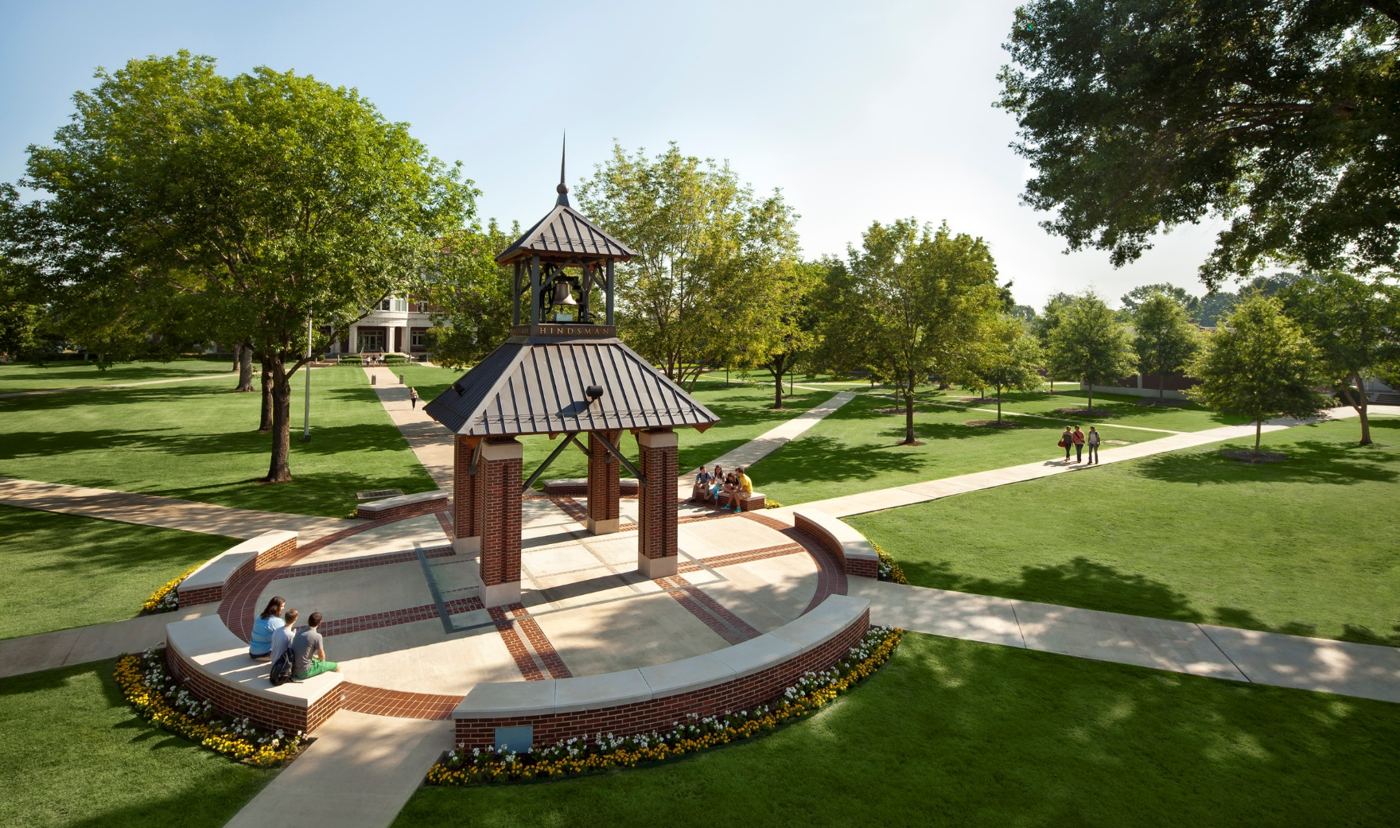
40th Arkansas Governor’s School July 7-August 3, 2019

Slide 2
Origins of Governor’s School
Idea developed in North Carolina in 1960s
Retain creative leaders and economic generators
Innovative approaches to learning
Challenge best and brightest to solve problems
Notes:
Governor’s schools began in North Carolina in the 1960s. They served many purposes, but among the most important were to retain creative leaders and economic generators in the home states, provide innovative approaches to learning, and challenge the best and brightest young citizens to confront contemporary challenges.

Slide 3
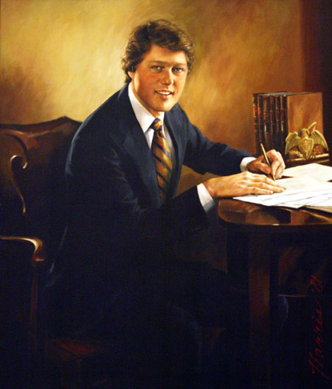
Arkansas Governor’s School
Started by Gov. Bill Clinton
First session was conducted in summer 1980
Notes:
Bill Clinton started the governor’s school in Arkansas in 1979.

Slide 4
AGS Areas of Study
400 rising high school seniors
Each specializing in one of the nine disciplines in AGS Area 1: Art, Drama, Choral Music, Instrumental Music, English/Language Arts, Mathematics, Natural Science, Social Science or Cybersecurity
Notes:
The school recruits 400 rising seniors in high school in nine fields in what’s called Area I: Art, Drama, Choral Music, Instrumental Music, English/Language Arts, Mathematics, Natural Science, Social Science, and a Specialty Area (ours this year is Cybersecurity). Students apply directly for each area and are accepted through a selection process involving teachers, ADE officials, governor’s office representatives, and AGS staff. The school also involves Area II which concentrates on epistemology/the nature of knowledge and Area III which concentrates on personal and social development. All classes are designed to be open, experiential and test free.

Slide 5
The “Tech Twist”
Maintaining the traditional AGS focus on arts and humanities
Unifying theme of technology
Cutting edge tools in modern classrooms and labs
Housing, recreation and nutrition facilities
Notes:
This year’s governor’s school adds a touch of technology to each curricular area of the program.

Slide 6
AGS Area I
English: writing for film, social media and the internet
Social Science: cybersocieties and online behavior
Math: cryptography and fractals
Music: pros and cons of digital editing
Drama: cinema for handheld media consumption
Natural Science: genomics and holograms
Visual Art: 3D printers, motion capture software and game engines
Cybersecurity: encryption and network vulnerabilities
Notes:
In English we will engage in discussions of writing for film, social media, and the internet.
In Social Science, we will study cyber-societies and deviant behavior online.
In Math, we will explore cryptography and fractals.
In Music, we will debate the pros and cons of digital editing.
In Drama, we will produce cinema for handheld media consumption.
In Natural Science, we will examine genomics and holograms.
In Visual Art, we will work with 3D printers, motion capture software, and game engines.
In Cybersecurity, we will learn about encryption and global network vulnerabilities.

Slide 7
AGS Area II
What is true?
--- Considered within the context of a connected world with instant access to information
Philosophy and Ethics --- Is technology changing humanity
and converting us into essentially cyborgs?
Implications of simulated reality, cybernetics, artificial intelligence, genetic manipulation and other technology
Notes:
The consideration of technology carries over into Area II where all students will grapple with the nature of truth in a connected and information accessible world. We will continue to focus on traditional questions of philosophy and ethics, but we will confront the idea that we are all essentially cyborgs. We will study how technology like the smart phone enhances the abilities of human beings that came before us. Speakers in the areas of science, philosophy, and science fiction will also offer insights into the practical, moral and philosophical technologies.

Slide 8
AGS Area III
Challenges of a Connected World
--- Cyberbullying
--- Social media based mass protest
--- Internet trolling
Civic Engagement
Community Development
Field trips, social time, exploration, speakers and films
Notes:
Taking the final step to personal and social development, Governor’s School Area III, students will face real-world challenges arising from a “connected world.” Students will confront issues such as cyber-bullying, social media based mass protest, and internet troll factories, and will have opportunities for civic engagement and community development. Finally, there is plenty of time for students to go on field trips, socialize, have fun, and explore.

Slide 9
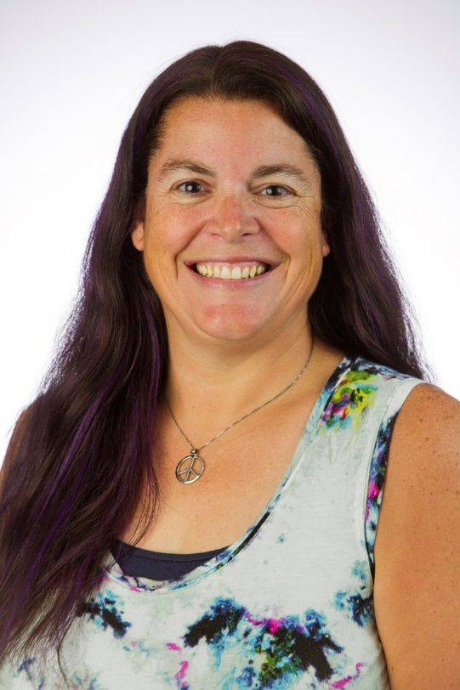
Program Director
Dr. Robin Lasey
Associate Professor of Chemistry
Founder, Board Member and Day Camp Director of the Community Science Network
Director of ATU Center for Excellence in Teaching and Learning
Notes:
Governor’s School will be on the Russellville campus of Arkansas Tech University from July 7 – August 3, 2019.

Slide 10
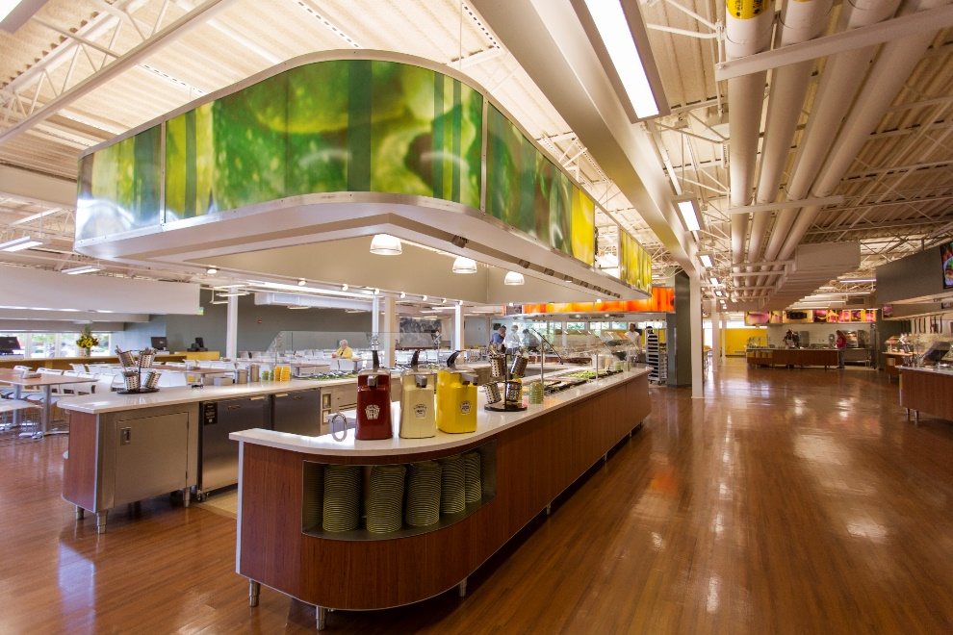
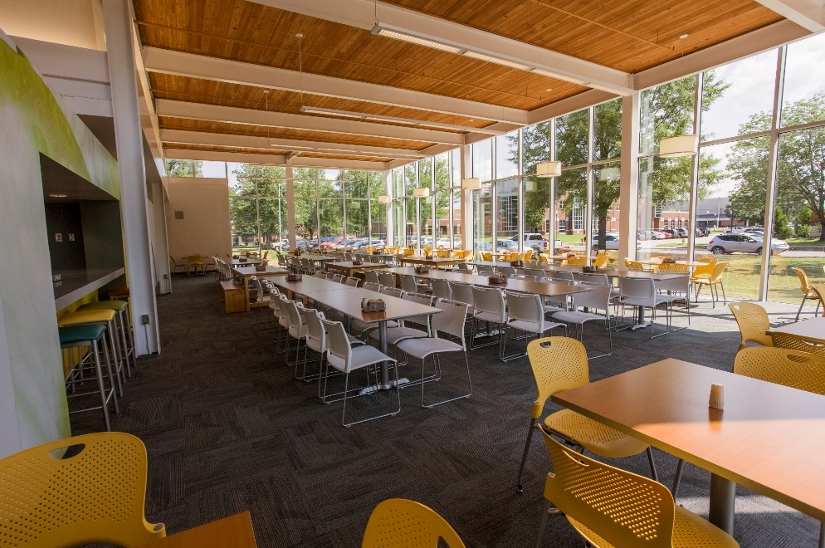
Food Services
Chambers Cafeteria

Slide 11
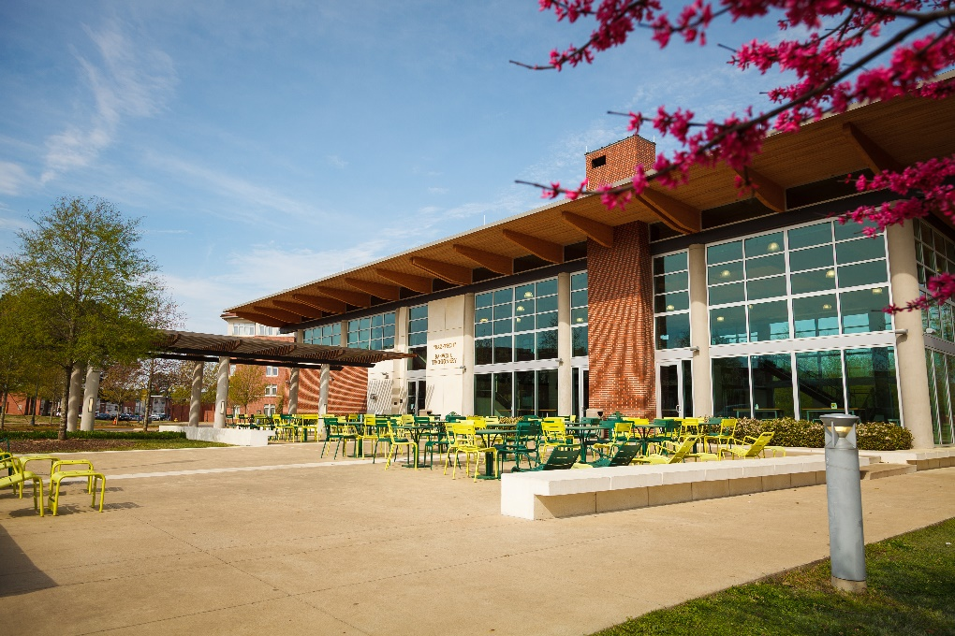
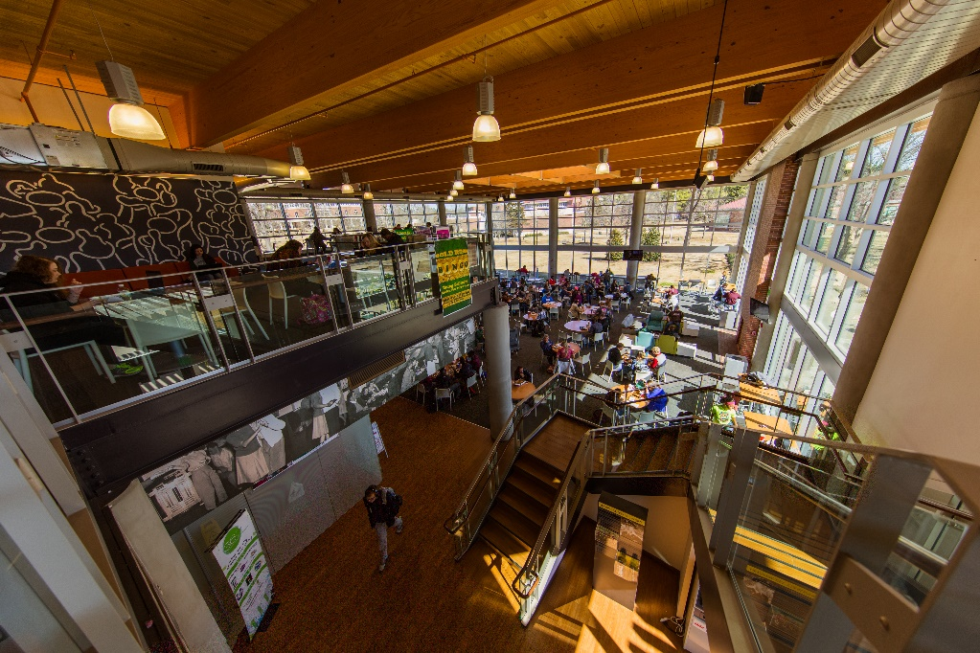
Food Services
Baswell Techionery

Slide 12
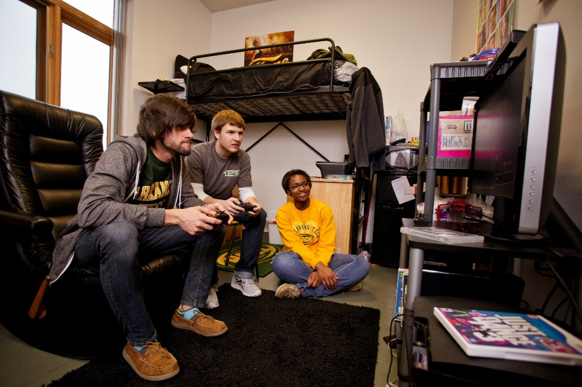
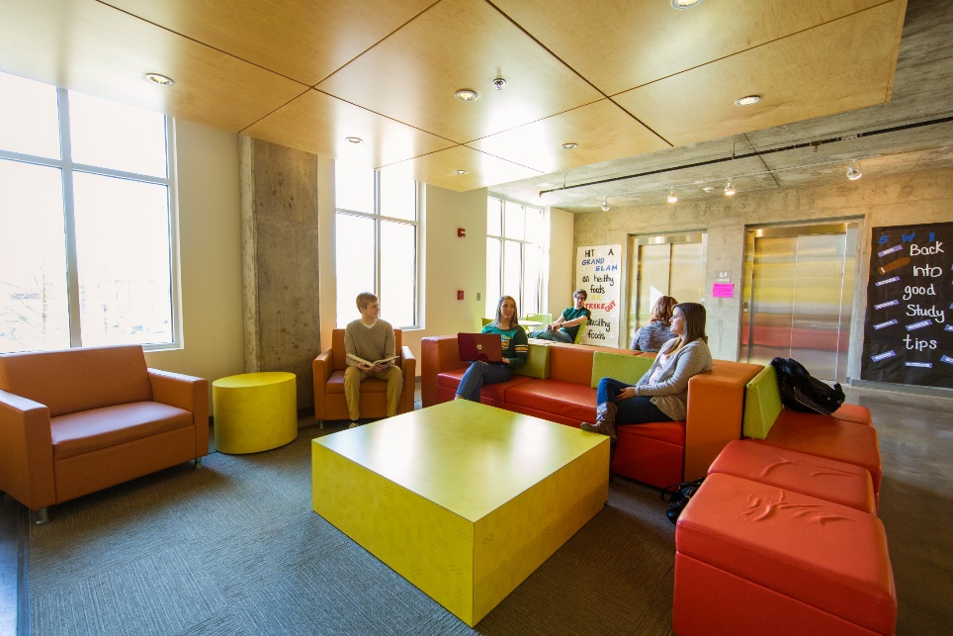
Residence Halls
Nutt Residence Hall and M Street Residence Hall

Slide 13
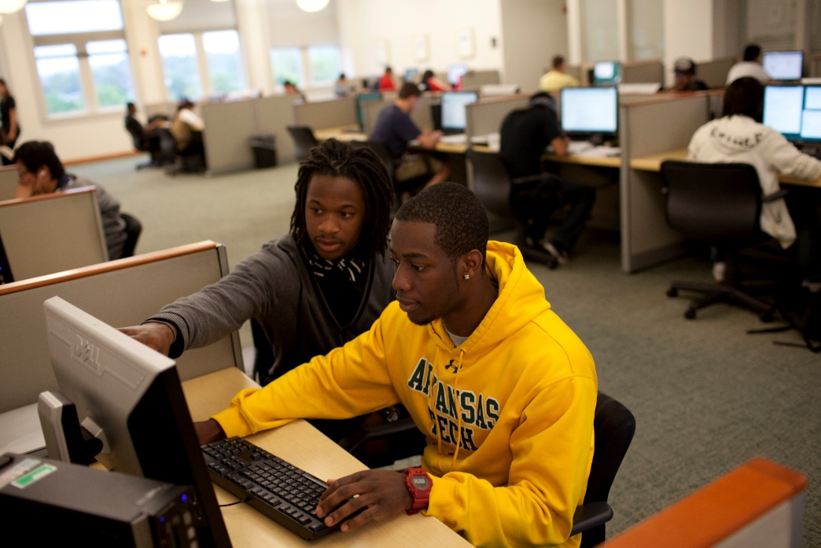
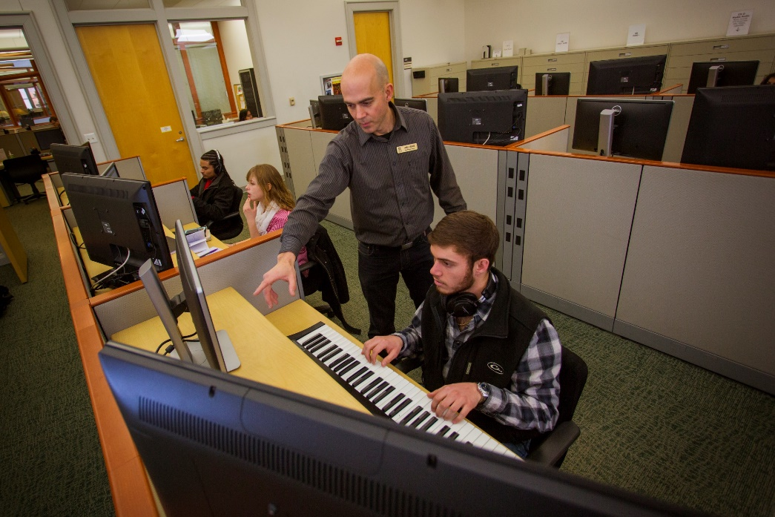
Library
Ross Pendergraft Library and Technology Center

Slide 14
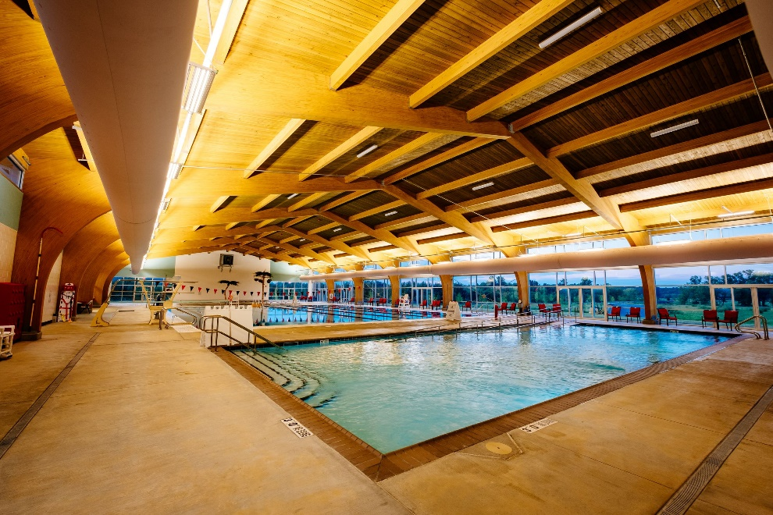
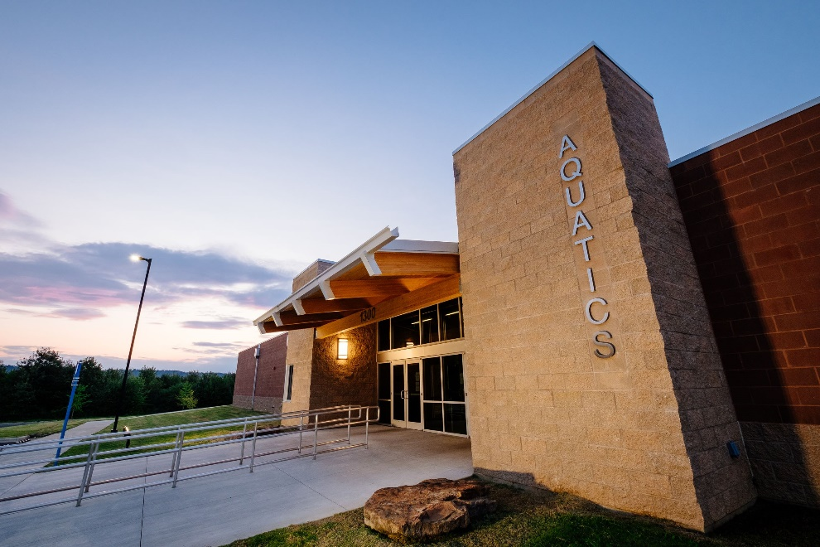
Recreational Facilities
Russellville Aquatic Center (Adjacent to Campus)

Slide 15
40th Arkansas Governor’s School
July 7-August 3, 2019 Arkansas Tech University Russellville
Apply at www.atu.edu/ags
Questions? Send e-mail to ags@atu.edu
Notes:
Classes will be led by about 30-40 faculty. 15-20 staff will also be helping out. High school students can get information and apply at https//www.atu.edu/ags/.

