Slide 1




HOW TO:
Look Up Classes

Slide 2


LET'S
BEGIN!

Slide 3


Note:
College Scheduler is a great tool to use to pre-plan upcoming future semesters
1
Login to OneTech
Find the “Registration Information” card in OneTech
2
Click the second drop down menu “Registration Quick Links”
3
Click “Plan Schedule (College Scheduler)” on the “Registration Quick Links” menu
4

Slide 4

Select the Term you are wanting to look at classes for
5
Select the campuses you want to view such as “Main (in-person)” or “Online” classes
6
Click “Add Course” and you will be able to view all the different subject areas and the classes which are available for that semester
7

Slide 5

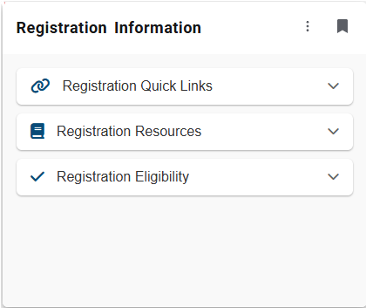
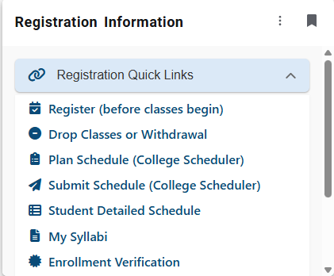
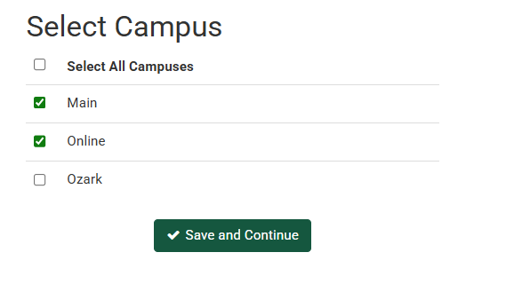
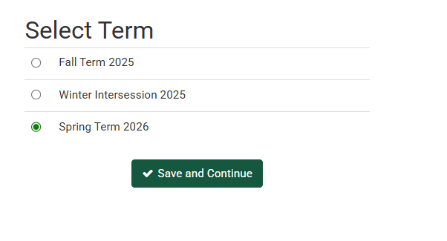

Slide 6
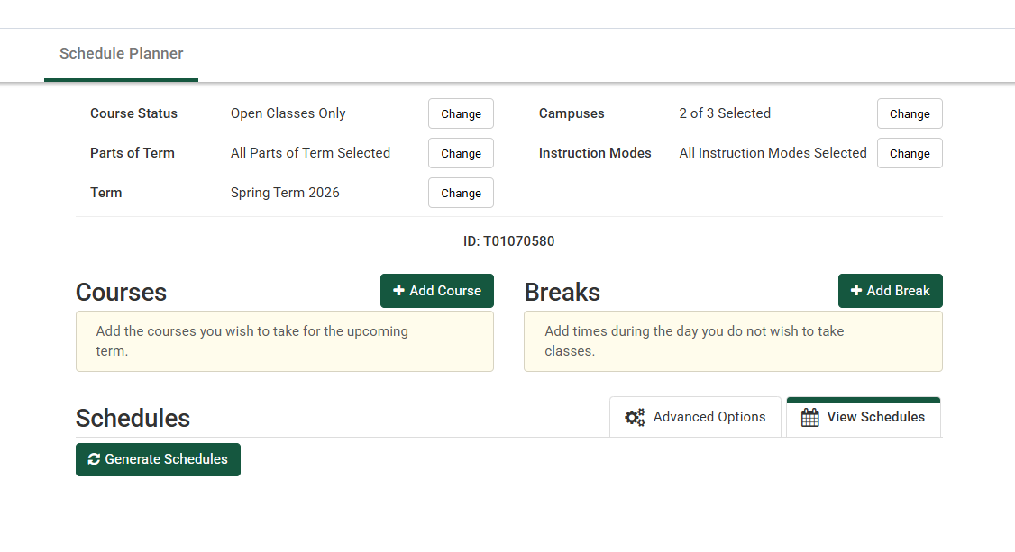
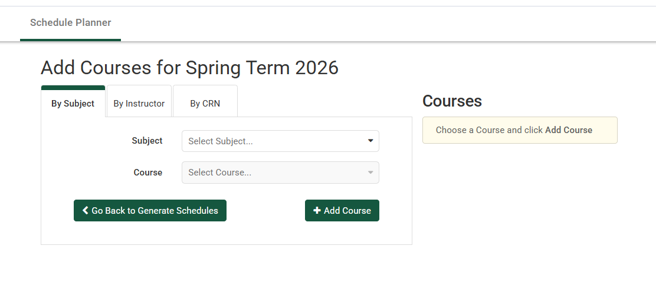

Slide 7

Contact Us!
Roy and Christine Sturgis Academic Advising Center
Center for Academic Advising and Career Development
106 West O Street
Rothwell Hall, Suite 107
Russellville AR, 72801
Phone: (479) 964-0843
Email: adviseme@atu.edu
www.atu.edu/advising

