Slide 1




HOW TO:
Find Your Advisor

Slide 2


LET'S
BEGIN!

Slide 3


Note: Advisors have multiples students in various disciplines that they advise. Please give them ample time to respond to your email.
1
Login to OneTech
2
Search for the “Advisor Information” Card
This will return the contact information for your advisor
3
Always give your advisor 24 hours for a response
4

Slide 4

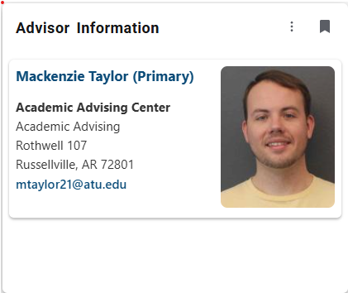

Slide 5
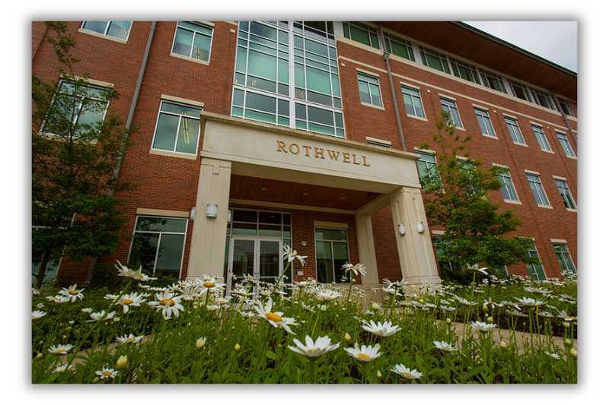
Contact Us!
Roy and Christine Sturgis Academic Advising Center
Center for Academic Advising and Career Development
106 West O Street
Rothwell Hall, Suite 107
Russellville AR, 72801
Phone: (479) 964-0843
Email: adviseme@atu.edu
www.atu.edu/advising

