Slide 1




HOW TO:
Contact Your Professors

Slide 2


LET'S
BEGIN!

Slide 3


Note:
Always check your professors office hours in the syllabus before requesting a specific time to meet!
1
Login to OneTech
Check your syllabus for the name of your professor
2
3
Find the “Directory” card in OneTech
Click “Banner Directory Search” on the “Directory” card
4

Slide 4
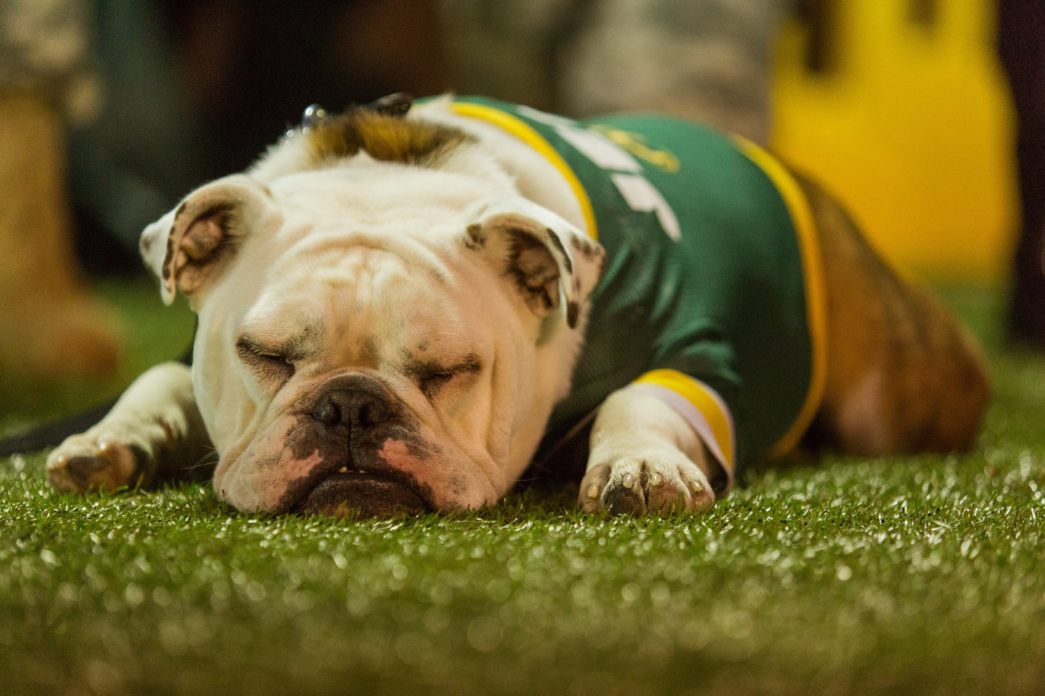
Type the name of your professor where it says “Name” and make sure that the “Search Type” is set to Faculty/Staff
5
This will return the contact information for your professor
6
Always give your professors 24 hours for a response and only ask to schedule to meet them during their scheduled office hours per the syllabus
7

Slide 5

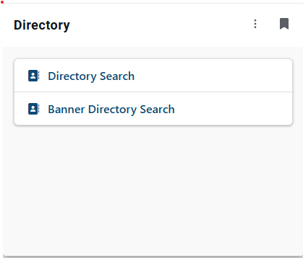
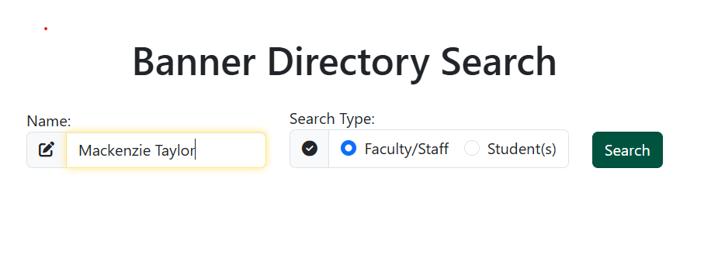
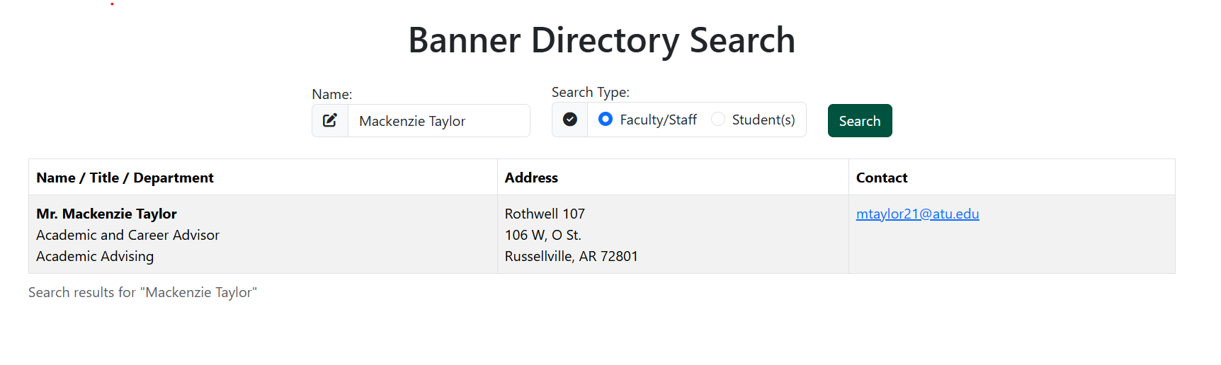

Slide 6
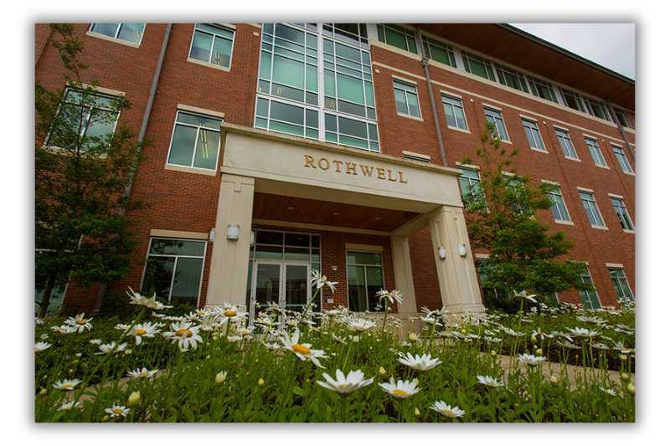
Contact Us!
Roy and Christine Sturgis Academic Advising Center
Center for Academic Advising and Career Development
106 West O Street
Rothwell Hall, Suite 107
Russellville AR, 72801
Phone: (479) 964-0843
Email: adviseme@atu.edu
www.atu.edu/advising

