Slide 1
The journey from themed housing to academic based
Living learning communities
Vice President FOR student services, Dr. Keegan Nichols
Dean of students, amy Pennington
Assistant Vice President for Student Success and Associate Professor of Psychology, Dr. Jason Warnick
Assistant Dean for residence life, Colette tobias
Area coordinator, Samantha piechocinski

Slide 2
outline
Living Learning Community Purpose
National Study of Living Learning Programs (NSSLP) Data
Tech’s OLD LLC Model Overview
Tech’s New LLC Model & Opportunities
Next Steps

Slide 3
What is a living learning community (LLC)?
Increase Academic Readiness
Retention initiative
Students take common courses and live together
Faculty engagement
Higher GPAs
Notes:
Research by Brower and Inkelas (2010) illustrate that
Living Learning Programs/Communities (LLCs) are residential housing programs that incorporate academically based themes and build community through common learning.
A study from the University of South Florida stated academic based learning programs had higher GPA than theme or interest based learning programs.
A study at the University of Toledo also showed an increase in average GPA of LLC participants vs non LLC participants for first year students.

Slide 4
National Study of Living Learning Programs (NSLLP):
46 Institutions
22,258 Students
617 Living Learning Programs
64% included 1-3 faculty members
  Common involvement: teaching, conducting workshops, mentorship, academic advising
85% utilized student affairs staff
  Administrative tasks, residential space, live in staff, facilitating social events

Slide 5
National Study of Living Learning Programs (NSLLP):
Top 5 goals of LLC programs
TOP 5 GOALS OF LIVING LEARNING COMMUNITIES PROGRAMS:
  1. Experiencing a smooth academic transition to college (55%) *
  2. Feeling a sense of belonging to the institution (54%)
  3. Demonstrating openness to views different than one’s own (52%)
  4. Learning about others different than one’s self (50%)
  5. Experiencing a smooth social transition to college (50%)
    *These are the percentage of L/L programs that indicated these goals were “very important”

Slide 6
NSLLP Case study findings
Academic/Student Affairs partnerships
Peer interaction/bonding
Academic Coursework Integration
First-year student impact
Notes:
Academic/Student Affairs partnerships integral to effective living‐learning programs, but partnerships can take different forms.
Peer interaction/bonding is the most powerful influence on students in living‐learning programs
Effective living‐learning programs have integration across all the activities within the program
Those students who had lived in an LLP during their first year in college had higher levels of academic self-confidence, were more likely to be a mentor for other students, and remained more committed to civic engagement three years later.

Slide 7
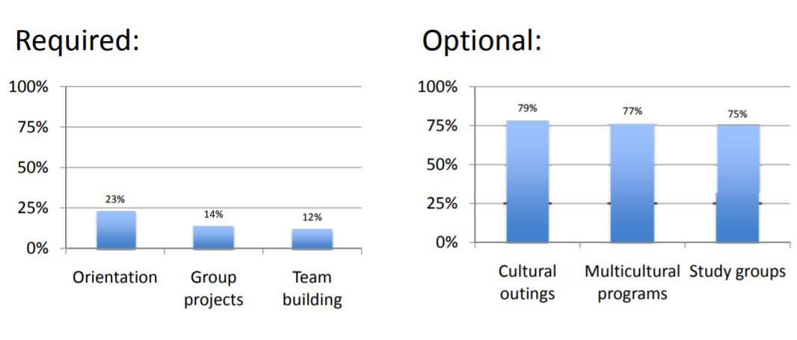
NSLLP Co-curricular activities offered
Notes:
One thing that is not mention but most programs at the NLP Conference also had additional required one hour workshops to enhance material of gateway courses

Slide 8
National Study of Living Learning Programs themes
Civic & Social Leadership
Disciplinary
Fine & Creative Arts
General Academic
Residential College
Research
Women’s Wellness/Health
ROTC
Transition
Umbrella
Honors
Cultural
Leisure
Political Interest
Upper Division
Notes:
The National Study of Living-Learning Programs (NSLLP) assesses how participation in Living-Learning Programs (LLPs) influences academic, social, and developmental outcomes for college students. NSLLP is administered
annually with both cross-sectional and longitudinal components. It is the only national outcome assessment of these programs.
NSLLP uses the "inputs-environments-outcome" (I-E-O) model developed by Alexander Astin (1993) to serve as the conceptual framework for assessment.
According to NSLLP, the I-E-O model suggest student outcomes (academic and social transition to college, perceptions of self-confidence, appreciation of differences etc.) result from both student inputs (demographics, high school achievement, precollege characteristics etc.) and college environments (various classes, programs, policies, peer interactions, experiences etc.).

Slide 9
Tech’s old themed housing model
Arkansas Tech University’s Department of Residence Life has four Themed Communities:
*student quotes about experience*
Engineering (College of Engineering & Applied Science)
  Hover craft competition
  Engineering week
  Ghost hunting
  Engineering 101 student panel
  Supplemental Instructor
First Year Experience (College of Education)
  Tech Traditions
  Tech Fit
  Tutoring & Wings
  Community Service
  Study Breaks
  Awareness Programming
Agriculture (College of Engineering & Applied Science)
  Ag Cook Out & Tailgate
  Fall on the Farm
  Thank a Farmer
  Ag Olympics
  Ag Around the World
Hospitality (College of Engineering & Applied Science)
  Lunch with a Leader
  Hospitality Expo in Little Rock
  Hospitality Games Competition
  Tour a local hotel
  Do the Right Thing & Wings
  True Colors Personality Test
Notes:
“I feel like it made the transition from high school to college much easier and smoother. Allowed me to get to know my classmates better and make good friends in my area of study.”
“The LLC has taught me how to become successful in college through the classes that they offer. The LLC also has helped me become more independent and grow a network of faculty and students.”

Slide 10
Tech’s Old themed housing gpas
Agriculture Fall 2015 2.67 Fall 2016 3.08
First Year Experience Fall 2015 2.71 Fall 2016 2.62
Hospitality Fall 2015 N/A Fall 2016 2.86
Engineering Fall 2015 N/A Fall 2016 2.69

Slide 11
Tech’s New living learning community model
LLC First Year (incoming freshmen only)
  14-30 residents per LLC
  Residents must be enrolled in:
    Fall
      LLC Related Course
      Gateway Course*
    Spring
      LLC Related Course
      Gateway Course*
  Exclusive Program Opportunity
    Alternative Spring Break*
    Summer Study Abroad*
    LLC Specific Internship*
*Recommendations – not required

Slide 12
NEW LLC Opportunities
Imagine the possibilities of your college leading your students through one of these majors in clusters that live and learn together!
College of Engineering & Applied Science
  Computer Science 47
  Pre Vet 27
    *Highest Agri Bus / Mech Eng
College of Arts & Humanities
  Game & Interactive Media Design 36
  Psychology 64
College of Business
  Management & Marketing 52
  Accounting 31
College of Education
  Elementary Education 51
  Health Physical Education Teacher Licensure 42
College of Natural & Health Sciences
  Nursing 170
  Biomedical Biology 74
Undeclared
  Undeclared 216
*Numbers based on Fall 2017 incoming freshmen class
Notes:
Use these declared and undeclared incoming freshmen majors as potential opportunities to start an LLC based on major interest.

Slide 13
Next steps
Complete NEW Living Learning Community application
    Faculty must apply annually
    Application is available today on the Residence Life webpage: https://www.atu.edu/reslife/forms.php
      Application is due December 15th 2017
      Decisions will be sent via email by January 16th 2018
      Marketing correspondence will go out January 2018
      Residents sign up for LLC February 2018
      Faculty / Partnership Training March 2018
      Program planning meetings will begin March 2018
    LLC evaluations will be considered by the LLC committee in the renewal process (starting next year)

Slide 14
Next steps
Faculty / Staff Commitment
  Faculty/Staff Coordinator responsible for meeting monthly with Residence Life Staff
  Faculty/Staff responsible for recruiting students to live in LLC
  Faculty/Staff will oversee/instruct course(s) connected to LLC
  Faculty/Staff will collaborate with Department of Residence Life to develop programmatic curriculum that correlates with classroom experience
Faculty / Staff Benefits
  Research, presentation, and publication opportunities
  Representation for your college
  Great addition to academic portfolio
  Help students increase GPAs and graduate

Slide 15
Next steps
Residence Life Commitment
  Provide website and printed marketing
  Identify and provide space for residents
  Supplemental programming funds for residents
  Live in staff support
  Assist with developing programmatic curriculum that correlates with classroom experience
Residence Life Benefits
  Increase student GPAs
  Increase residential and campus retention
  Enhance connections with Academic Affairs

Slide 16
references
Astin, A. W. (1993). What matters in college? Four critical years revisited. San Francisco: Jossey Bass.
Beckett, A., Brower, A., Hobgood, K., Inkelas, K., & Seyforth, S. Designing effective living learning communities. The National Study of Living Learning Programs. Retrieved from https://www.uwstout.edu/learncomm/upload/oct6effectivellcs.pdf
Brower, A. (2008). More like a home than an hotel: the impact of living-learning programs on college high-risk drinking. The Journal of College and University Student Housing, 35, 38. Retrieved from https://www.uwstout.edu/learncomm/upload/oct6effectivellcshandout.pdf
Brower, A. & Inkelas, K.. (2010). Living learning programs: one high impact educational practice we now know A lot about. Association of America Colleges & Universities: Liberal Education, 92. Retrieved from https://www.aacu.org/publications-research/periodicals/living-learning-programs-one-high-impact-educational-practice-we
Griffith, S., Ning, B., & Wang, S. (2010). The impact of living learning community participation on 1st year students’ gpa, retention, and engagement. Retrieved from https://cerpp.usc.edu/files/2013/11/Wang_Griffith_andNingAIRPresentation2010.pdf
Nanna, E., Skillman, L., & Zgela, A. (2011). Living-learning community best practices: A collaboration between academic and student affairs [PDF document]. Retrieved from http://naspafl.org/Resources/Documents/presentations/LLC.pdf
Stier, M.M. (2014). The relationship between living learning communities and student success on first year and second-year student at the university of south florida. Retrieved from http://scholarcommons.usf.edu/cgi/viewcontent.cgi?article=6329&context=etd

