Slide 1
College Work Study
Presented by :
Budget, Human Resources, and Financial Aid

Slide 2
The Involvement Circle
CWS
Budget:
The Money
Human Resources: Employment Paperwork
Financial Aid: Eligibility & Assignments
Payroll: Timesheets

Slide 3
BUDGET

Slide 4
Budget Office
Lou Ann Reeves
College Work Study
Office: 964-0821 Ext 3508
Email: rreeves5@atu.edu
Brown Hall, Suite 406
105 West O Street
Russellville, AR 72801
Phone: (479) 964-0821

Slide 5
College Work Study Funds
College work study funding is a federal award granted to ATU for the benefit of our student workers. Campus wide-cooperation is vital to the usage and expenditure of these funds each fiscal year to benefit all eligible students.
Department budget shows 25% portion.
Only portion that should be listed when completing a budget transfer if asked to provide funds for your department.
Some funds are budgeted in the department, but most are held in contingency pools that feed the departments.

Slide 6
Important Facts
All paperwork must be completed and turned into Human Resources. Human Resources will forward the paperwork to Financial Aid who will then forward to the Payroll Office. Requests must be received by the 22nd of the month. (ATU Student Employment Handbook)
Eligibility: based on FAFSA information
Award: Amount student is allowed to work given the department budget and request submitted
Benefits:
Less taxes for the students
Cheaper option for the department
Student assignments do not show as encumbrances on Self-Service Banner
Assignments will be reduced to earnings after the last semester payroll is processed. After reduction, available funds are assessed and distributed to areas in need. Campus-wide cooperation is necessary to ensure funds are expensed before the end of the fiscal year. Any unexpended funds could result in a decrease of future federal award funding.

Slide 7
Thinking Process
How much student labor is needed to help our department?
How many students will it take to cover the need?
What are the college work study and non-work study department balances?
Identify the students to work.
Are the students college work study eligible?
If so, determine eligibility
Submit student worker request for hours TO BE worked.
Make sure to use college work study funds first! (if available)

Slide 8
HUMAN RESOURCES

Slide 9
Office of Human Resources
Mervin Vergara
Student Workers
Office: 964-0583 Ext 2209
Email: mvergara@atu.edu
Brown Hall, Suite 434
105 West O Street
Russellville, AR 72801
Phone: (479) 964-0583
Fax: (479) 968-0693

Slide 10
Human Resources Procedures
Background Checks
“Effective July 1, 2017, any student worker needing security access will be required to go through the background check process before they can gain access to Banner or other computer systems here at Tech.” (from Student Employment Handbook)
Takes a week to complete
Good for one year
Request Forms
Personnel Packets
Terminations

Slide 11
Procedures for Student Workers
Department offers student a job and prepares “Request/Assignment for Student Employment”
Requests are completed as such:
January – May
June only
July only
August - December
Human Resources-Resources and Forms-under General Forms: Request/Assignment for Student Employment
https://www.atu.edu/hr/docs/Student%20Employment%20Request%202%202018.pdf
“Department sends new student worker to HR with request form (on or before their first day of work), appropriate ID for I-9 form and voided check for direct deposit.” (from Student Employment Handbook)

Slide 12
Procedures Cont.
Human Resources will provide student with an employment packet which contains a Personnel Data Event Form, State & Federal Tax Forms, Drug Free Workplace acknowledgement, Selective Service, I-9 and Disclosure Forms.
HR reviews packet and identification for completion. If missing information, the department will be notified and student may not be eligible to begin work.
“Once all paperwork has been completed, the Human Resources Office will forward the request form to the Financial Aid Office, which will then be forwarded to Payroll. Requests received after the 22nd of each month may not be processed until the following month.” (Student Employment Handbook)

Slide 14
I-9 Form
It’s the LAW!
U.S. employers are required by law to verify the employment authorization of all workers they hire.
The I-9 form must be completed by the first day of work.
Employers who hire or continue to employ individuals knowing that they are not authorized to be employed in the U.S. or who fail to comply with employment authorization verification requirements, may face civil, and in some cases, criminal penalties including fines:
Failing to comply with Form I-9 employment verification requirements | $216 for each form (minimum) | $2,156 for each form (maximum)

Slide 15
Acceptable Documents
Must be original forms of identification
Cannot specify what to bring
Employee has three business days from hire date to provide identification

Slide 16
Termination for Student Employees
Terminations are very important. We must ensure that all computer access is terminated for that employee. We also use this information in the case of employment verifications.
Student workers who have graduated, resigned, been terminated, or will not return for the next semester:
Complete Part 2 at the bottom of the request forms and return form to HR

Slide 17
Termination Cont.
Students will need to update their mailing address online if moving.
Once terminated in the system, the student will not have access to retrieve their electronic W-2. If they have selected the electronic consent, they will want to “uncheck” this box before they leave.

Slide 18
FINANCIAL AID

Slide 19
Office of Financial Aid
Tracey Hale
College Work-Study
Office: 964-0583 Ext 3312
Email: thale@atu.edu
Brown Hall, Suite 206
105 West O Street
Russellville, AR 72801
Phone: (479) 968-0399
Fax: (479) 964-0857
Email: fa.help@atu.edu

Slide 20
Processing student employment requests
Human Resources will send all assignments to Financial Aid Office
Review student for college work study eligibility
Review department budget for available funds
College work study vs. non-work study
In the past, students have been changed to college work study if eligible and the department has funds. This will continue in order to guarantee the college work study award is spent by the end of the fiscal year.
Completed assignments will be sent to Payroll
Payroll will add the timesheet tab for students to enter hours worked
Departments will be notified of college work study assignment via email

Slide 21
Form Information
Use phone number for the contact person handling work study
Provide a contact email for notification (not the student). Only listed emails will be notified
Sign the form. Supervisor and Department Head or Dean must sign the form.

Slide 22
Argos
Timesheet approvers
Web browsers
Work Study Reports
Department college work study eligibility – all students
Department college work study limit check - department

Slide 23
Argos Report

Slide 24
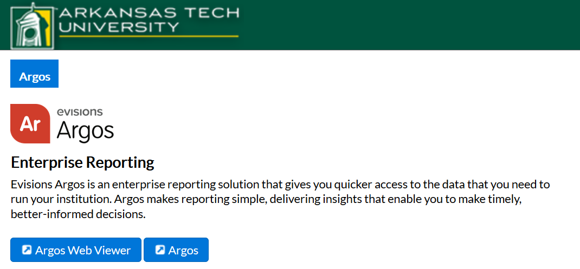
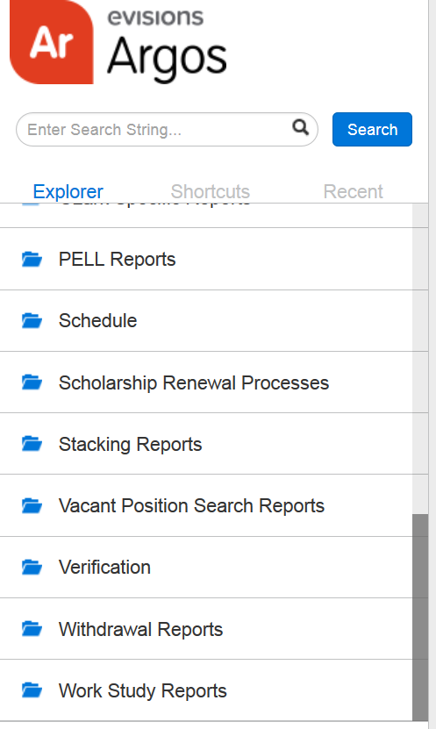
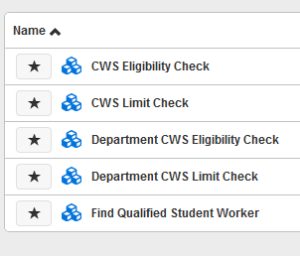
2)
1)
3)

Slide 25
Department CWS Eligibility Check
Choose academic year and submit
Amount offered: $400 – initial minimum for fall/spring award ($200 each semester)
Amount accepted: student has accepted offer
Unmet need: amount may be added to college work study eligibility
Not on list: either not packaged or has no college work study eligibility

Slide 26
Department CWS Eligibility Check Cont.
Can see if student has another assignment and when the assignment ends
Student can contact Financial Aid office and ask for an increase in college work study eligibility if there is an unmet need
Any additional aid or declining any aid may change college work study eligibility

Slide 27
Department CWS Limit Check
Shows student’s assignment balance after each pay period
Monitor balance!
Does balance need to be increased or decreased
Decrease to allow another student to use funds or add funds back to college work study account if student will not be able to earn the assigned funds
Increase when a student goes over assigned amount – this helps tremendously if completed before the payroll process begins
Shows 100% amount available to each banner position.
Shows balance remaining after an assignment has been processed

Slide 28
Additional Information
Send an email for increases and decreases needed on a current assignment.
Assignments will be reduced to earnings after the last payroll for the semester has been processed.

Slide 29
Office of Payroll
Betty York
Tax forms, Direct deposit forms
Office: 964-0583 Ext 3602
Email: byork1@atu.edu
Brittany Flippo
Student workers, Timesheets for part-time employees
Office: 964-0583 Ext 3601
Email: bflippo1@atu.edu
Brooke Southard
International Student Taxation
Office: 964-0583 Ext 2214
Email: bsouthard@atu.edu
Payroll Office
Brown Hall Suite 410
105 West O Street
Russellville, AR 72801
Phone: (479) 968-0696

Slide 30
PAYROLL FACTS
Students must complete all necessary paperwork with Human Resources before they can begin work.
“If the student’s rate of pay exceeds the minimum wage, the request form and justification memo must be sent to the VP of Administration and Finance for approval, BEFORE it is routed to the Human Resource Office.” (Student Employment Handbook)
“Request forms received after the 22nd of the month may not be processed until the following month.” (Student Employment Handbook)
Requests must be signed by someone at the department head level or above. The department head or above may designate the time sheet approver.

Slide 31
PAYROLL FACTS CONT.
Student workers are not to exceed 28 hours per week.
If a student works in more than one department, it is the responsibility of the student to divide the hours accordingly so as not to exceed the 28 hour limit.
International Students cannot work more than 20 hours per week during the school year.
A work week is considered Sunday through Saturday.
If the week crosses over into the next month, the hours are still counted the same as a week.

Slide 32
QUESTIONS???

